Slide 1
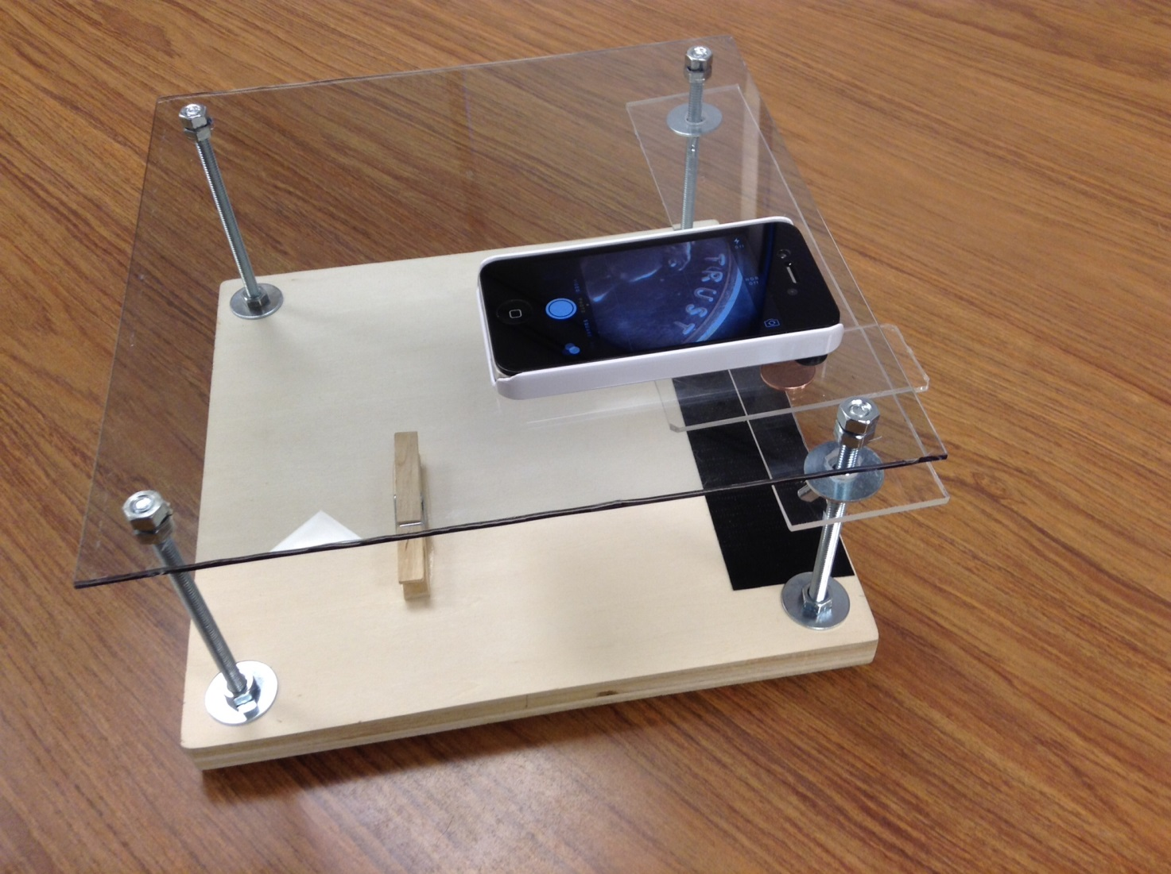
Each table group has an “iPad/iPhone microscope

Slide 2
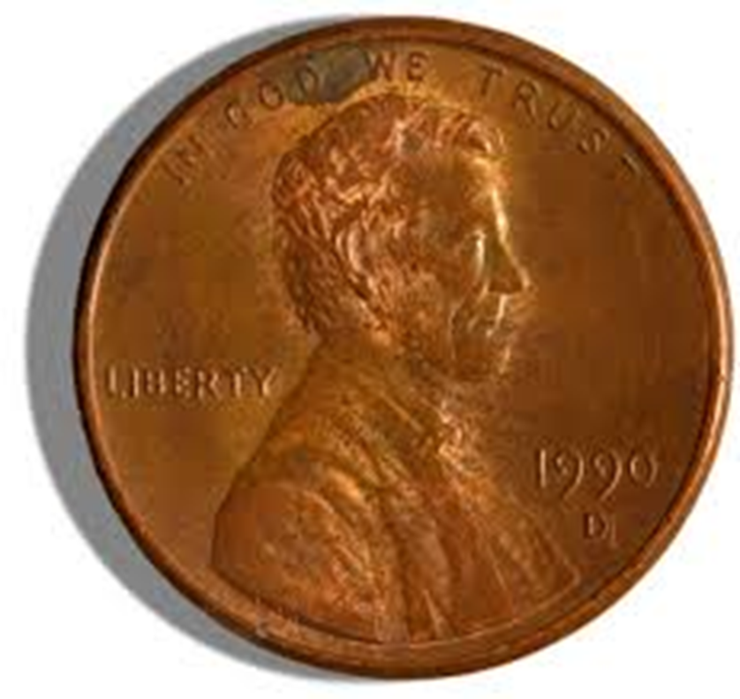
Each group should have a penny

Slide 3
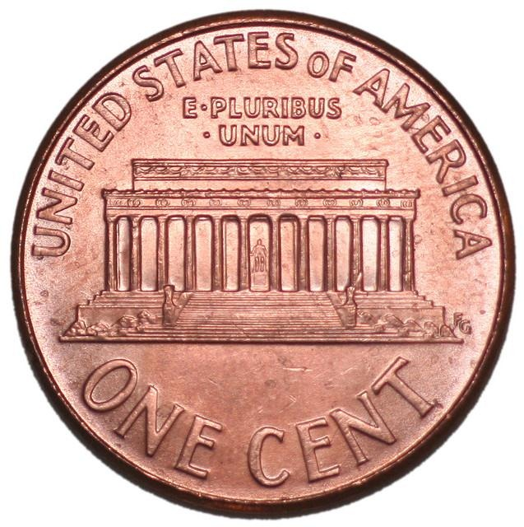
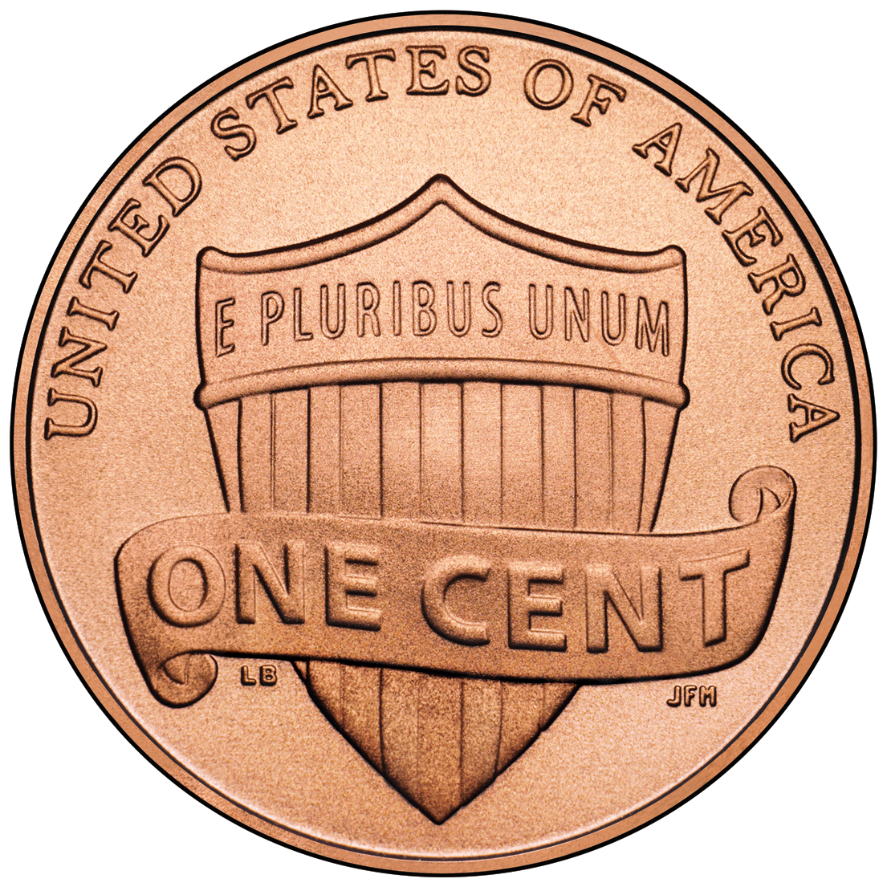
Not just any penny

Slide 4
FINDING ABE LINCOLN

Slide 5
iPad/iPhone Microscope
What are the following pictures?

Slide 6
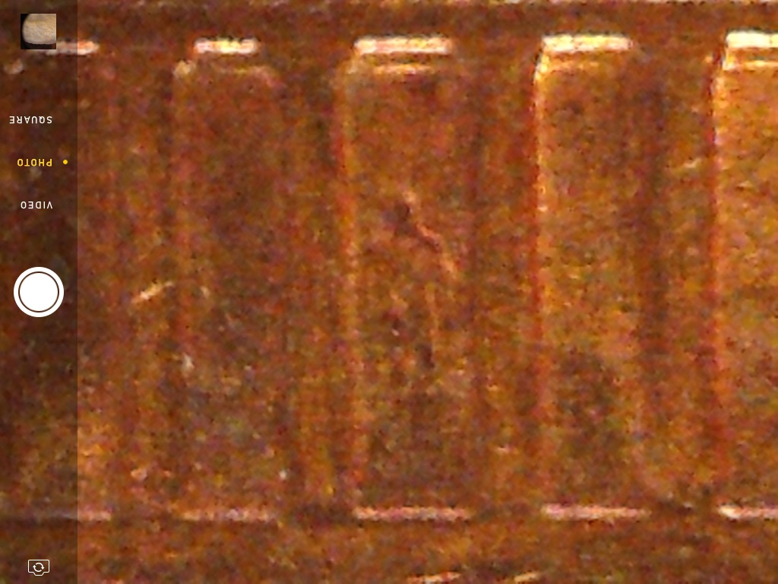

Slide 7
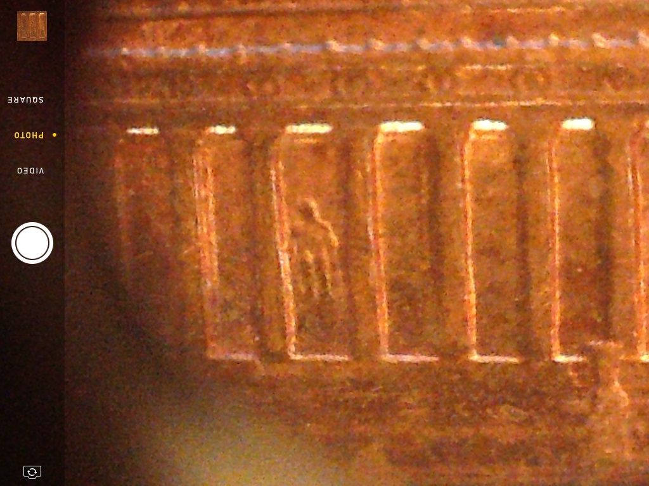

Slide 8
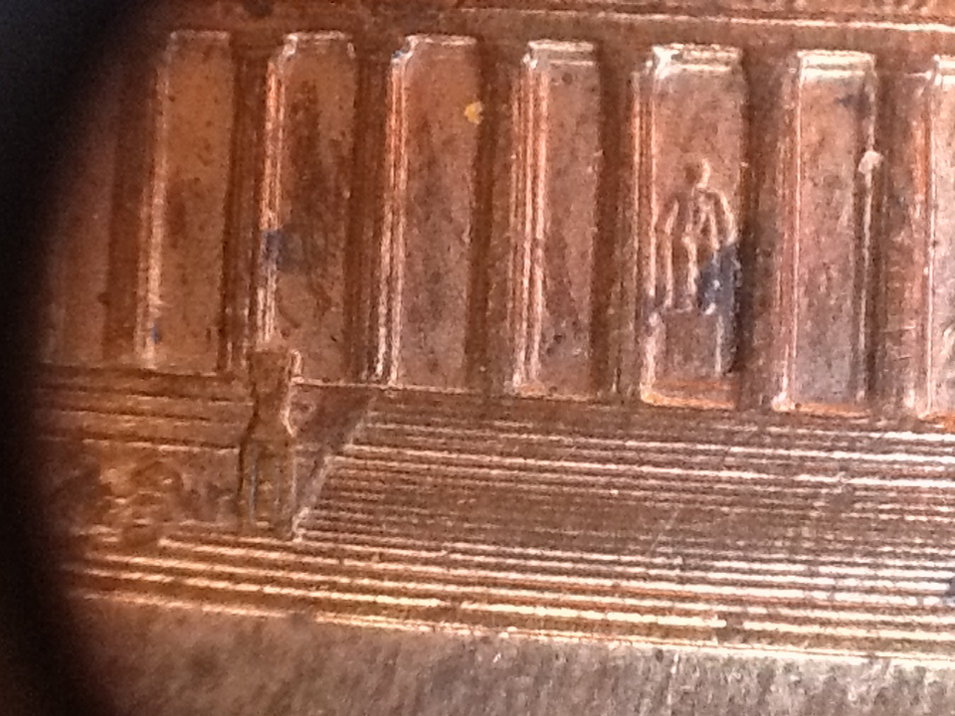

Slide 9
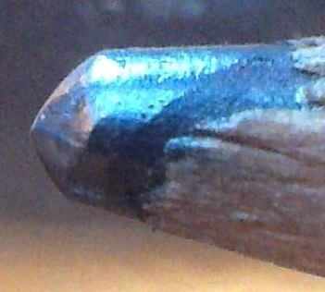

Slide 10
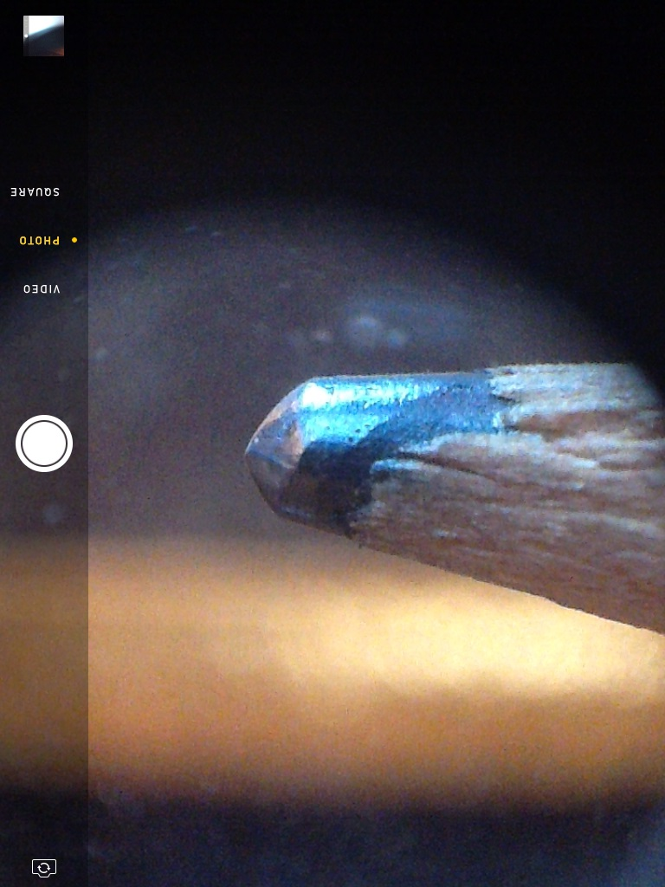

Slide 11
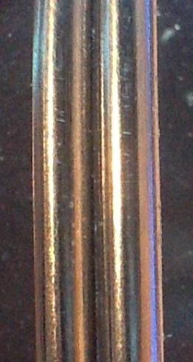

Slide 12
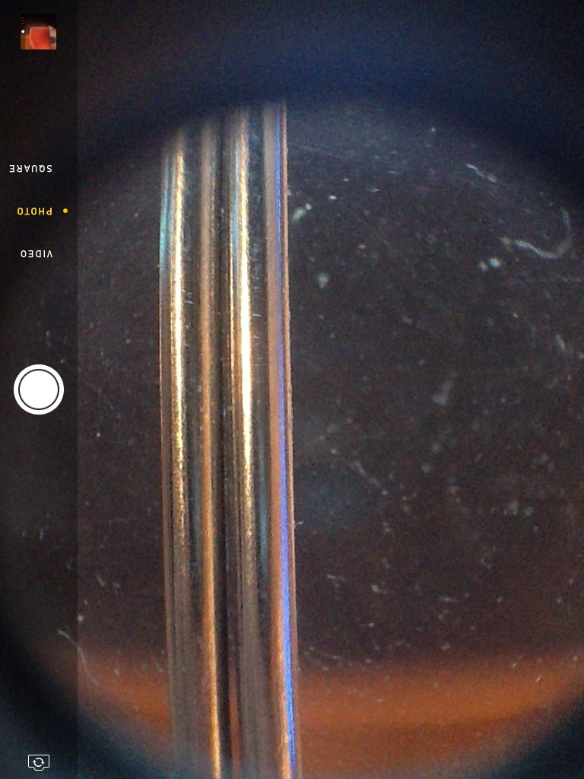

Slide 13
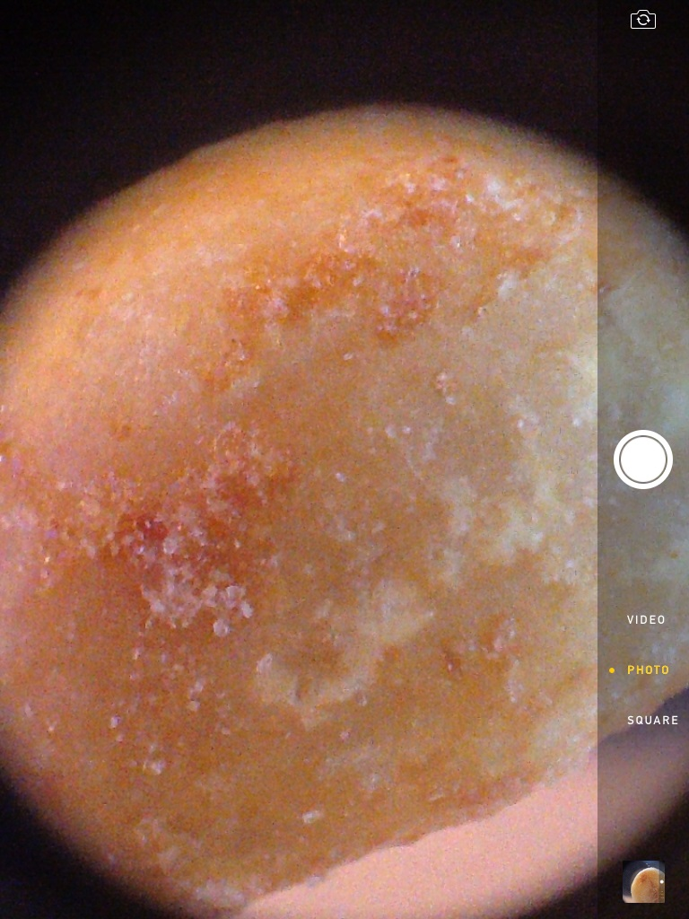

Slide 14
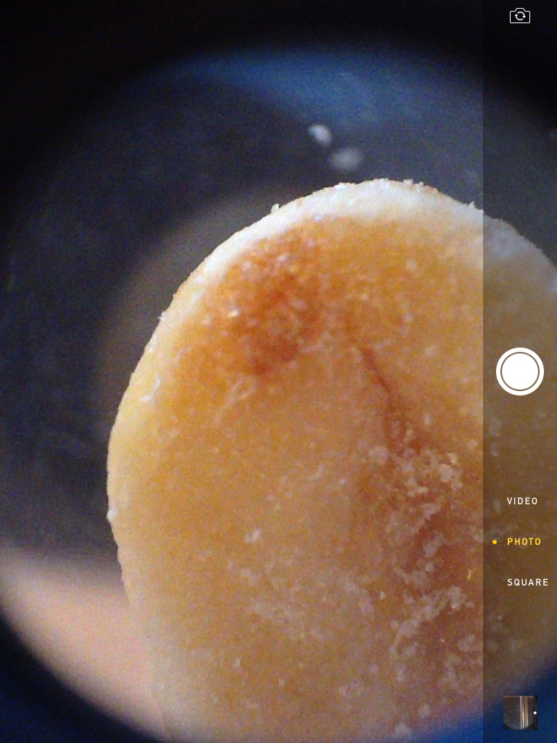

Slide 15
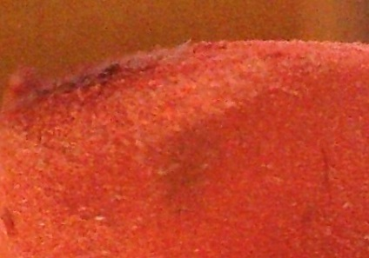

Slide 16
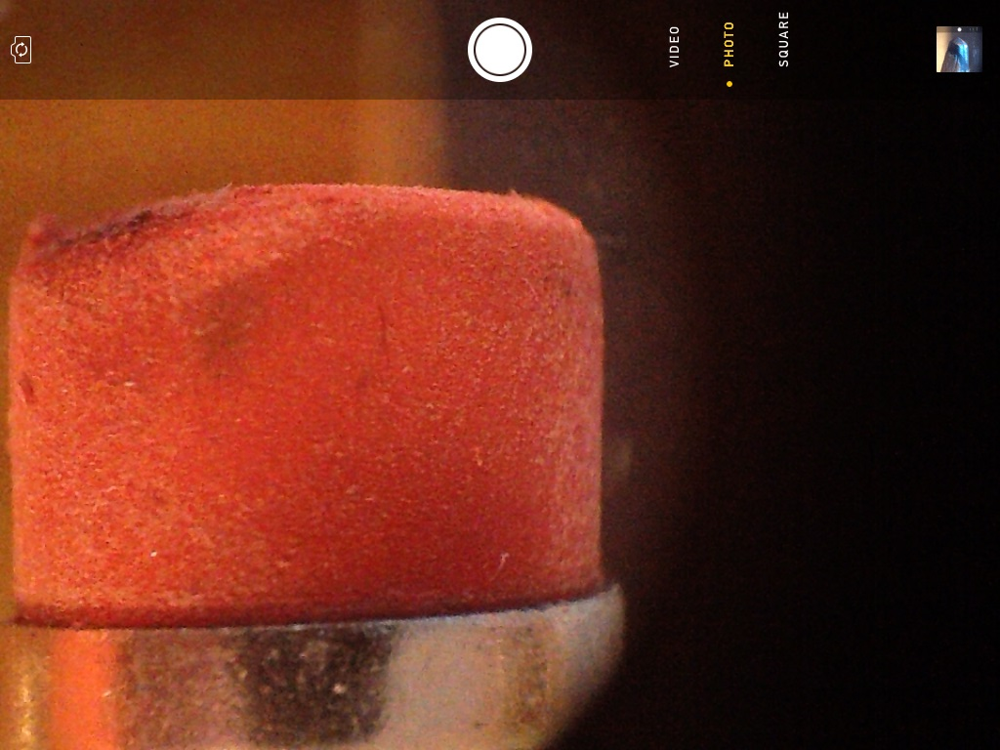

Slide 17
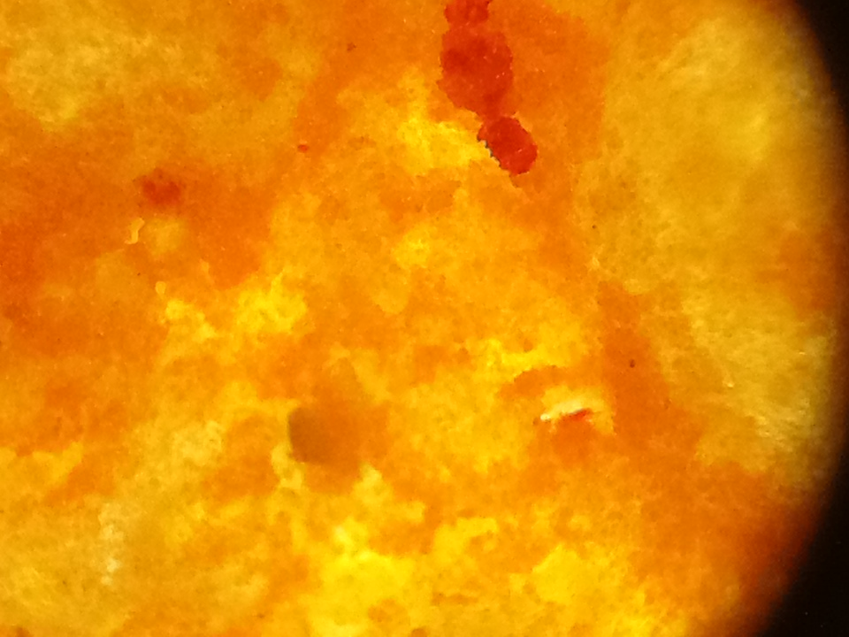

Slide 18
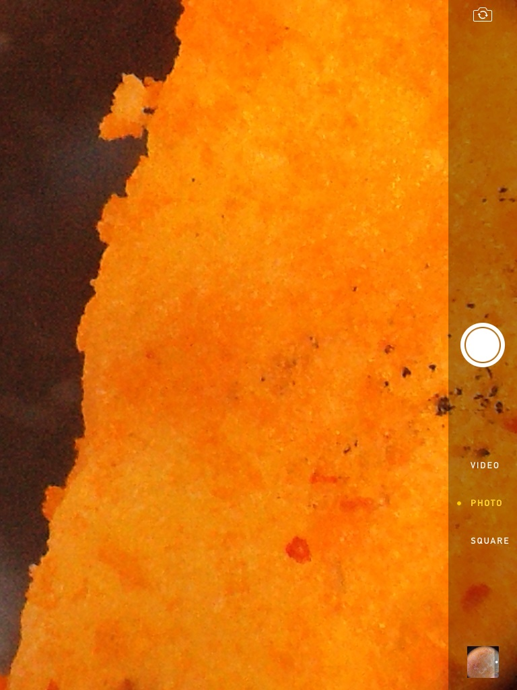

Slide 19
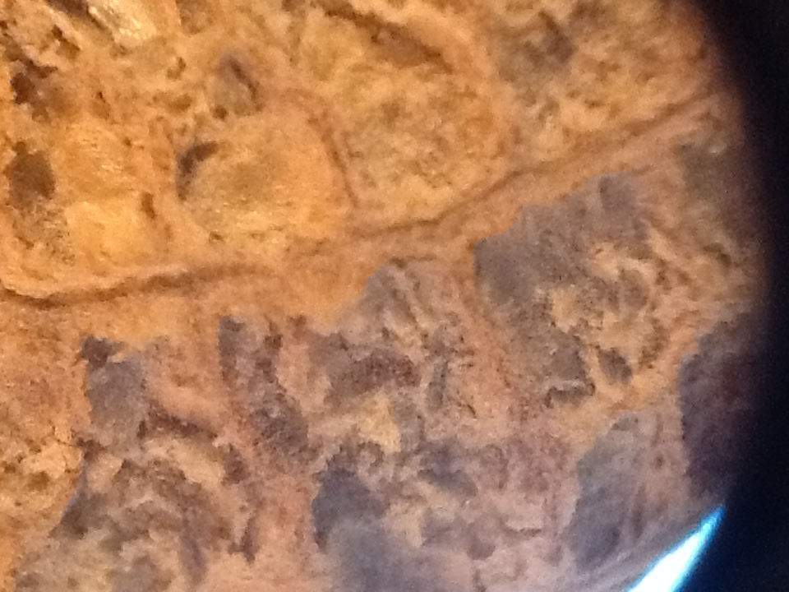

Slide 20
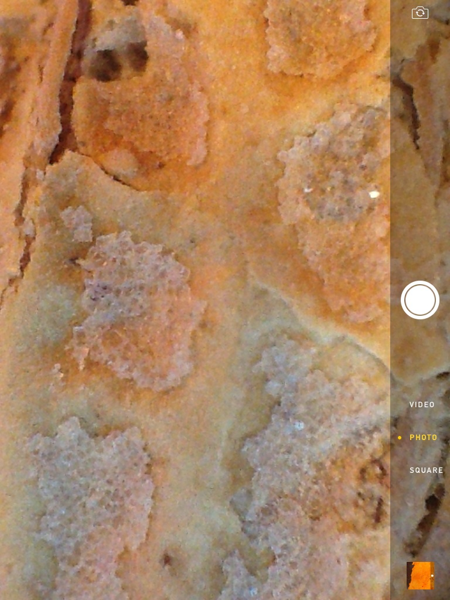

Slide 22
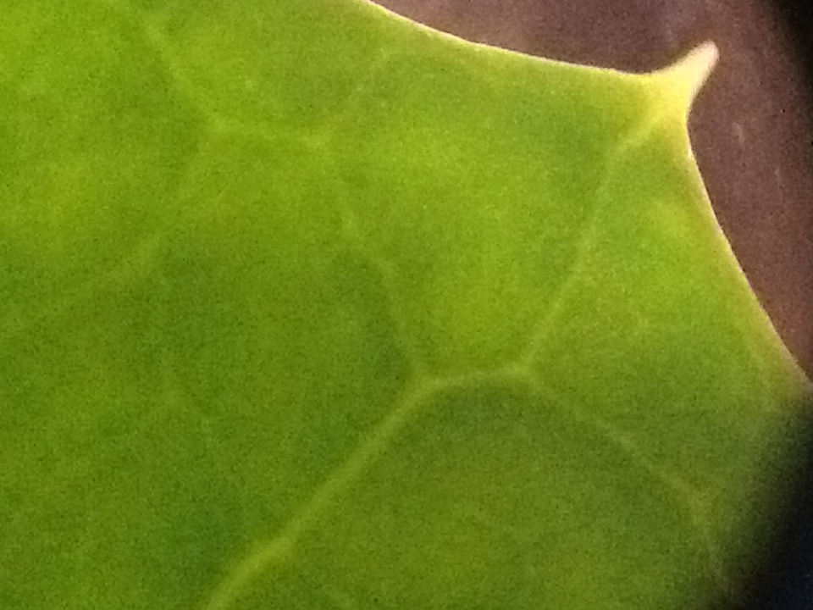

Slide 23
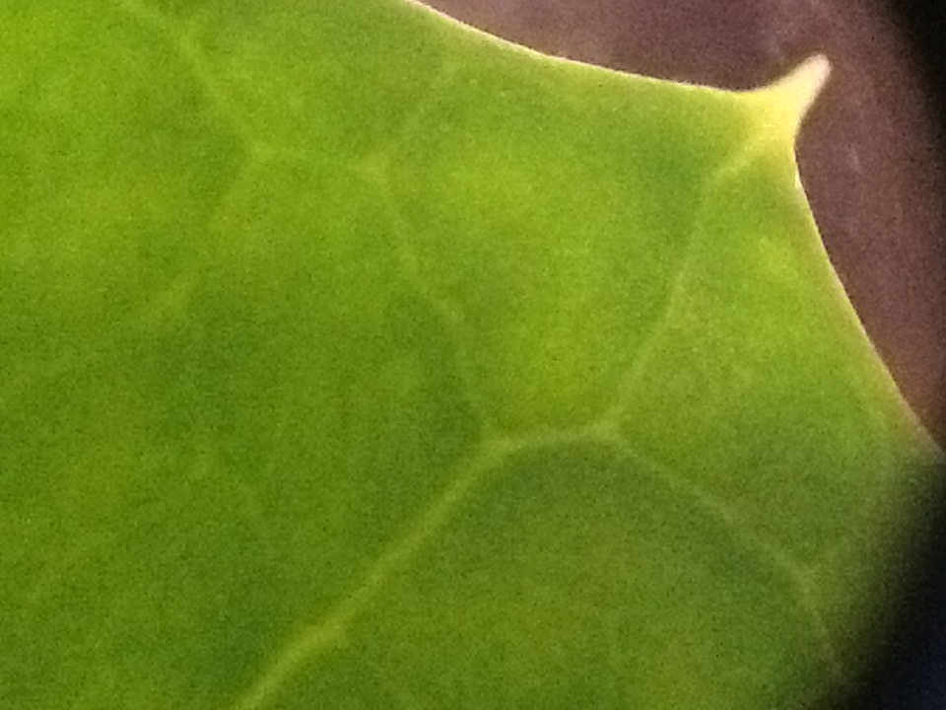

Slide 24
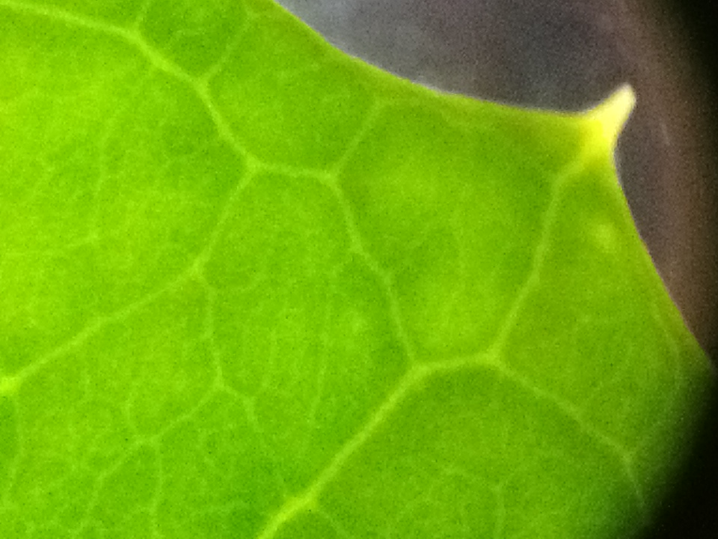

Slide 25
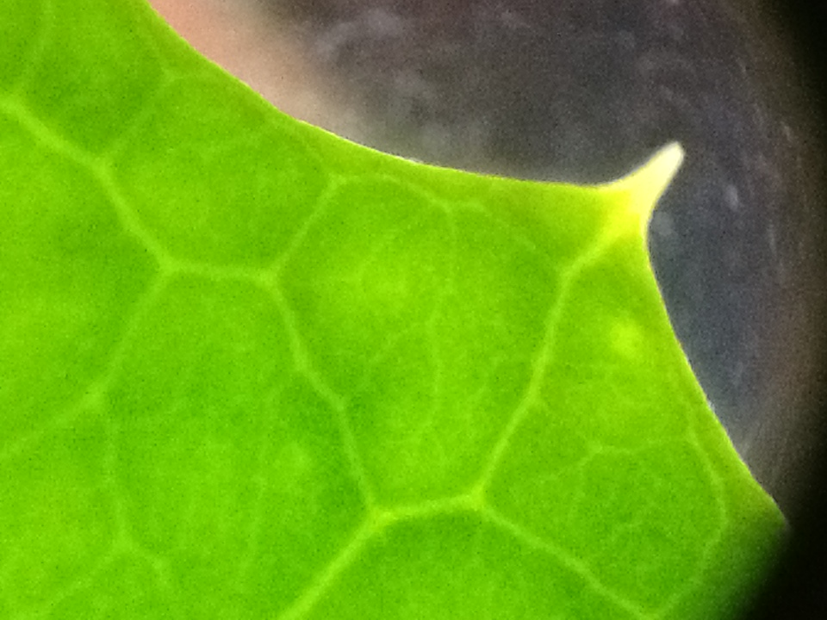

Slide 26
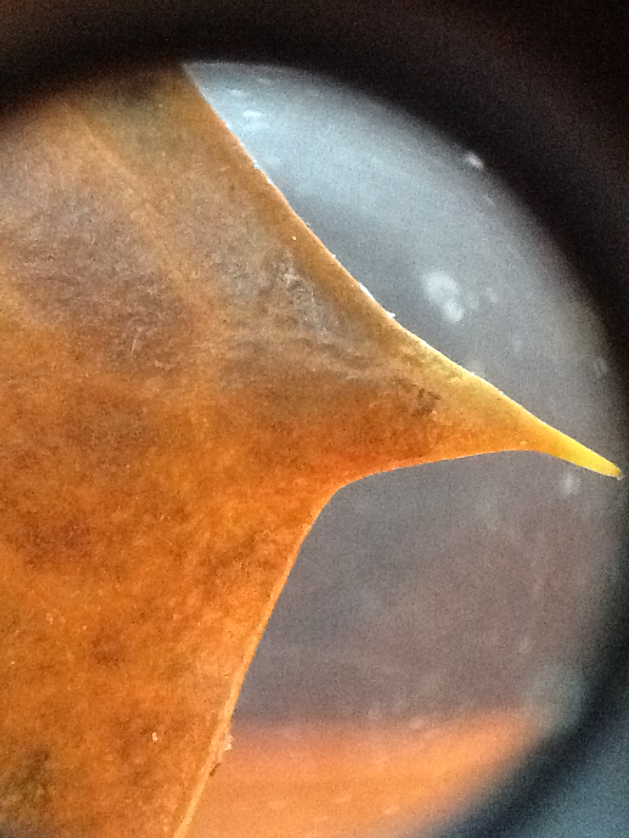

Slide 27
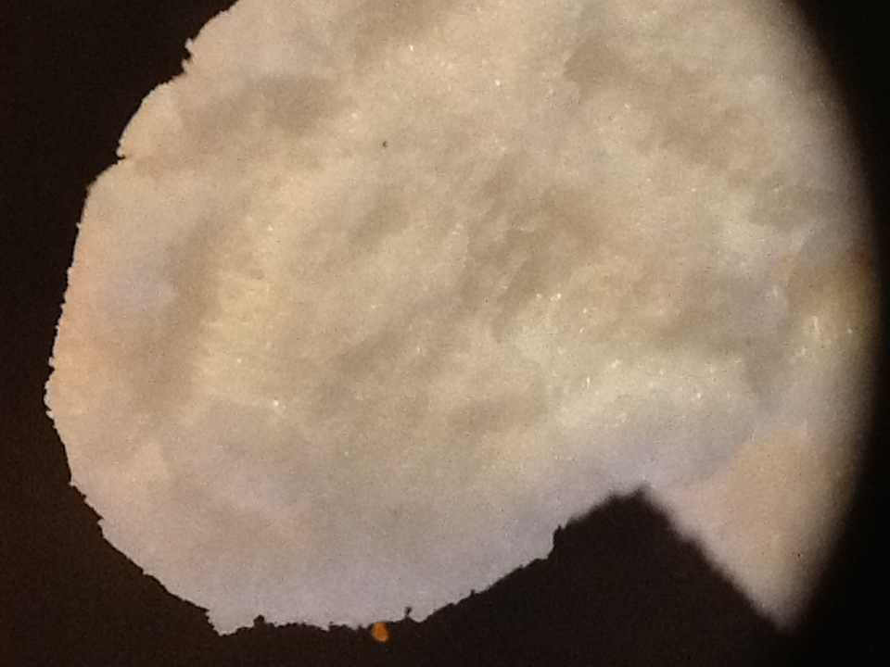

Slide 28
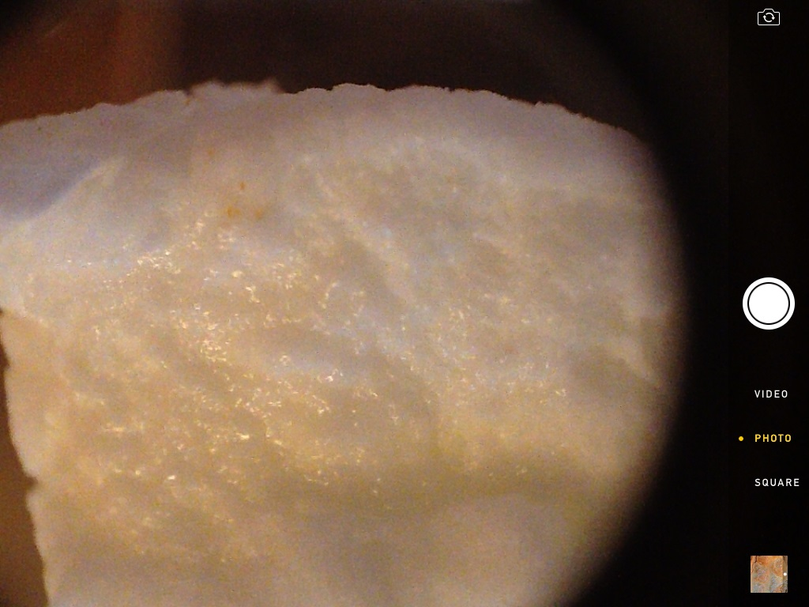

Slide 29
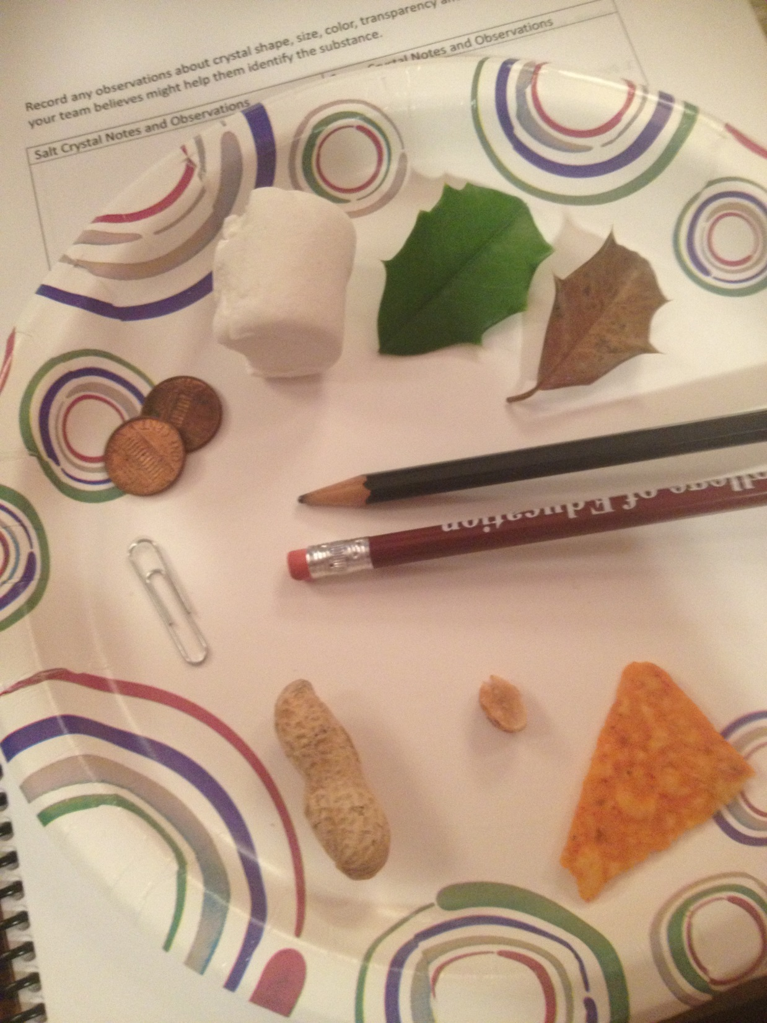

Slide 30
Time to look at some Salt and Sugar Crystals

Slide 31
Once your group understands how to use the microscope get a small sample of both salt and sugar crystals from the materials table.
Observe each sample under the microscope at low and high power. Record any observations about crystal shape, size, color, transparency and any other properties your team believes might help them identify the substance if you were given an unknown sample.
You can also take pictures to use later.

Slide 32
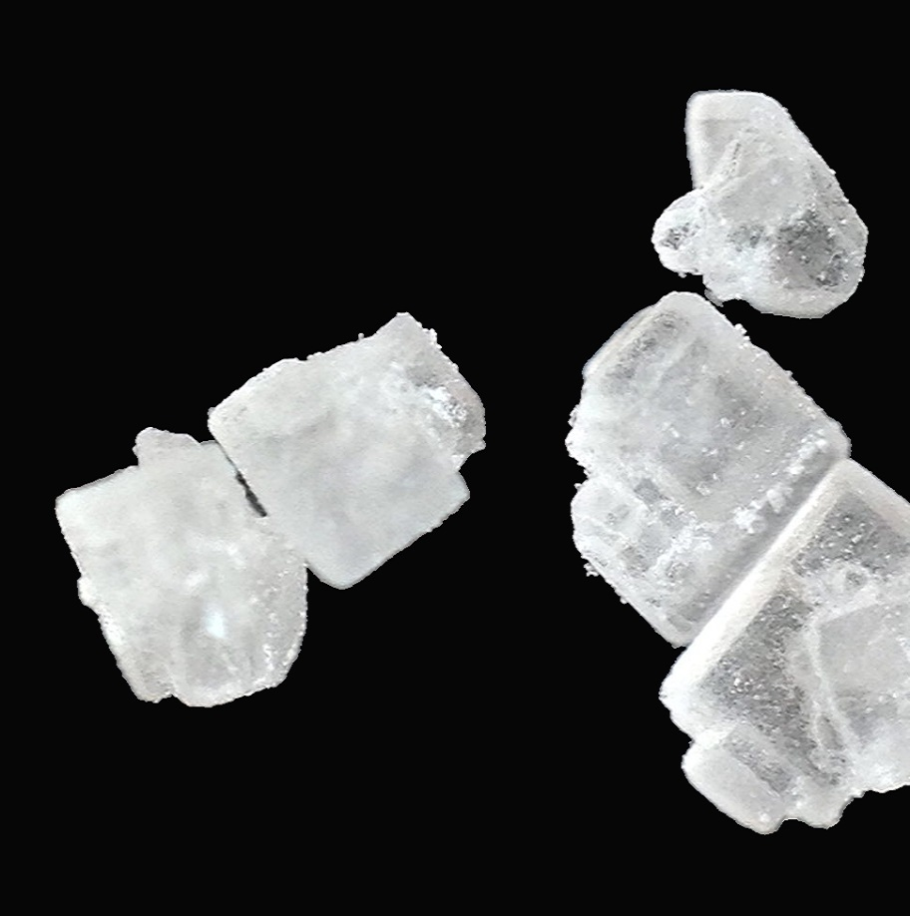
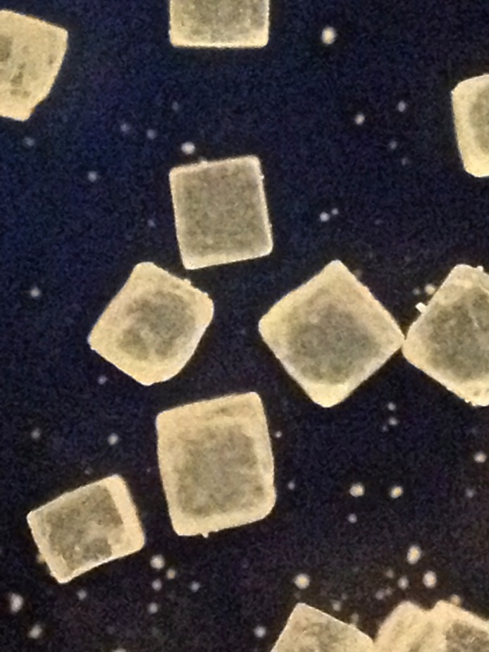

Slide 33
After your team has made all the observations they need of the known salt and sugar samples they should return to the materials table to collect a Test Sample. Observe under the microscope. Then select what is in the Test Sample from the choices below.
The Test Sample is…
A. Salt only
B. Sugar only
C. Salt and sugar only (no unknown substance)
D. Salt mixed with an unknown substance
E. sugar mixed with an unknown substance
F. salt and sugar and an unknown substance
Identify

Slide 34
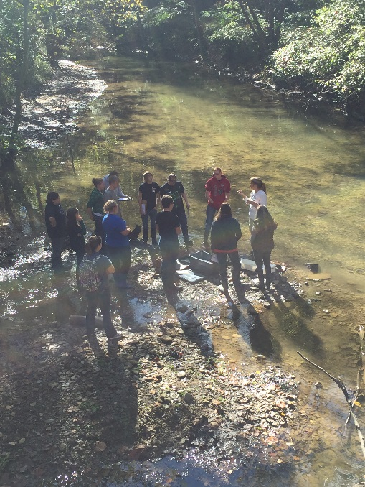
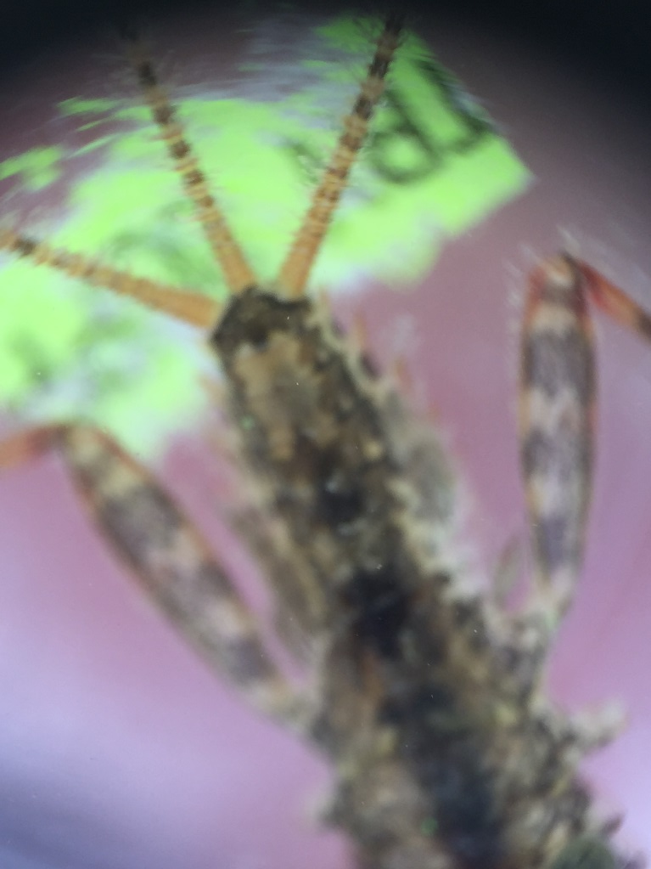
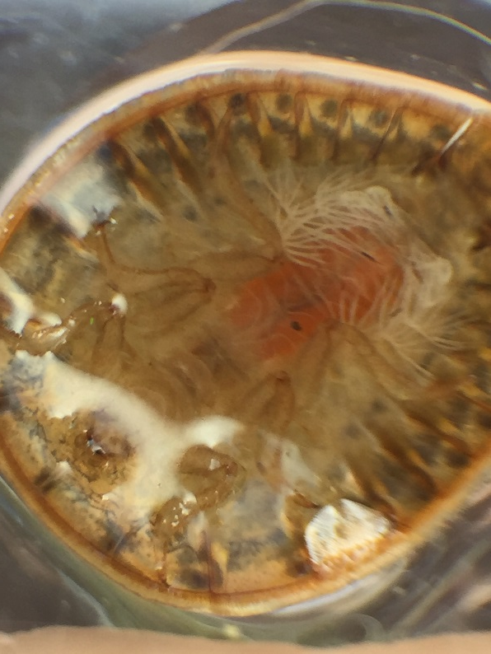
What else can be used with these microscopes?

Slide 35
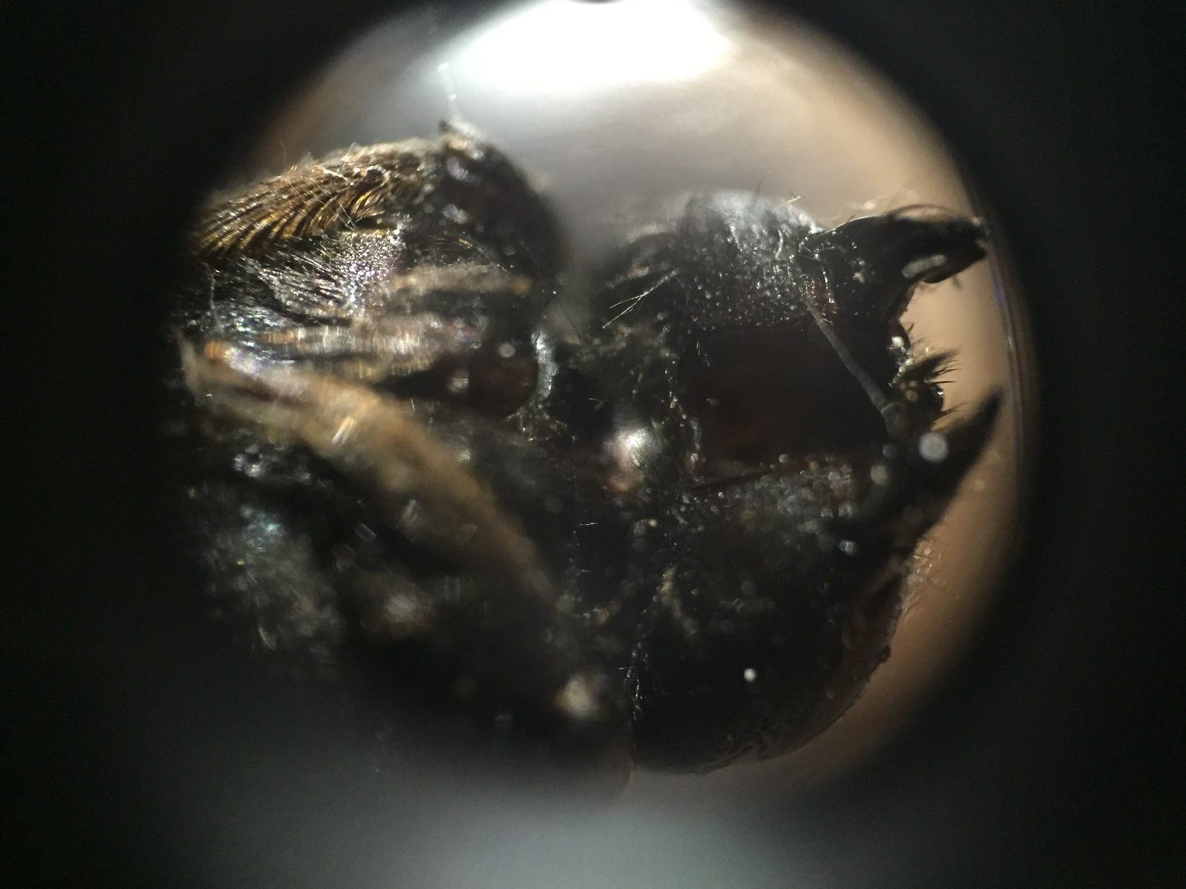

Slide 36
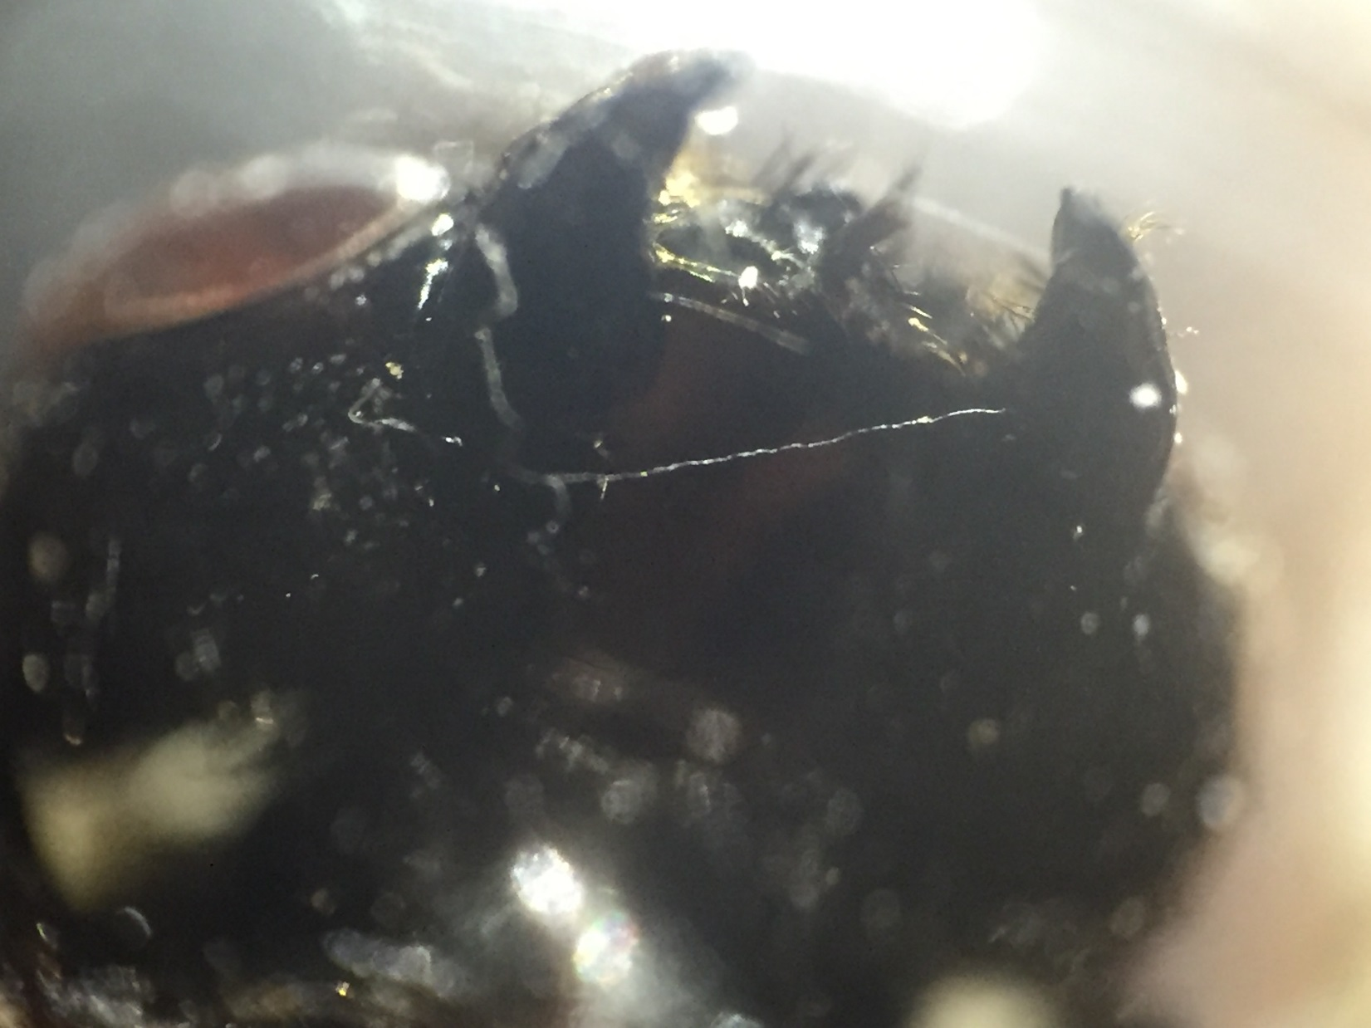

Slide 37
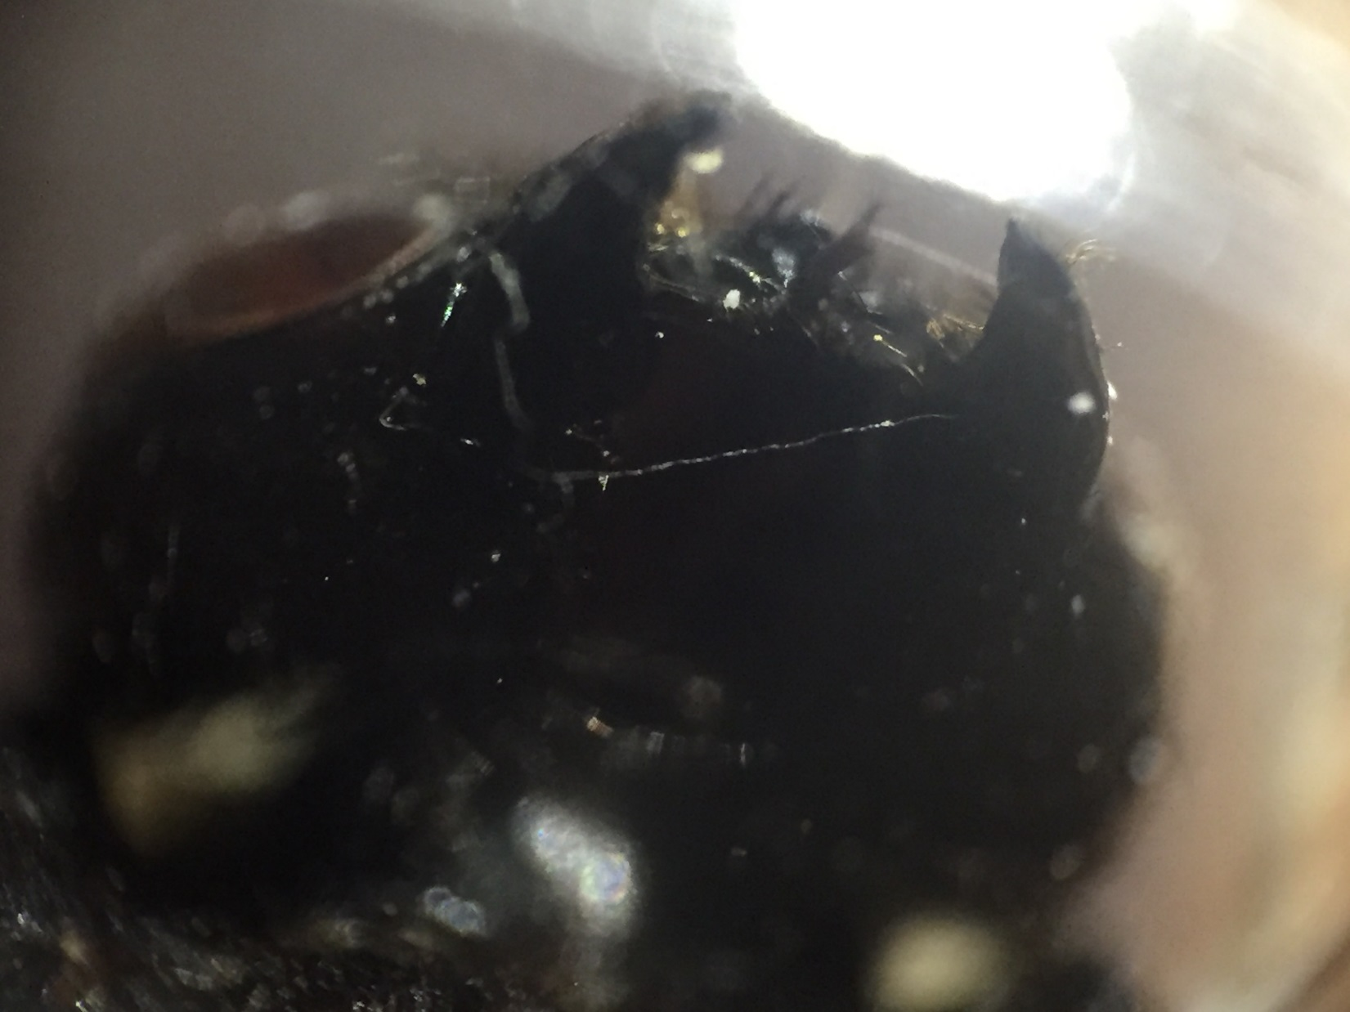

Slide 38
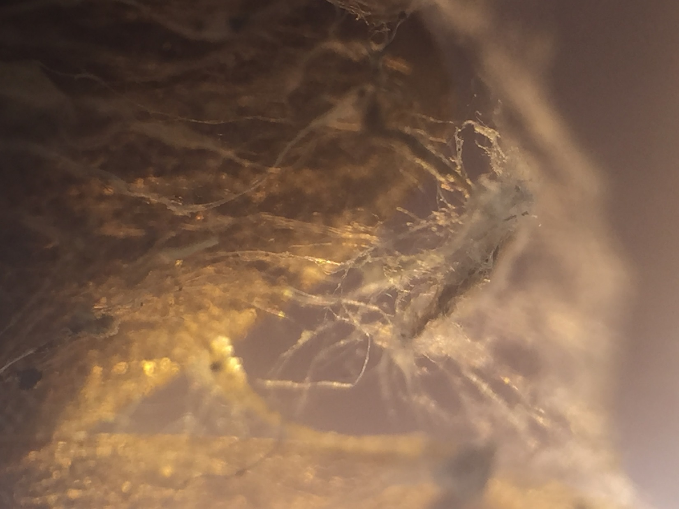

Slide 39
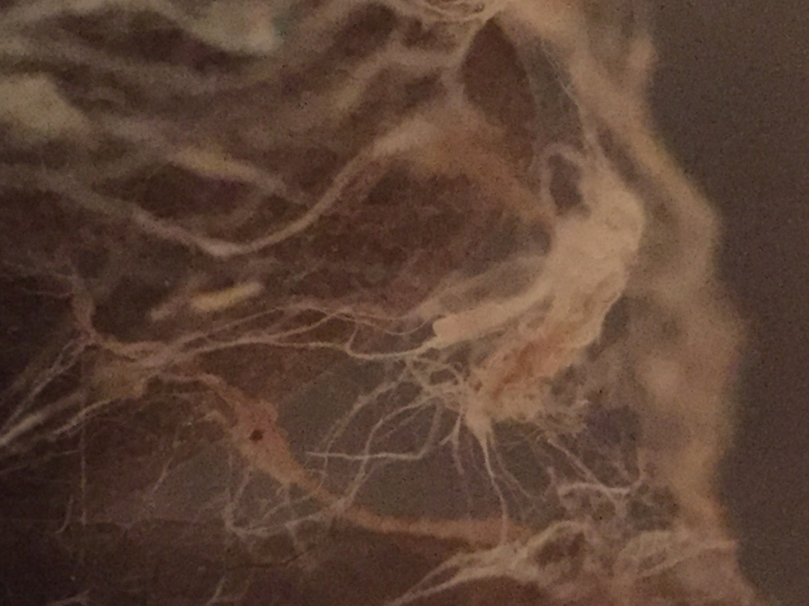

Slide 40
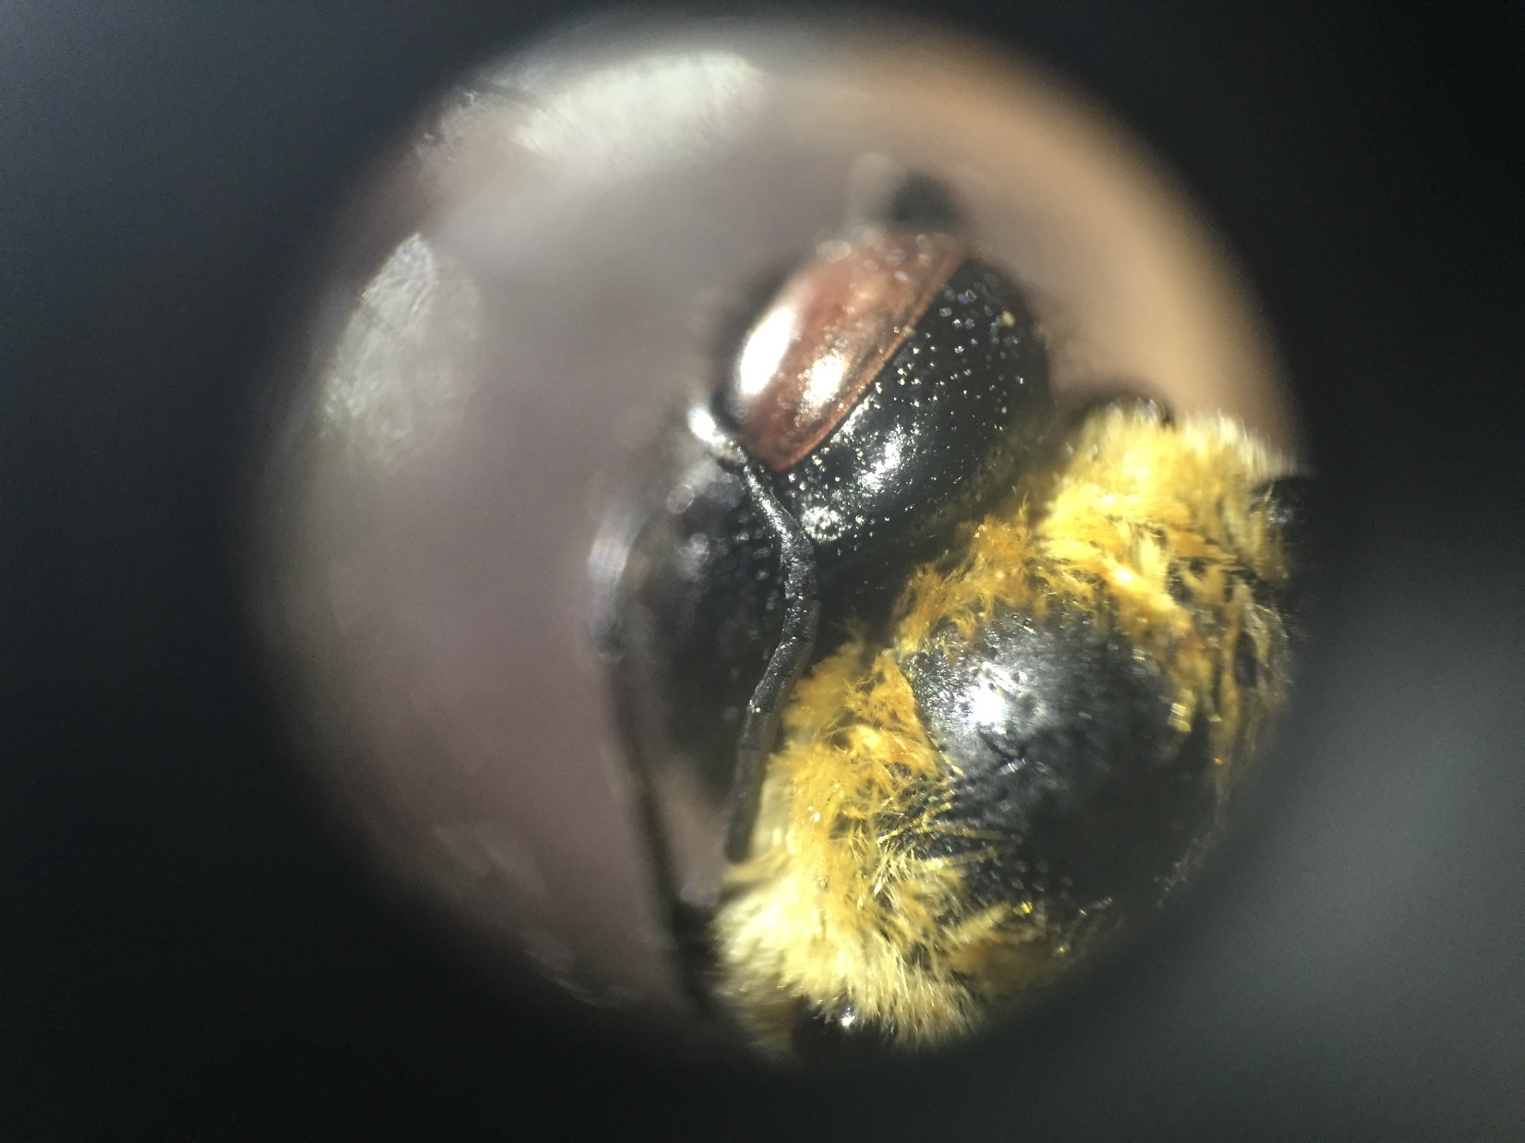

Slide 41
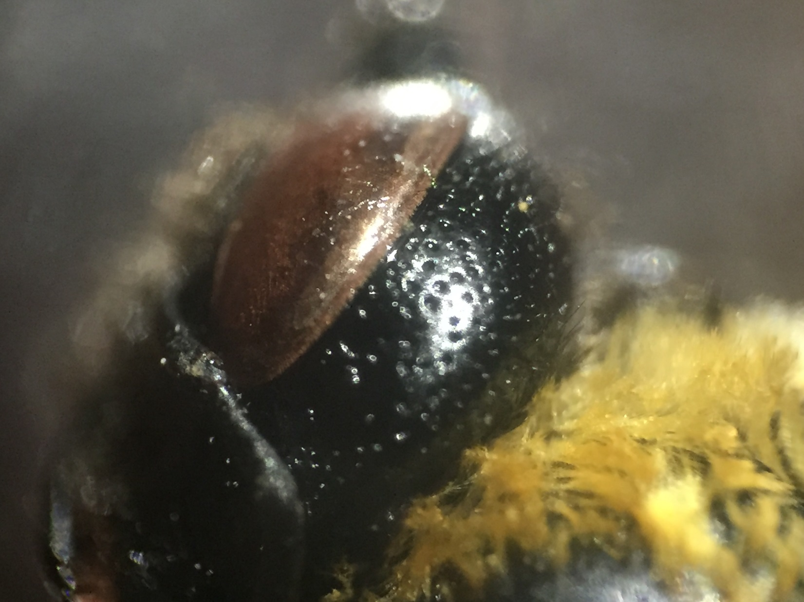

Slide 42
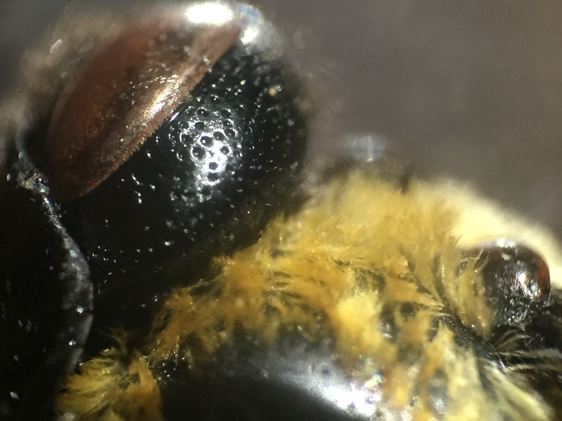

Slide 43
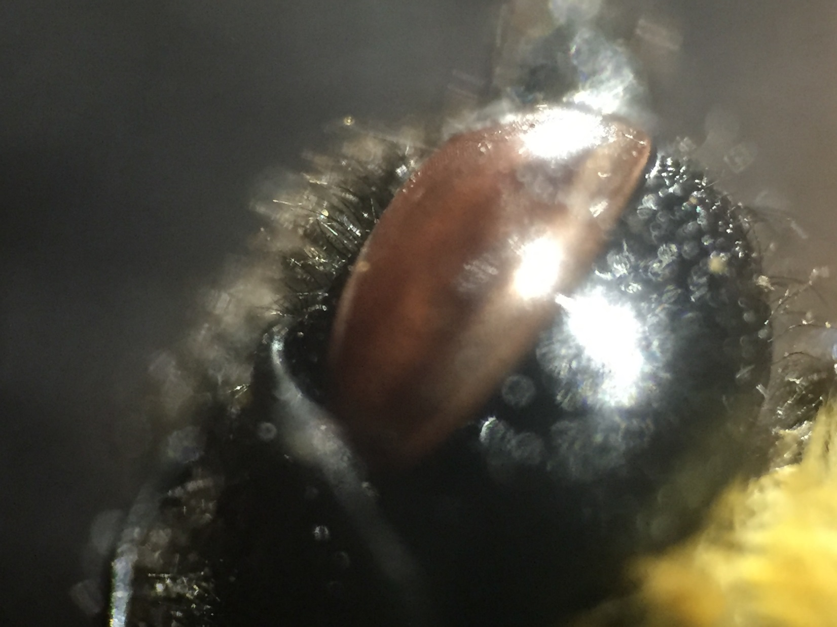

Slide 44
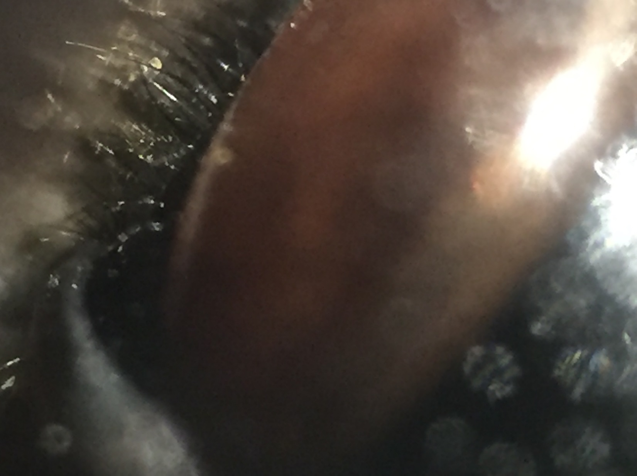

Slide 45
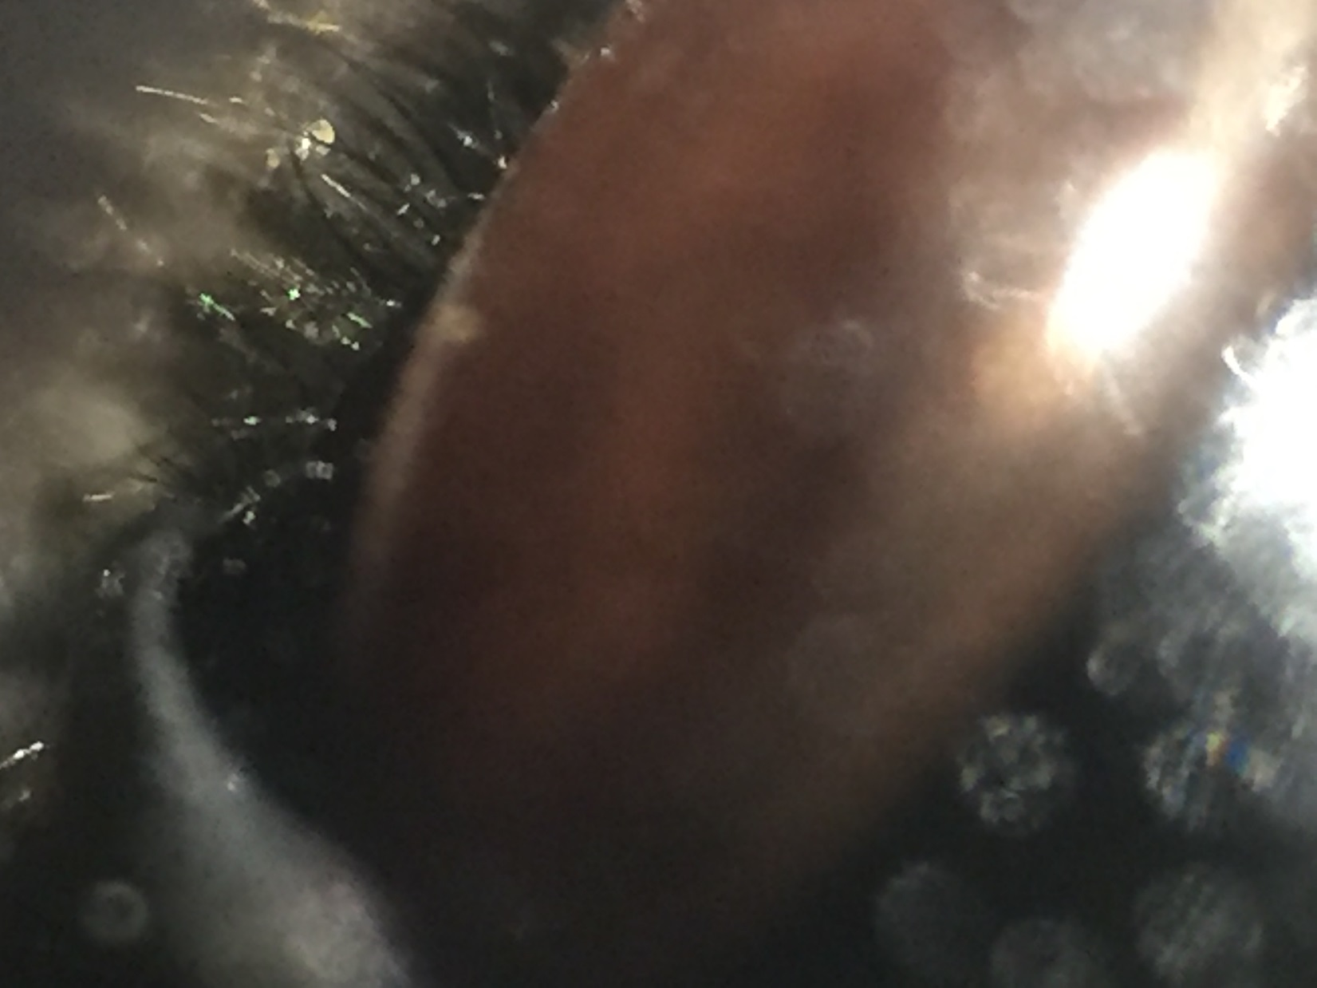

Slide 46
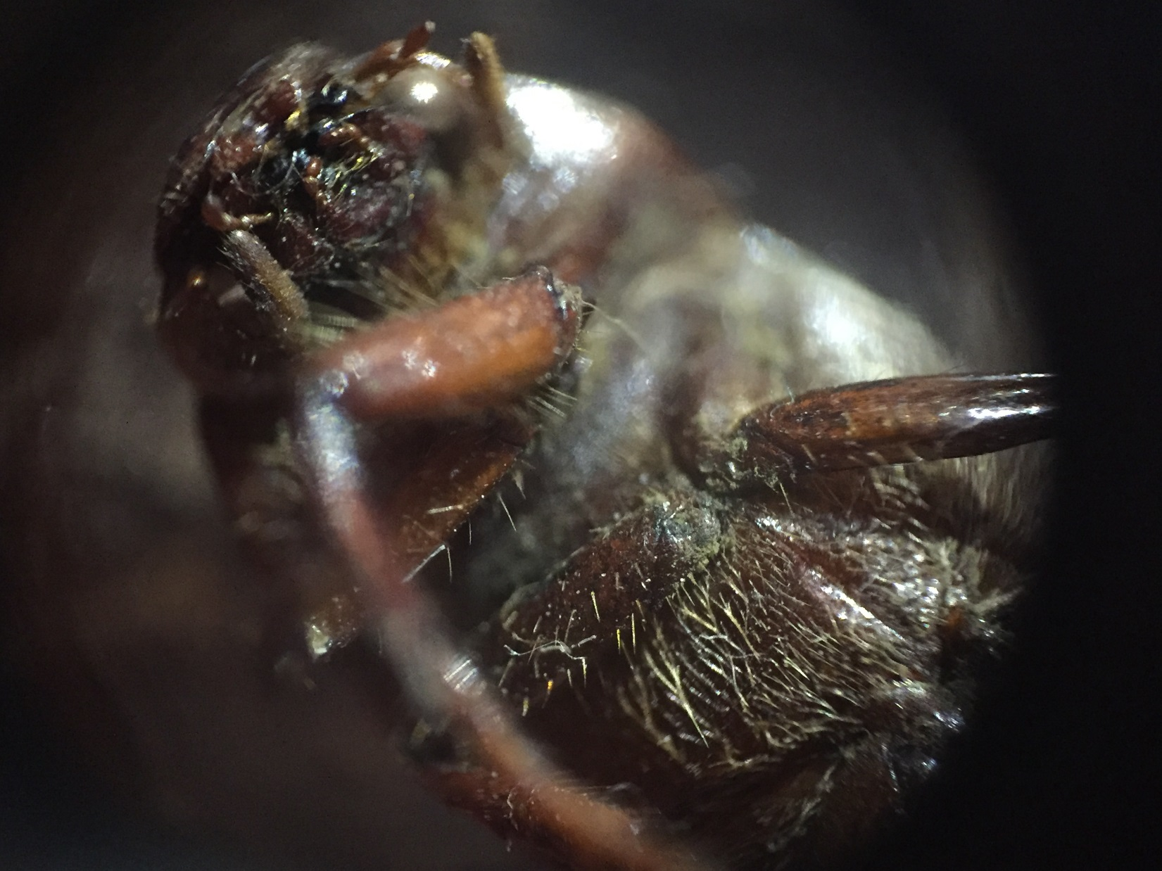

Slide 47
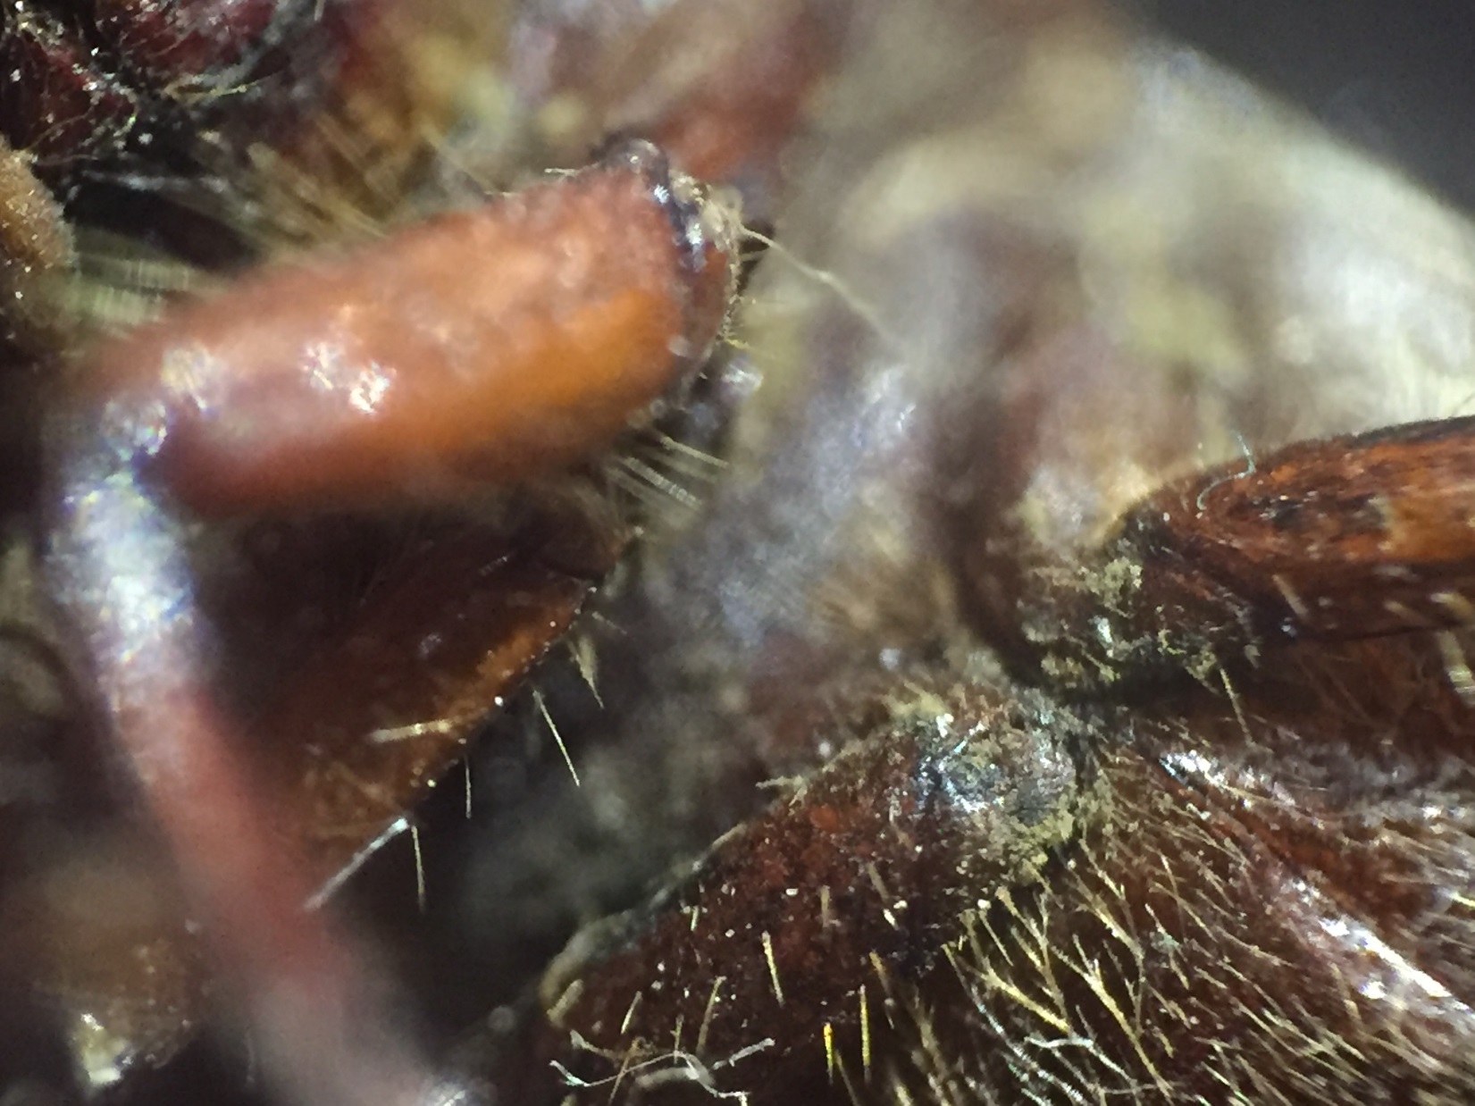

Slide 48
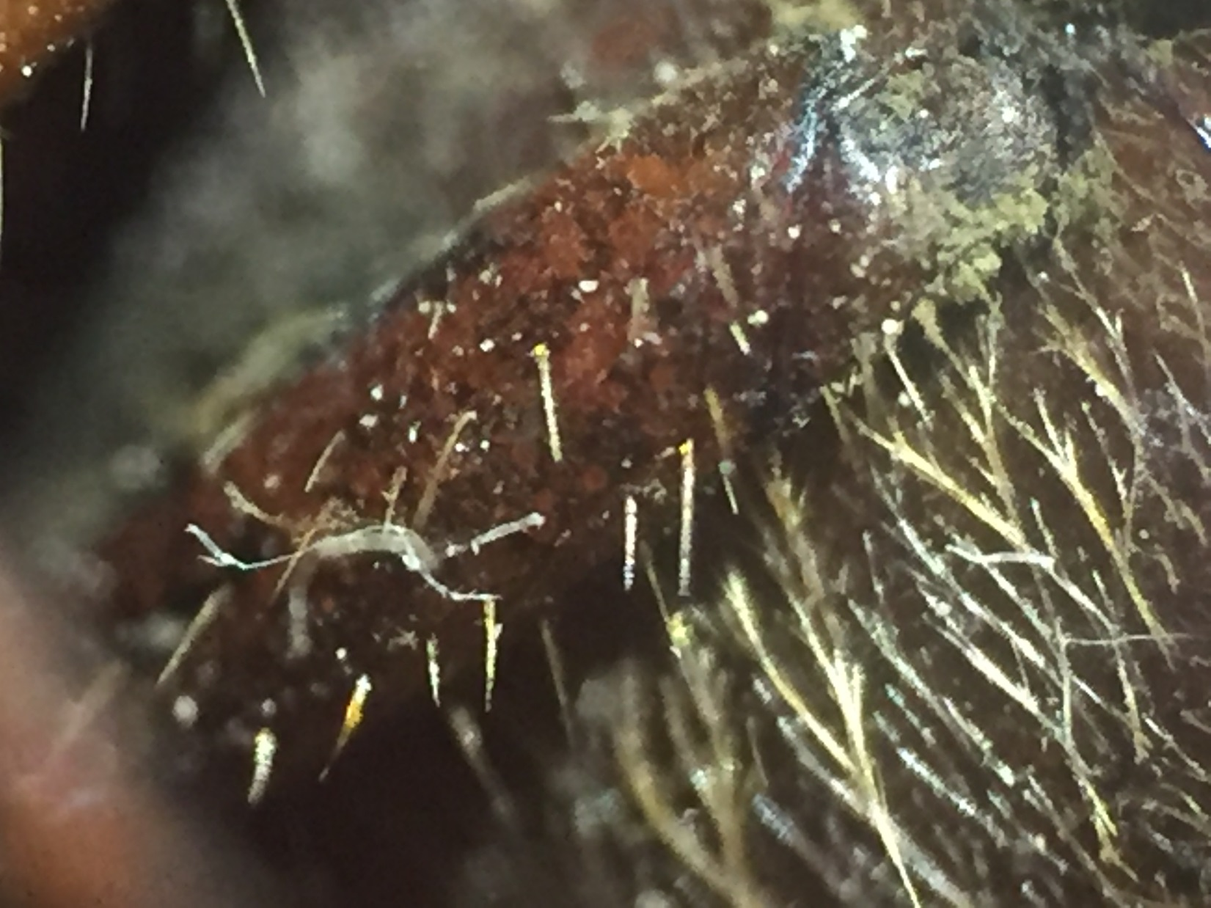

Slide 49
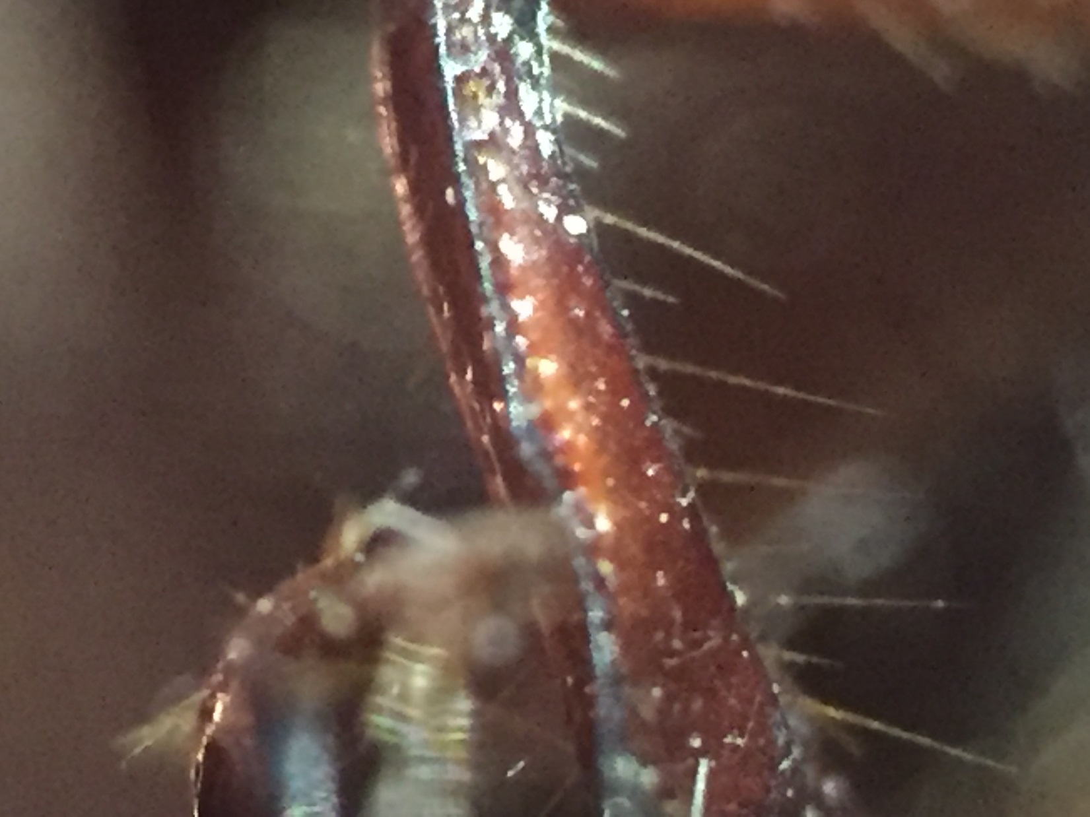

Slide 50
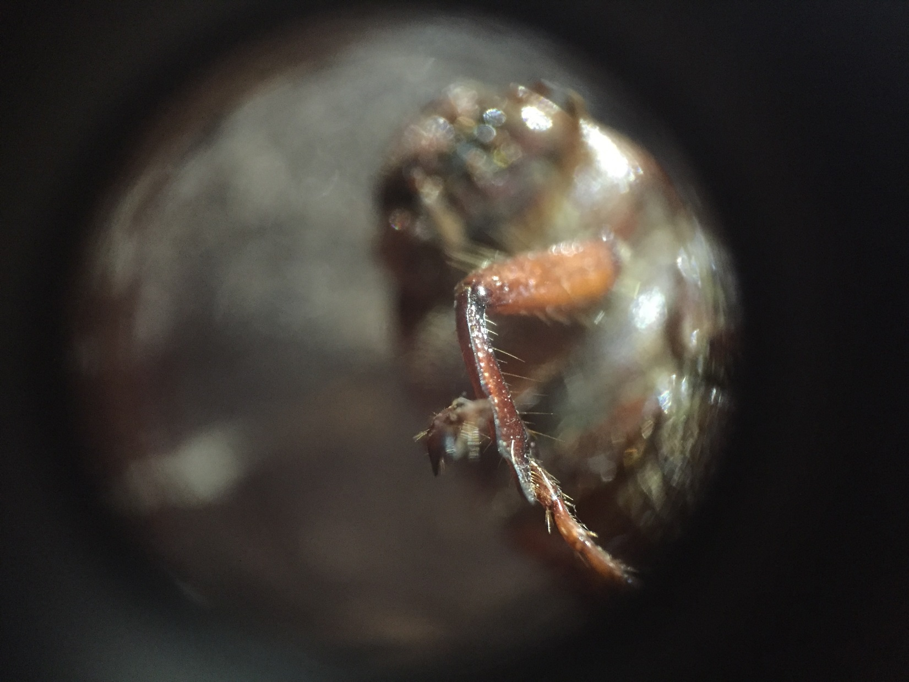

Slide 51
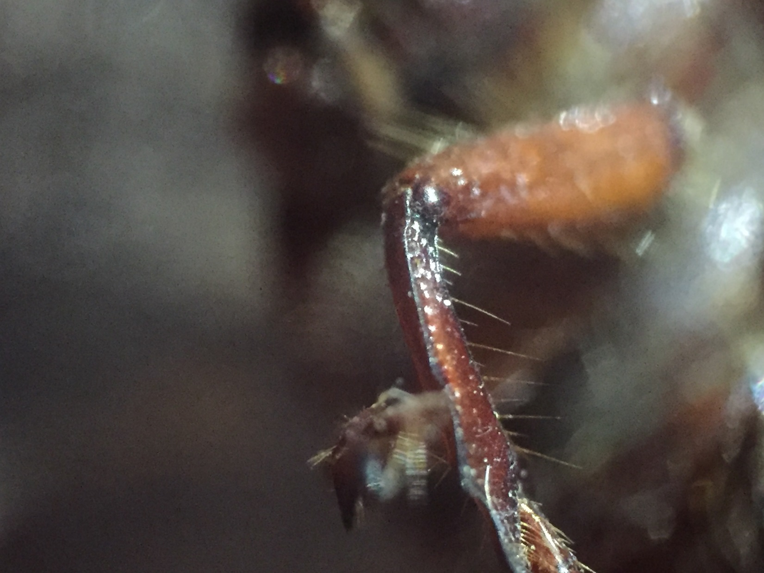

Slide 52
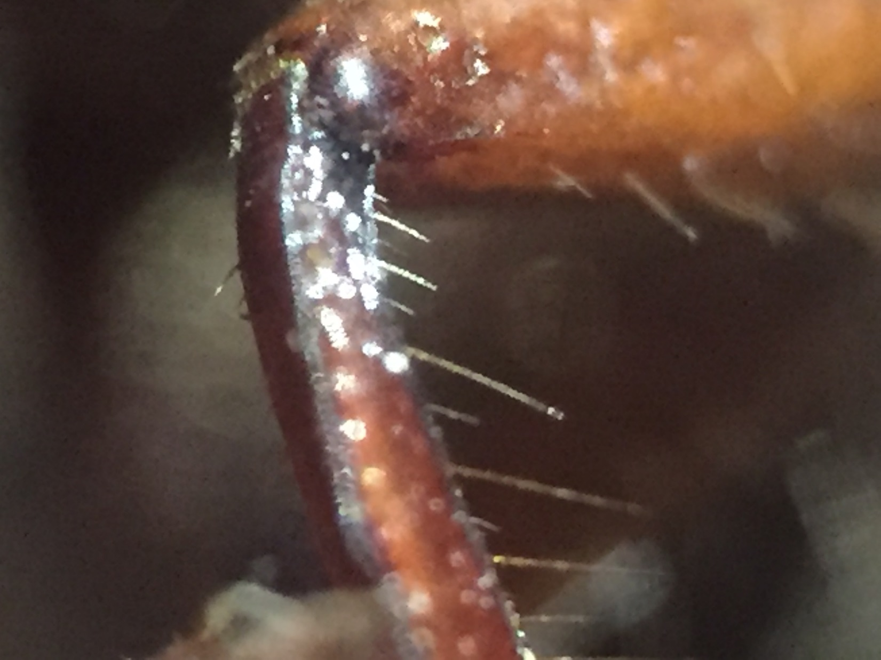

Slide 53
Do you want to look at some leaves?

Slide 55
Any Questions

Slide 56
Which car is the best?

Slide 57
How will your group determine which car is best?

Slide 58
Draw a picture to show how you plan to set up your investigation.

Slide 59
What data will you need to determine which car is best?
Construct a Data Table on the back of your sheet.

Slide 60
Which car is best?
What is your Evidence?

