Slide 1
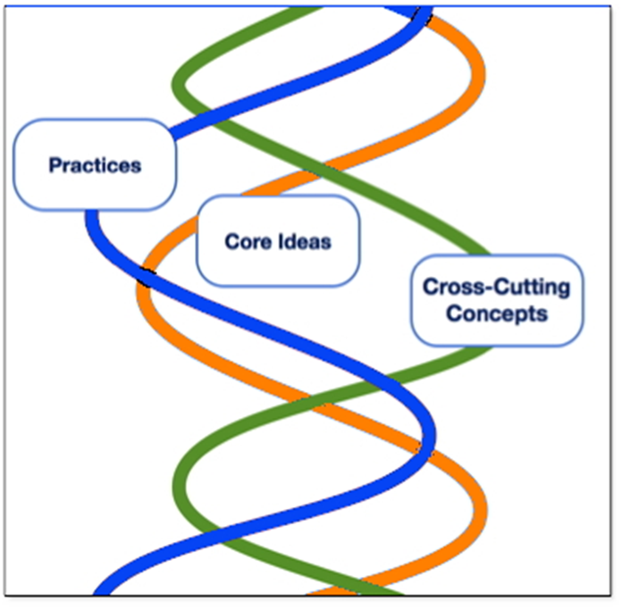
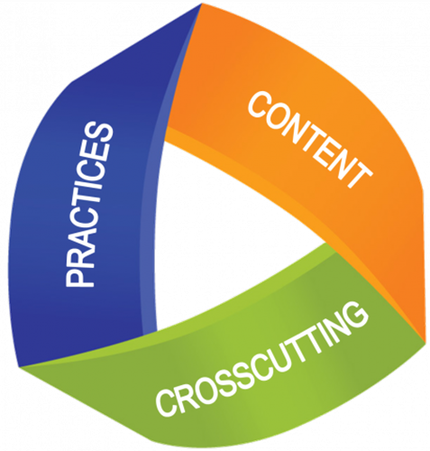
The three dimensions of NGSS

Slide 2
Science and Engineering Practices
1. Asking questions (science) and defining problems (engineering)
2. Developing and using models
Planning and carrying out investigations
Analyzing and interpreting data
5. Using mathematics and computational thinking
6. Constructing explanations (science) and designing solutions (engineering)
7. Engaging in argument from evidence
8. Obtaining, evaluating, and communicating information
Notes:
Dimension 1 [Scientific and Engineering Practices] describes (a) the major practices that scientists employ as they investigate and build models and theories about the world and (b) a key set of engineering practices that engineers use as they design and build systems. We use the term “practices” instead of a term such as “skills” to emphasize that engaging in scientific investigation requires not only skill but also knowledge that is specific to each practice (Framework, p. 2-5).
Science is not just a body of knowledge that reflects current understanding of the world; it is also a set of practices used to establish, extend, and refine that knowledge. Both elements—knowledge and practice—are essential (Framework, p. 3).
Similarly, engineering involves both knowledge and a set of practices. The major goal of engineering is to solve problems that arise from a specific human need or desire. To do this, engineers rely on their knowledge of science and mathematics as well as their understanding of the engineering design process (Framework, p. 2-3).
The practices include. . .
Asking questions is essential to developing scientific habits of mind. Even for individuals who do not become scientist or engineers, the ability to ask well-defined questions is an important component of science literacy, helping to make them critical consumers of scientific knowledge.
Questions are the engine that drive science and engineering. Science asks:
What exists and what happens?
Why does it happen?
How does one know?
(Framework, 3-6)
Engineering asks:
What can be done to address a particular human need or want?
How can the need be better specified?
What tools and technologies are available, or could be developed, for addressing this need?
How does one communicate phenomena, evidence, explanations, and design solutions?
(Framework, p. 3-6)
Conceptual models, the focus of this section, are, in contrast, explicit representations that are in some ways analogous to the phenomena they represent. Conceptual models allow scientists and engineers to better visualize and understand a phenomenon under investigation or develop a possible solution to a design problem.
Although they do not correspond exactly to the more complicated entity being modeled, they do bring certain features into focus while minimizing or obscuring others. Because all models contain approximations and assumptions that limit the range of validity of their application and the precision of their predictive power, it is important to recognize their limitations.
(Framework, p. 3-8)
Conceptual models, the focus of this section, are, in contrast, explicit representations that are in some ways analogous to the phenomena they represent. Conceptual models allow scientists and engineers to better visualize and understand a phenomenon under investigation or develop a possible solution to a design problem.
Although they do not correspond exactly to the more complicated entity being modeled, they do bring certain features into focus while minimizing or obscuring others. Because all models contain approximations and assumptions that limit the range of validity of their application and the precision of their predictive power, it is important to recognize their limitations.
(Framework, p. 3-8)
Conceptual models, the focus of this section, are, in contrast, explicit representations that are in some ways analogous to the phenomena they represent. Conceptual models allow scientists and engineers to better visualize and understand a phenomenon under investigation or develop a possible solution to a design problem.
Although they do not correspond exactly to the more complicated entity being modeled, they do bring certain features into focus while minimizing or obscuring others. Because all models contain approximations and assumptions that limit the range of validity of their application and the precision of their predictive power, it is important to recognize their limitations.
(Framework, p. 3-8)
Scientists and engineers investigate and observe the world with essentially two goals: (1) to systematically describe the world and (2) to develop and test theories and explanations of how the world works. In the first, careful observation and description often lead to identification of features that need to be explained or questions that need to be explored.
The second goal requires investigations to test explanatory models of the world and their predictions and whether the inferences suggested by these models are supported by data.
Planning and designing such investigations require the ability to design experimental or observational inquiries that are appropriate to answering the question being asked or testing a hypothesis that has been formed. This process begins by identifying the relevant variables and considering how they may be observed, measured, and controlled (constrained by the experimental design to take particular values). (Framework, 3-9 &10)
Once collected, data must be presented in a form that can reveal any patterns and relationships and that allows results to be communicated to others. Because raw data as such have little meaning, a major practice of scientists is to organize and interpret the data through tabulating, graphing, or statistical analysis. Such analysis can bring out the meaning of the data—and their relevance—so that they may be used as evidence (Framework, p. 3-11).
Mathematics and computational tools are central to science and engineering.
Mathematics enables the numerical representation of variables, the symbolic representation of relationships between physical entities, and the prediction of outcomes. Mathematics provides powerful models for describing and predicting such phenomena as atomic structure, gravitational
forces, and quantum mechanics.
Mathematics enables ideas to be expressed in a precise form and enables the identification of new ideas about the physical world.
Although there are differences in how mathematics and computational thinking are applied in science and in engineering, mathematics often brings these two fields together by enabling engineers to apply the mathematical form of scientific theories and by enabling scientists to use powerful information technologies designed by engineers.
(Framework, p. 3-13)
Engaging students with standard scientific explanations of the world—helping them to gain an understanding of the major ideas that science has developed—is a central aspect of science education. Asking students to demonstrate their own understanding of the implications of a scientific idea by developing their own explanations of phenomena, whether based on observations they have made or models they have developed, engages them in an essential part of the process by which conceptual change can occur (Framework, p. 3-15).
In engineering, the goal is a design rather than an explanation. The process of developing a design is iterative and systematic, as is the process of developing an explanation or theory in science (Framework, p. 3-15 & 16).
Engineers’ activities, however, have elements that are distinct from those of scientists. These elements include specifying constraints and criteria for desired qualities of the solution, developing a design plan, producing and testing models or prototypes, selecting among alternative design features to optimize the achievement of design criteria, and refining design ideas based on the performance of a prototype or simulation (Framework, p. 3-15 & 16).
In science, the production of knowledge is dependent on a process of reasoning that requires a scientist to make a justified claim about the world. In response, other scientists attempt to identify the claim’s weaknesses and limitations. Their arguments can be based on deductions from premises, on inductive generalizations of existing patterns, or on inferences about the best possible explanation. Argumentation is also needed to resolve questions involving, for example, the best experimental design, the most appropriate techniques of data analysis, or the best interpretation of a given data set (Framework, p. 3-17).
In engineering, reasoning and argument are essential to finding the best possible solution to a problem. At an early design stage, competing ideas must be compared (and possibly combined) to achieve an initial design, and the choices are made through argumentation about the merits of the various ideas pertinent to the design goals. At a later stage in the design process, engineers test their potential solution, collect data, and modify their design in an iterative manner. The results of such efforts are often presented as evidence to argue about the strengths and weaknesses of a particular design (Framework, p. 3-18).
From the very start of their science education, students should be asked to engage in the communication of science, especially regarding the investigations they are conducting and the observations they are making. Careful description of observations and clear statement of ideas, with the ability to both refine a statement in response to questions and to ask questions of others to achieve clarification of what is being said begin at the earliest grades.
Beginning in upper elementary and middle school, the ability to interpret written materials becomes more important.
Early work on reading science texts should also include explicit instruction and practice in interpreting tables, diagrams, and charts and coordinating information conveyed by them with information in written text.
Not only must students learn technical terms but also more general academic language, such as “analyze” or “correlation,” which are not part of most students’ everyday vocabulary and thus need specific elaboration if they are to make sense of scientific text. It follows that to master the reading of scientific material, students need opportunities to engage with such text and to identify its major features; they cannot be expected simply to apply reading skills learned elsewhere to master this unfamiliar genre effectively.
In engineering, students likewise need opportunities to communicate ideas using appropriate combinations of sketches, models, and language. They should also create drawings to test concepts and communicate detailed plans; explain and critique models of various sorts, including scale models and prototypes; and present the results of simulations, not only regarding the planning and development stages but also to make compelling presentations of their ultimate solutions.
(Framework, p. 3-21)

Slide 3
Crosscutting Concepts
Patterns
Cause and effect
Scale, proportion, and quantity
Systems and system models
Energy and matter
Structure and function
Stability and change
Notes:
Heidi’s slide
The crosscutting concepts have application across all domains of science. As such, they provide one way of linking across the domains in Dimension 3. These crosscutting concepts are not unique to this report. They echo many of the unifying concepts and processes in the National Science Education Standards [7], the common themes in the Benchmarks for Science Literacy [6], and the unifying concepts in the Science College Board Standards for College Success [9] (Framework, p. 2-5).
These crosscutting concepts were selected for their value across the sciences and in engineering. These concepts help provide
students with an organizational framework for connecting knowledge from the various disciplines into a coherent and scientifically based view of the world (Framework, p. 4-1).
1. Patterns. Observed patterns of forms and events guide organization and classification, and they prompt questions about relationships and the factors that influence them.
2. Cause and effect: Mechanism and explanation. Events have causes, sometimes simple, sometimes multifaceted. A major activity of science is investigating and explaining causal relationships and the mechanisms by which they are mediated. Such mechanisms can then be tested across given contexts and used to predict and explain events in newcontexts.
3. Scale, proportion, and quantity. In considering phenomena, it is critical to recognize what is relevant at different measures of size, time, and energy and to recognize how changes in scale, proportion, or quantity affect a system’s structure or performance.
(Framework, p. 4-1)
4. Systems and system models. Defining the system under study—specifying its boundaries and making explicit a model of that system—provides tools for understanding and testing ideas that are applicable throughout science and engineering.
5. Energy and matter: Flows, cycles, and conservation. Tracking fluxes of energy and matter into, out of, and within systems helps one understand the systems’ possibilities and limitations.
6. Structure and function. The way in which an object or living thing is shaped and its substructure determine many of its properties and functions.
7. Stability and change. For natural and built systems alike, conditions of stability and determinants of rates of change or evolution of the system are critical elements of study.
(Framework, p. 4-2)

Slide 4
44 Total Disciplinary Core Ideas (DCI)
1. Physical
2. Life
3. Earth and Space
4. Engineering, Technology and the Applications of Science

Slide 5
Classroom Observation
Energy and Matter across Science Disciplines
High School Science classroom in Northern Kentucky
Read the Crosscutting Concept of Energy and Matter
Look for the Science and Engineering Practices

Slide 6
Read Quote 1
https://www.teachingchannel.org/videos/cross-discipline-lesson-achieve
Question 1:
What about this classroom looks different from a “traditional” lab experience?
You can record your thoughts, ideas and notes from your
conversations in your journal or under the quotes on green sheet

Slide 7
Read Quote 2
Question 2
What evidence can you see of how this type of experience impacts student learning?

Slide 8
Read Quote 3
Question 3
How does Ms. Shelton empower her students to lead their own learning?

Slide 9
Assessment
Discuss at your table how were the students assessed?
Did you see formative and summative assessment?
How would you have assessed these projects?

