Slide 1
How can the examination of student/educator work be supported as a routine for continuous improvement?

Slide 2
Richard Elmore, Educational Leadership professor at Harvard University says…
“You can have the internal capacity. You can have strong, well-informed leadership, teachers working in teams, external support and professional development, coherent curriculum, a school improvement plan – everything the literature tells us we should have – and yet not be getting the expected growth. Or, what many schools experience is that you get initial growth, but then the line goes flat.”

Slide 3
As teachers, most of our time is spent considering, designing/ selecting, facilitating and reflecting on highly effective teaching and learning. Sometimes we find ourselves in situations where we are confused why student achievement data isn’t improving commensurate with the intent and effort of teachers in the classroom.

Slide 4
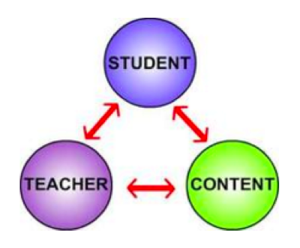
Elmore offers three ways schools can increase student learning and performance:
Change the content
Increase knowledge and skill of teachers to facilitate
Engage students in quality tasks

Slide 5
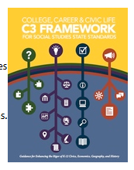
Content
….The concepts, thinking, and reasoning processes, skills and procedures that students are expected to learn and apply in specific content areas and at specific grade levels. These are defined by state and local standards.
Kentucky Academic Standards for ELA/Mathematics
CONTENT, STANDARDS, EXPECTATIONS

Slide 6
Teacher
The work a teacher does to create the conditions and develop student capacity to learn and apply content- based on clearly defined instructional models that inform the tasks they select or design, the pedagogy they use, how they support and monitor learning, what they expect students to complete, and how they judge and support a proficient performance.
FACILITATION

Slide 7
Regardless of what “standards” teachers use, what processes and habits are in place for you to calibrate the expectation for mastery?
How do you and your colleagues collectively set expectation for what mastery of that knowledge, reasoning, or skill?
Do some teachers define mastery differently than their colleagues?

Slide 8
Student
The work a student does with guidance and assistance from a teacher, to learn and apply content, to reflect on what and how they have learned, and to be able to assess their own learning performance against expected learning and performance.
ASSIGNMENTS, TASKS, WORK
WHEN WE USE THE TERM TASKS, WE ARE TALKING ABOUT HE THINKING STUDENTS ARE ENGAGED IN SO TO DEMONSTRATE A CERTAIN COGNITIVE DEMAND
-- NOT A SYNONYM FOR PRODUCT
All of the processes a student must undertake to complete the thing…...

Slide 9
Richard Elmore says,
In its simplest terms, the instructional core is composed of the teacher and the student in the presence of content. It is the relationship between the teacher, the student, and the content – not the qualities of any one of them by themselves – that determines the nature of instructional practice, and each corner of the instructional core has its own particular role and resources to bring to the instructional process. Simply stated, the instructional task is the actual work that students are asked to do in the process of instruction – not what teachers think they are asking students to do, or what the official curriculum says that the students are asked to do, but what they are actually asked to do..”

Slide 10
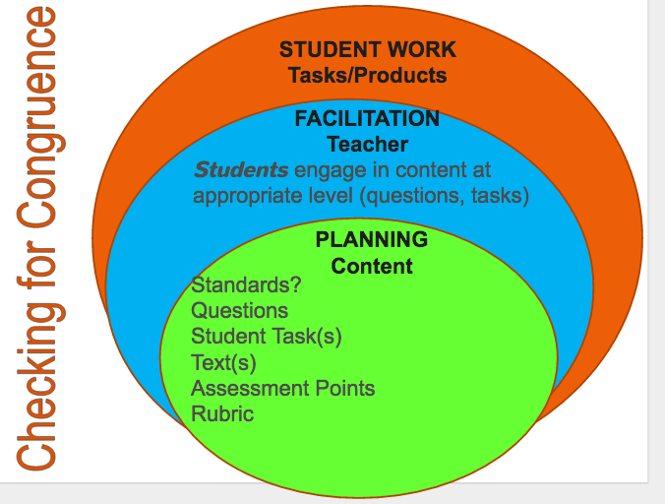

Slide 11
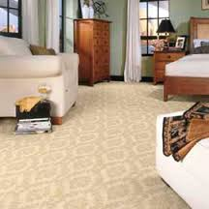
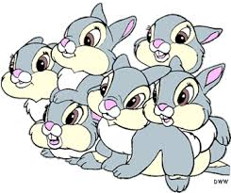
Martha’s Carpet or Fencing Task
Martha was recarpeting her bedroom, which was 15 feet long and 10 feet wide. How many square feet of carpeting will she need to purchase.
OR
Ms. Brown’s class will raise rabbits for their spring science fair. They have 24 feet of fencing with which to build a rectangular rabbit pen to keep rabbits.
If Ms. Brown’s students want their rabbits to have as much room as possible how long would each of the sides of the pen be?
How long would each of the sides of the pen be if they had only 16 feet of fencing?
How would you go about determining the pen with the most room for any amount of fencing? Organize your work so that someone else who reads it will understand it.

Slide 12
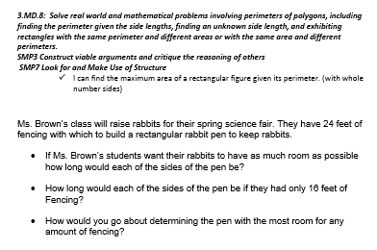
Handout

Slide 13
Do the Math - 3 minutes
Work with a partner at your table to answer the Rabbit Task.

Slide 14
Select a letter (A, B, C, D) from the center of your table.
Take your scenario recording sheet with you to the poster that matches your letter.
You will have 4 minutes at each station to discuss strengths/weaknesses of the student work and record your thoughts.
Please rotate when the timer goes off.
Student Work
Facilitation
Content
Notes:
You have a packet of vignettes that correspond to the lesson on the purple paper. Read through each vignette to determine congruency in the facilitation and in student work. Think about the evidence that can support your naming these as either congruent or incomgruent.
Talk to your table partner about your findings.
Discuss whole group.

Slide 15
Gallery walk #2 “Facilitation”
As you observe the teacher facilitation scenarios, note and discuss what the teacher did well and what the teacher might have done better.
What evidence shows that the cognitive complexity was or was not maintained?
Be prepared to share out.

Slide 16
Debriefing the Scenarios
The scenarios made me think…..
As I reflect on the tasks students are given and how I facilitate my instruction, I realize…
How might analyzing a rigorous task or student work in isolation not tell us the depth of student thinking involved in a task?
What role does facilitation play in affecting the cognitive demand required by the task?

Slide 17
How can the examination of student/educator work be supported as a routine for continuous improvement?

