Slide 1

Pulaski County Schools
Elementary
Summer Science PD
June 12^{th,} 2015

Slide 2

What can we do today?
Overview of NGSS and the Three Dimensions
Look at resources to help understand NGSS
Microscope Investigation I and II
Bundling Activity
Long-Term plan sheet calendar
Physics Progression investigations
PHeT simulations and other online resources
Time to plan and discuss with grade band partner
Engineering Investigations
Formative Assessment Probes by Page Keeley
Analyze PLTW Launch modules and compare with NGSS

Slide 3

Rate Your Familiarity with NGSS
Choose one of the following that best describes your familiarity with the NGSS and explain your choice:
I know there are new science standards
Know a little about them/I know they have different colored sections on the paper
Read some of the framework/standards
I have a real deep understanding of standards their meaning and the content taught
I could lead a PD or group planning on the standards.
Notes:
Read the choices and decide which one best describes your knowledge level. Close your eyes and on the count of three, raise your hand and hold up the number of fingers that best represents your familiarity with the NGSS.

Slide 4




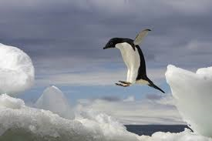

Which one are you?
NOT LISTENING – I AM
GOING TO RETIRE SOON
I AM REALLY SCARED
I GOT THIS - NO PROBLEM
I AM AFRAID TO LOOK
I AM EAGER AND READY
TO JUMP RIGHT IN
HE THINKS WE ARE ACTUALLY
GOING TO DO THIS

Slide 5
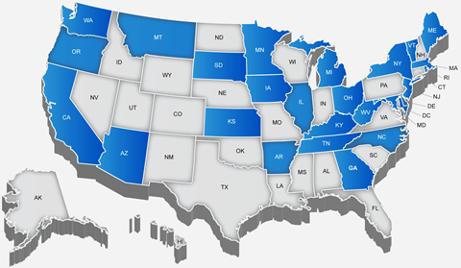
Kentucky was one of the 26 Lead States to help with the development of The Next Generation Science Standards

Slide 6




Lots of work completed, underway, and left to do
Assessments
Curricula
Instruction
Teacher Development
Notes:
From Heidi Schweingruber’s slides—the notes below are a bit out of date, but this slide is here to help everyone understand where we are in the process and what still needs to come (will help us to ward off questions about assessments—we need some canned responses to questions about what the assessment will look like—similar to CCSS math assessments? Or…)
The Carnegie Corporation has taken a leadership role to ensure that the development of common science standards proceeds and is of the highest quality by funding a two-step process: first, the development of this framework by the National Research Council (NRC) and, second, the development of a next generation of science standards based on the framework by Achieve, Inc. (Framework, p. viii).
This framework is the first part of a two-stage process to produce a next-generation set of science standards for voluntary adoption by states. The second step—the development of a set of standards based on this framework—is a state-led effort coordinated by Achieve Inc. involving multiple opportunities for input from the states’ science educators, including teachers, and the public (Framework, p. 1-2).
As our report was being completed, Achieve’s work on science standards was already under way, starting with an analysis of international science benchmarking in high-performing countries that is expected to inform the standards development process (Framework, p. 1-8).
Recommendation 3: Standards should be limited in number.
The framework focuses on a limited set of scientific and engineering practices, crosscutting concepts, and disciplinary core ideas, which were selected by using the criteria developed by the framework committee (and outlined in Chapter 2) as a filter. We also drew on previous reports, which recommended structuring K-12 standards around core ideas as a means of focusing the K-12 science curriculum [3, 4]. These reports’ recommendations emerged from analyses of existing national, state, and local standards as well as from a synthesis of current research on learning and teaching in science (Framework, p. 12-3).
Basically, a coherent set of science standards will not be sufficient to prepare citizens for the 21st century unless there is also coherence across all subject areas of the K-12 curriculum (Framework, p. 12-8).

Slide 7

A New Vision of Science Learning that Leads to a New Vision of Teaching
www.kevincrumpscience.weebly.com
Notes:
The Committee on a Conceptual Framework for New Science Education Standards was charged with developing a framework that articulates a broad set of expectations for students in science. The overarching goal of our framework for K-12 science education is to ensure that by the end of 12th grade, all students have some appreciation of the beauty and wonder of science; possess sufficient knowledge of science and engineering to engage in public discussions on related issues; are careful consumers of scientific and technological information related to their everyday lives; are able to continue to learn about science outside school; and have the skills to enter careers of their choice, including (but not limited to) careers in science, engineering, and technology (Framework, ES 1).

Slide 8

NGSS Framework
THREE DIMENSIONS:
1. Practices
2. Crosscutting Concepts
3. Disciplinary Core Ideas
Let’s take a look at a page in your grade level

Slide 9
Performance Expectations
Integrate practices, core ideas and Crosscutting Concepts
Statements of what is to be assessed
NOT lesson plans
State what students should be able to do at the end of instruction
Organized by Topic and DCI

Slide 10
What’s Different about the Next Generation Science Standards?
Where can I find out?

Slide 11


NGSS website: www.nextgenscience.org
There is also a FREE NGSS App

Slide 12

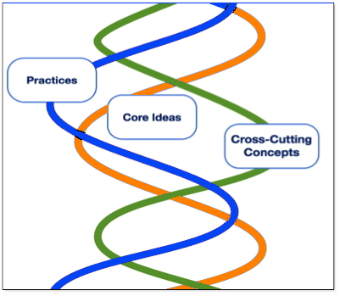
Three Dimensions Intertwined
The NGSS are written as Performance Expectations
NGSS will require contextual application of the three dimensions by students.
Focus is on how and why as well as what
Look at the handout that has the three dimensions

Slide 13

Science and Engineering Practices
1. Asking questions (science) and defining problems (engineering)
2. Developing and using models
Planning and carrying out investigations
Analyzing and interpreting data
5. Using mathematics and computational thinking
6. Constructing explanations (science) and designing solutions (engineering)
7. Engaging in argument from evidence
8. Obtaining, evaluating, and communicating information
Notes:
Dimension 1 [Scientific and Engineering Practices] describes (a) the major practices that scientists employ as they investigate and build models and theories about the world and (b) a key set of engineering practices that engineers use as they design and build systems. We use the term “practices” instead of a term such as “skills” to emphasize that engaging in scientific investigation requires not only skill but also knowledge that is specific to each practice (Framework, p. 2-5).
Science is not just a body of knowledge that reflects current understanding of the world; it is also a set of practices used to establish, extend, and refine that knowledge. Both elements—knowledge and practice—are essential (Framework, p. 3).
Similarly, engineering involves both knowledge and a set of practices. The major goal of engineering is to solve problems that arise from a specific human need or desire. To do this, engineers rely on their knowledge of science and mathematics as well as their understanding of the engineering design process (Framework, p. 2-3).
The practices include. . .
Asking questions is essential to developing scientific habits of mind. Even for individuals who do not become scientist or engineers, the ability to ask well-defined questions is an important component of science literacy, helping to make them critical consumers of scientific knowledge.
Questions are the engine that drive science and engineering. Science asks:
What exists and what happens?
Why does it happen?
How does one know?
(Framework, 3-6)
Engineering asks:
What can be done to address a particular human need or want?
How can the need be better specified?
What tools and technologies are available, or could be developed, for addressing this need?
How does one communicate phenomena, evidence, explanations, and design solutions?
(Framework, p. 3-6)
Conceptual models, the focus of this section, are, in contrast, explicit representations that are in some ways analogous to the phenomena they represent. Conceptual models allow scientists and engineers to better visualize and understand a phenomenon under investigation or develop a possible solution to a design problem.
Although they do not correspond exactly to the more complicated entity being modeled, they do bring certain features into focus while minimizing or obscuring others. Because all models contain approximations and assumptions that limit the range of validity of their application and the precision of their predictive power, it is important to recognize their limitations.
(Framework, p. 3-8)
Conceptual models, the focus of this section, are, in contrast, explicit representations that are in some ways analogous to the phenomena they represent. Conceptual models allow scientists and engineers to better visualize and understand a phenomenon under investigation or develop a possible solution to a design problem.
Although they do not correspond exactly to the more complicated entity being modeled, they do bring certain features into focus while minimizing or obscuring others. Because all models contain approximations and assumptions that limit the range of validity of their application and the precision of their predictive power, it is important to recognize their limitations.
(Framework, p. 3-8)
Conceptual models, the focus of this section, are, in contrast, explicit representations that are in some ways analogous to the phenomena they represent. Conceptual models allow scientists and engineers to better visualize and understand a phenomenon under investigation or develop a possible solution to a design problem.
Although they do not correspond exactly to the more complicated entity being modeled, they do bring certain features into focus while minimizing or obscuring others. Because all models contain approximations and assumptions that limit the range of validity of their application and the precision of their predictive power, it is important to recognize their limitations.
(Framework, p. 3-8)
Scientists and engineers investigate and observe the world with essentially two goals: (1) to systematically describe the world and (2) to develop and test theories and explanations of how the world works. In the first, careful observation and description often lead to identification of features that need to be explained or questions that need to be explored.
The second goal requires investigations to test explanatory models of the world and their predictions and whether the inferences suggested by these models are supported by data.
Planning and designing such investigations require the ability to design experimental or observational inquiries that are appropriate to answering the question being asked or testing a hypothesis that has been formed. This process begins by identifying the relevant variables and considering how they may be observed, measured, and controlled (constrained by the experimental design to take particular values). (Framework, 3-9 &10)
Once collected, data must be presented in a form that can reveal any patterns and relationships and that allows results to be communicated to others. Because raw data as such have little meaning, a major practice of scientists is to organize and interpret the data through tabulating, graphing, or statistical analysis. Such analysis can bring out the meaning of the data—and their relevance—so that they may be used as evidence (Framework, p. 3-11).
Mathematics and computational tools are central to science and engineering.
Mathematics enables the numerical representation of variables, the symbolic representation of relationships between physical entities, and the prediction of outcomes. Mathematics provides powerful models for describing and predicting such phenomena as atomic structure, gravitational
forces, and quantum mechanics.
Mathematics enables ideas to be expressed in a precise form and enables the identification of new ideas about the physical world.
Although there are differences in how mathematics and computational thinking are applied in science and in engineering, mathematics often brings these two fields together by enabling engineers to apply the mathematical form of scientific theories and by enabling scientists to use powerful information technologies designed by engineers.
(Framework, p. 3-13)
Engaging students with standard scientific explanations of the world—helping them to gain an understanding of the major ideas that science has developed—is a central aspect of science education. Asking students to demonstrate their own understanding of the implications of a scientific idea by developing their own explanations of phenomena, whether based on observations they have made or models they have developed, engages them in an essential part of the process by which conceptual change can occur (Framework, p. 3-15).
In engineering, the goal is a design rather than an explanation. The process of developing a design is iterative and systematic, as is the process of developing an explanation or theory in science (Framework, p. 3-15 & 16).
Engineers’ activities, however, have elements that are distinct from those of scientists. These elements include specifying constraints and criteria for desired qualities of the solution, developing a design plan, producing and testing models or prototypes, selecting among alternative design features to optimize the achievement of design criteria, and refining design ideas based on the performance of a prototype or simulation (Framework, p. 3-15 & 16).
In science, the production of knowledge is dependent on a process of reasoning that requires a scientist to make a justified claim about the world. In response, other scientists attempt to identify the claim’s weaknesses and limitations. Their arguments can be based on deductions from premises, on inductive generalizations of existing patterns, or on inferences about the best possible explanation. Argumentation is also needed to resolve questions involving, for example, the best experimental design, the most appropriate techniques of data analysis, or the best interpretation of a given data set (Framework, p. 3-17).
In engineering, reasoning and argument are essential to finding the best possible solution to a problem. At an early design stage, competing ideas must be compared (and possibly combined) to achieve an initial design, and the choices are made through argumentation about the merits of the various ideas pertinent to the design goals. At a later stage in the design process, engineers test their potential solution, collect data, and modify their design in an iterative manner. The results of such efforts are often presented as evidence to argue about the strengths and weaknesses of a particular design (Framework, p. 3-18).
From the very start of their science education, students should be asked to engage in the communication of science, especially regarding the investigations they are conducting and the observations they are making. Careful description of observations and clear statement of ideas, with the ability to both refine a statement in response to questions and to ask questions of others to achieve clarification of what is being said begin at the earliest grades.
Beginning in upper elementary and middle school, the ability to interpret written materials becomes more important.
Early work on reading science texts should also include explicit instruction and practice in interpreting tables, diagrams, and charts and coordinating information conveyed by them with information in written text.
Not only must students learn technical terms but also more general academic language, such as “analyze” or “correlation,” which are not part of most students’ everyday vocabulary and thus need specific elaboration if they are to make sense of scientific text. It follows that to master the reading of scientific material, students need opportunities to engage with such text and to identify its major features; they cannot be expected simply to apply reading skills learned elsewhere to master this unfamiliar genre effectively.
In engineering, students likewise need opportunities to communicate ideas using appropriate combinations of sketches, models, and language. They should also create drawings to test concepts and communicate detailed plans; explain and critique models of various sorts, including scale models and prototypes; and present the results of simulations, not only regarding the planning and development stages but also to make compelling presentations of their ultimate solutions.
(Framework, p. 3-21)

Slide 14


Crosscutting Concepts
Patterns
Cause and effect
Scale, proportion, and quantity
Systems and system models
Energy and matter
Structure and function
Stability and change
Notes:
Heidi’s slide
The crosscutting concepts have application across all domains of science. As such, they provide one way of linking across the domains in Dimension 3. These crosscutting concepts are not unique to this report. They echo many of the unifying concepts and processes in the National Science Education Standards [7], the common themes in the Benchmarks for Science Literacy [6], and the unifying concepts in the Science College Board Standards for College Success [9] (Framework, p. 2-5).
These crosscutting concepts were selected for their value across the sciences and in engineering. These concepts help provide
students with an organizational framework for connecting knowledge from the various disciplines into a coherent and scientifically based view of the world (Framework, p. 4-1).
1. Patterns. Observed patterns of forms and events guide organization and classification, and they prompt questions about relationships and the factors that influence them.
2. Cause and effect: Mechanism and explanation. Events have causes, sometimes simple, sometimes multifaceted. A major activity of science is investigating and explaining causal relationships and the mechanisms by which they are mediated. Such mechanisms can then be tested across given contexts and used to predict and explain events in newcontexts.
3. Scale, proportion, and quantity. In considering phenomena, it is critical to recognize what is relevant at different measures of size, time, and energy and to recognize how changes in scale, proportion, or quantity affect a system’s structure or performance.
(Framework, p. 4-1)
4. Systems and system models. Defining the system under study—specifying its boundaries and making explicit a model of that system—provides tools for understanding and testing ideas that are applicable throughout science and engineering.
5. Energy and matter: Flows, cycles, and conservation. Tracking fluxes of energy and matter into, out of, and within systems helps one understand the systems’ possibilities and limitations.
6. Structure and function. The way in which an object or living thing is shaped and its substructure determine many of its properties and functions.
7. Stability and change. For natural and built systems alike, conditions of stability and determinants of rates of change or evolution of the system are critical elements of study.
(Framework, p. 4-2)

Slide 15
44 Total Disciplinary Core Ideas (DCI)
1. Physical
2. Life
3. Earth and Space
4. Engineering, Technology and the Applications of Science

Slide 16
KCAS for Science
(Kentucky Core Academic Standards)
This is Kentucky’s adopted version of the NGSS
This is the Topic Arrangement
Located on my website:
www.kevincrumpscience.weebly.com

Slide 17
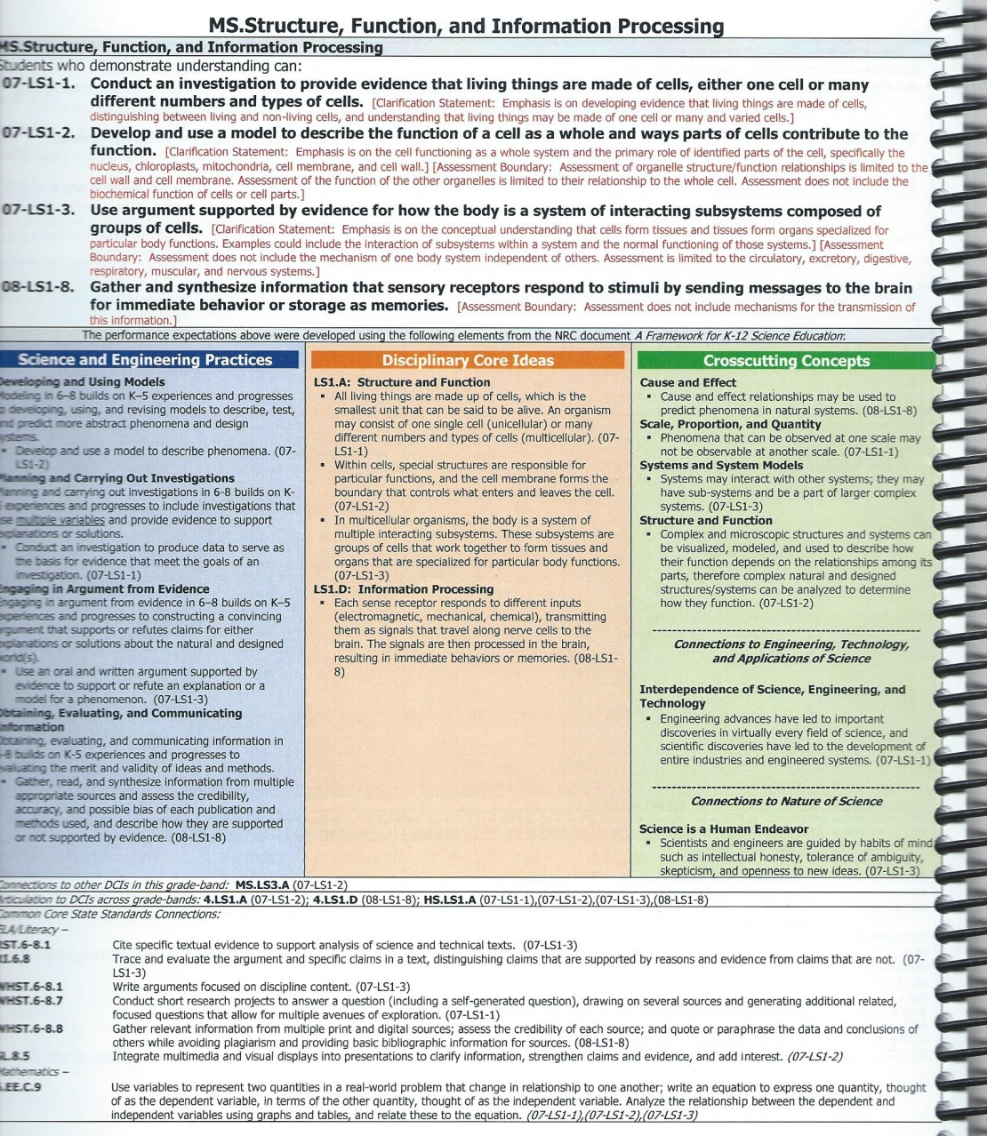

How do I read this document?

Slide 18


Slide 19
Activity
Use the activity handout and the information from the next few slides to demonstrate how the NGSS is presented within the Framework.
Open to any content page within the KCAS for Science
What’s In The Box?

Slide 20

Performance Expectations
(What is assessed)

Slide 21
Grade Level. Topic
Students who demonstrate understanding can: Code – represents the specific Performance Expectations written in black. After each Performance Expectation it will be followed by two statements in red: Clarification Statement Assessment Boundary

Slide 22

Foundation Box

Slide 23
The THREE DIMENSIONS:
The Foundation Box (in the middle)
Blue Science and Engineering Practices | Orange Disciplinary Core Ideas | Green Crosscutting Concepts

Slide 24
Connection
Box

Slide 25
The Connection Box (at the bottom)
Connections to other DCIs in this grade-band
Articulation to DCIs across grade-bands
Common Core State Standards Connections: ELE/Literacy Mathematics

Slide 26
www.kevincrumpscience.weebly.com
Go to my website and click on
Inside the NGSS Box

Slide 28
Take a look at the NGSS website: www.nextgenscience.org
Take a few minutes to examine the three dimensions of the framework.
Look through each appendix
Are there any questions about the website or anything we have discussed so far?

Slide 29
Exploring The Performance Expectations
This activity will explore the NGSS and determine how the 3 dimensions are blended within each Performance Expectation.
Select any Performance Expectation from your grade level

Slide 30
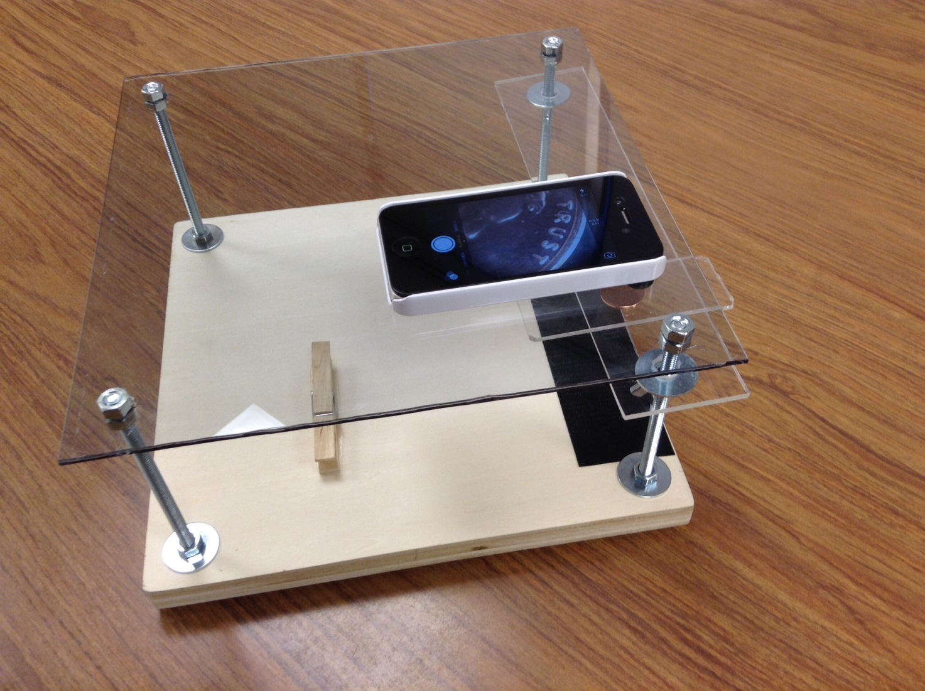
Each table group has an “iPad/iPhone microscope

Slide 31
iPad/iPhone Microscope
What are the following pictures?

Slide 32


Slide 33
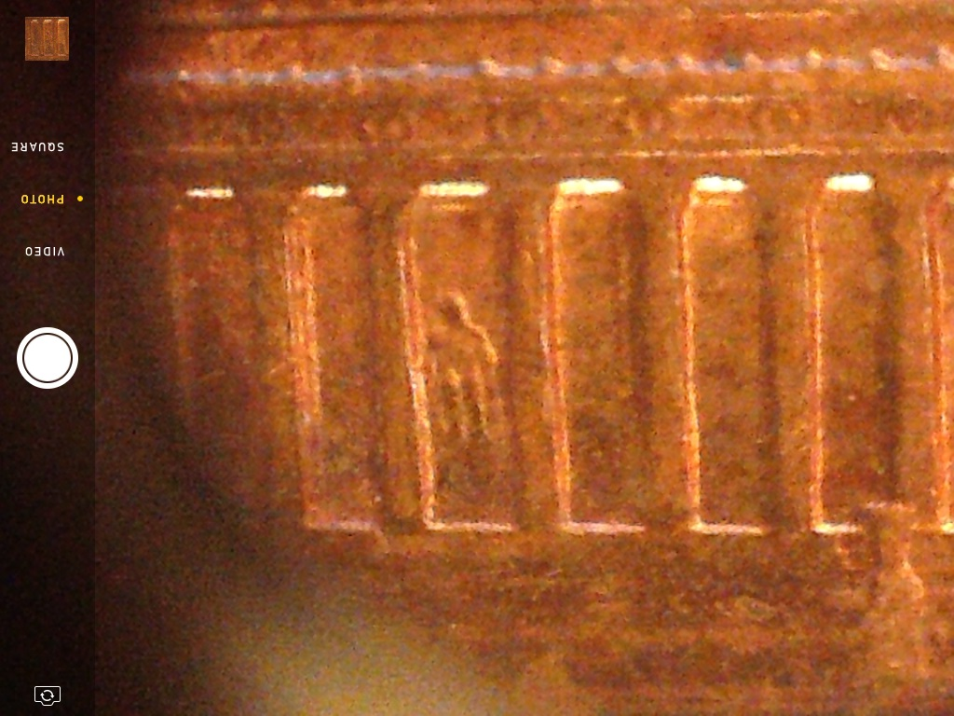

Slide 34
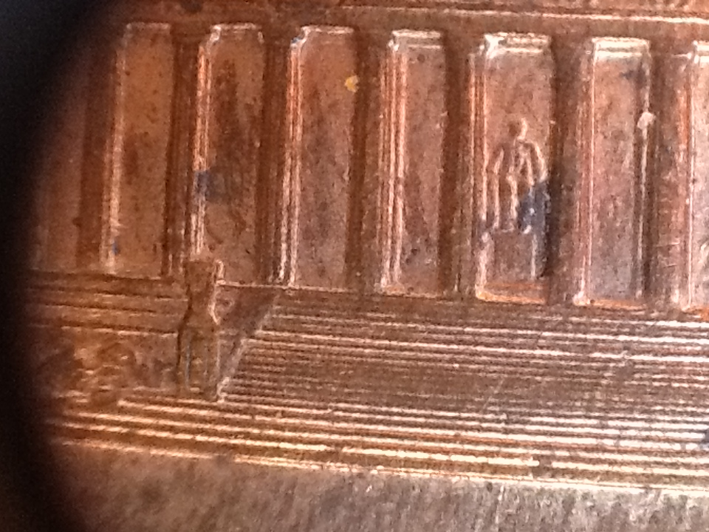

Slide 35
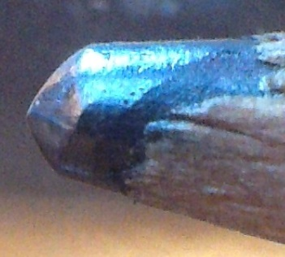

Slide 36
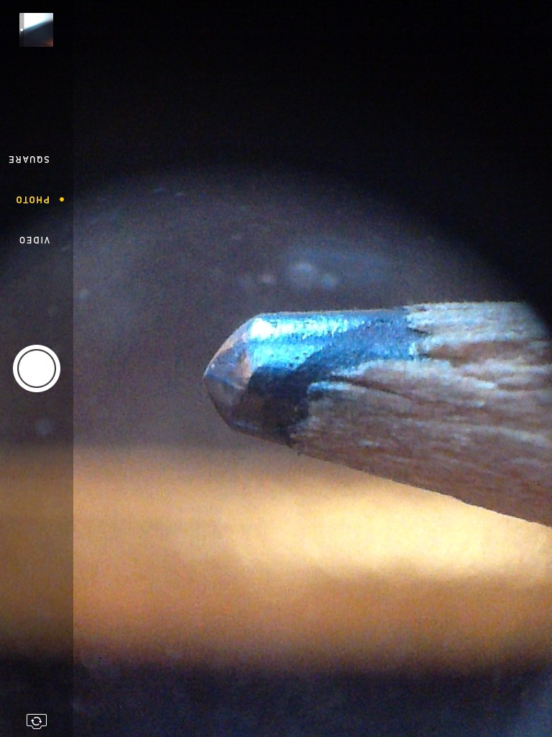

Slide 37
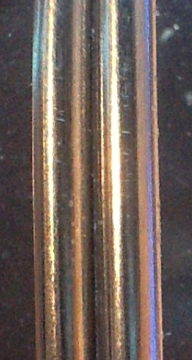

Slide 38


Slide 39


Slide 40
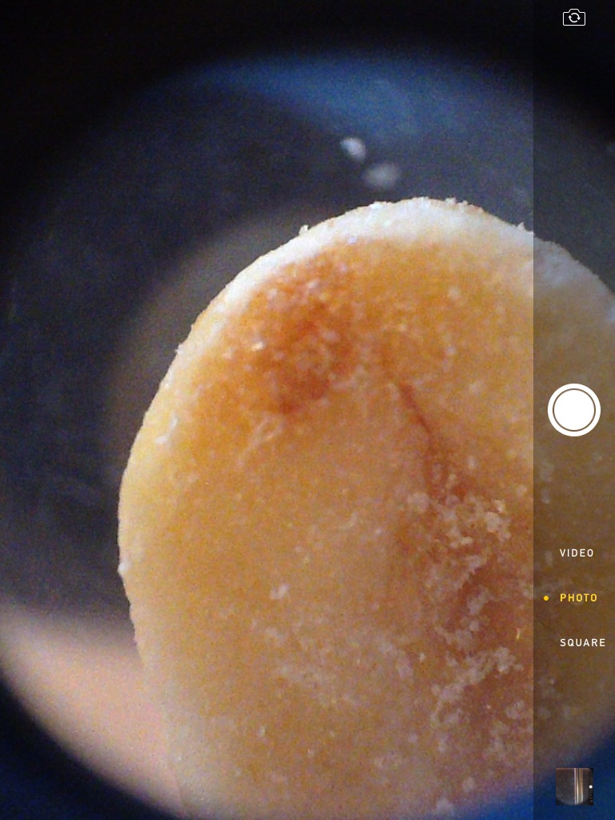

Slide 41
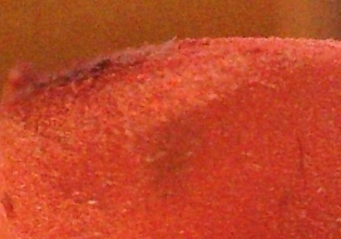

Slide 42


Slide 43
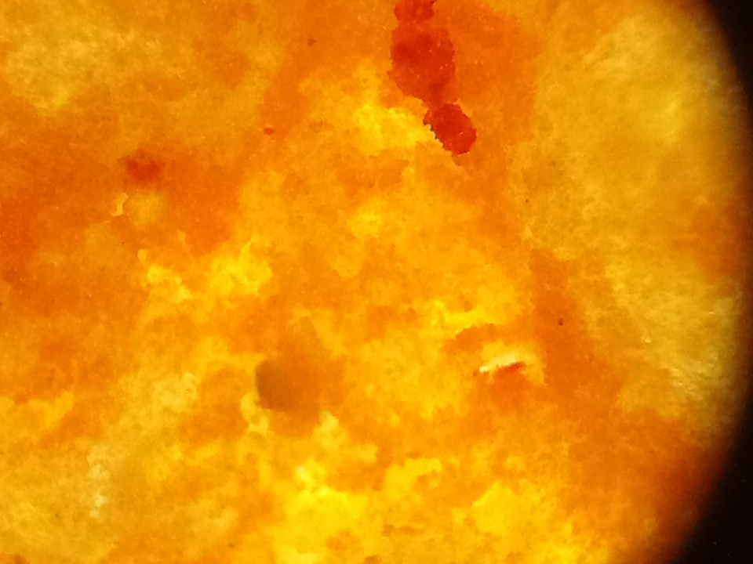

Slide 44


Slide 45


Slide 46


Slide 47


Slide 48


Slide 49


Slide 50
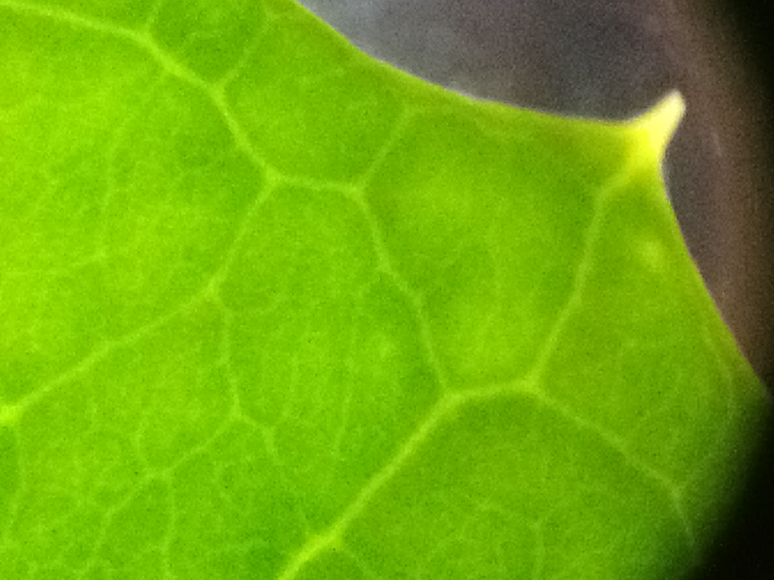

Slide 51
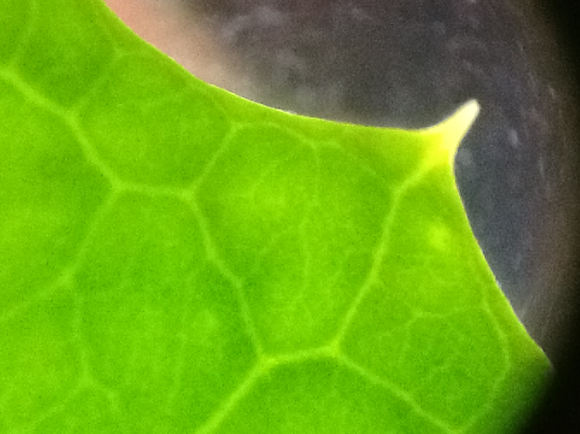

Slide 52
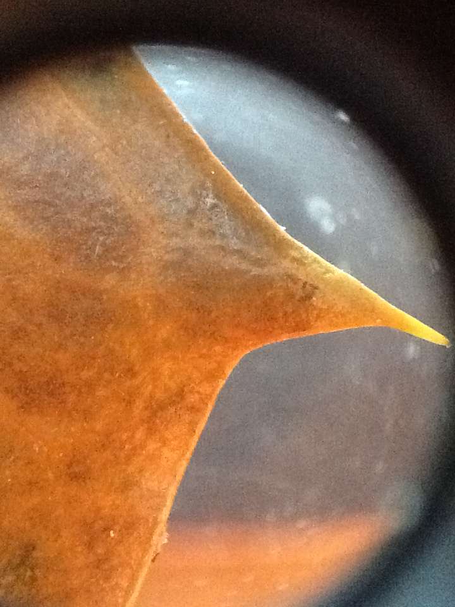

Slide 53
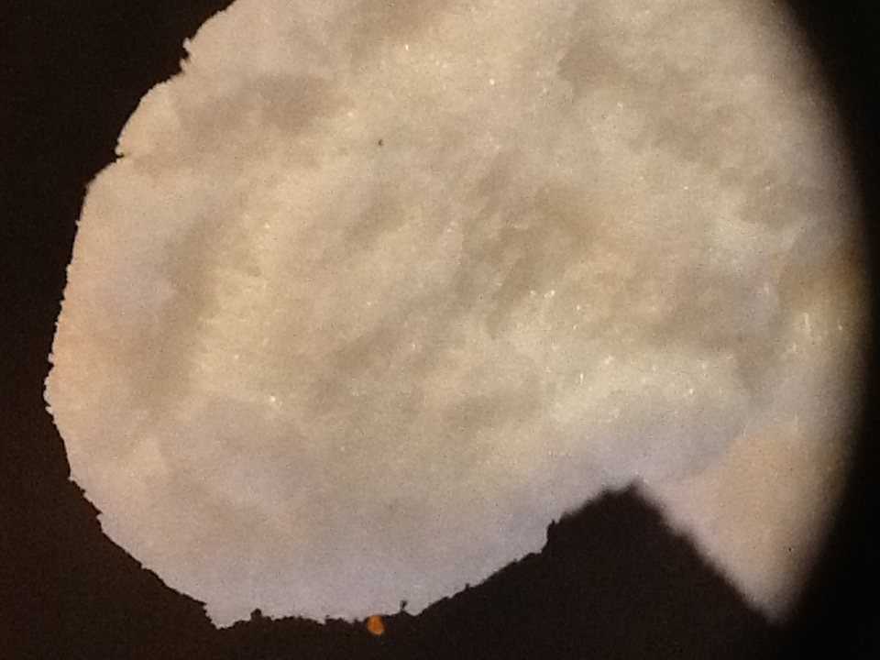

Slide 54
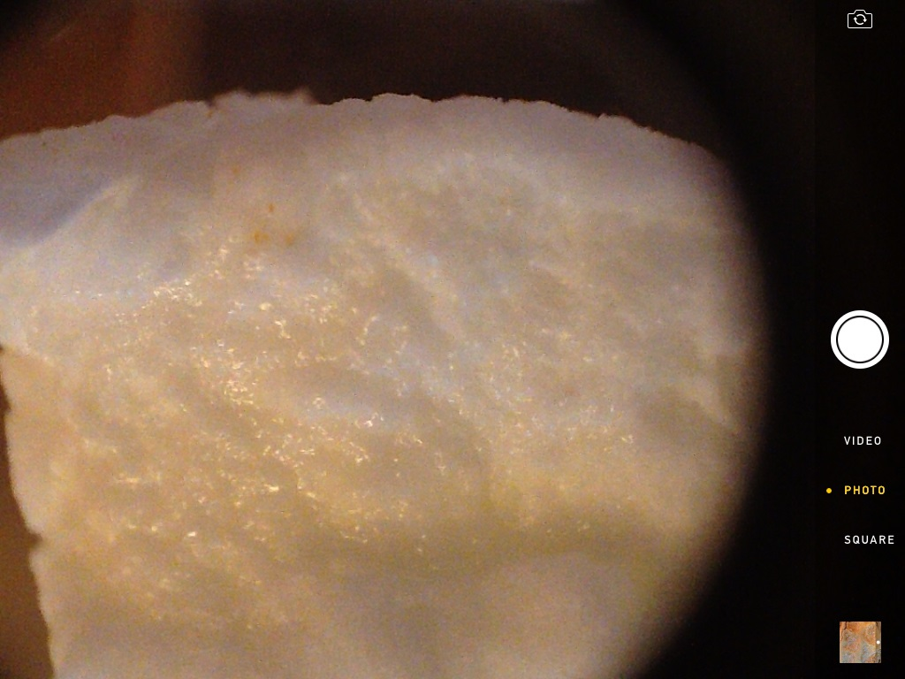

Slide 55
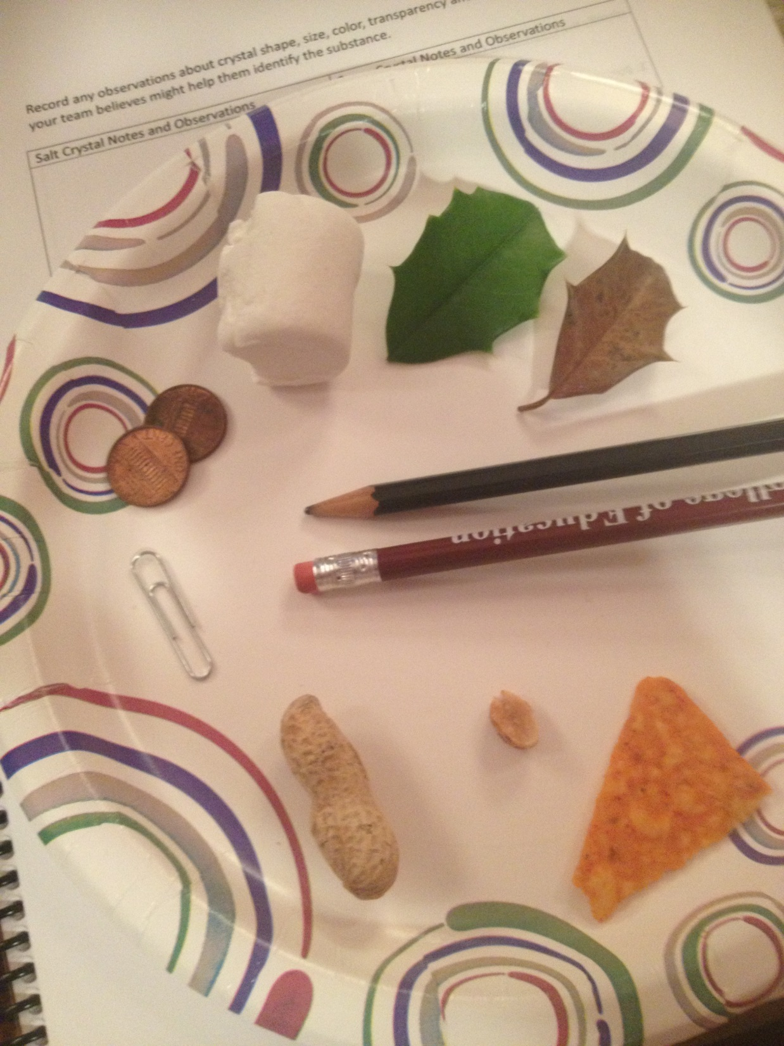

Slide 56
Each table group has an “iPad/iPhone microscope.
Find objects to practice and learn to focus and zoom in and out using your iPad or iPhone.

Slide 57
Once your group understands how to use the microscope get a small sample of both salt and sugar crystals from the materials table.
Observe each sample under the microscope at low and high power. Record any observations about crystal shape, size, color, transparency and any other properties your team believes might help them identify the substance if you were given an unknown sample.
You can also take pictures to use later.

Slide 58
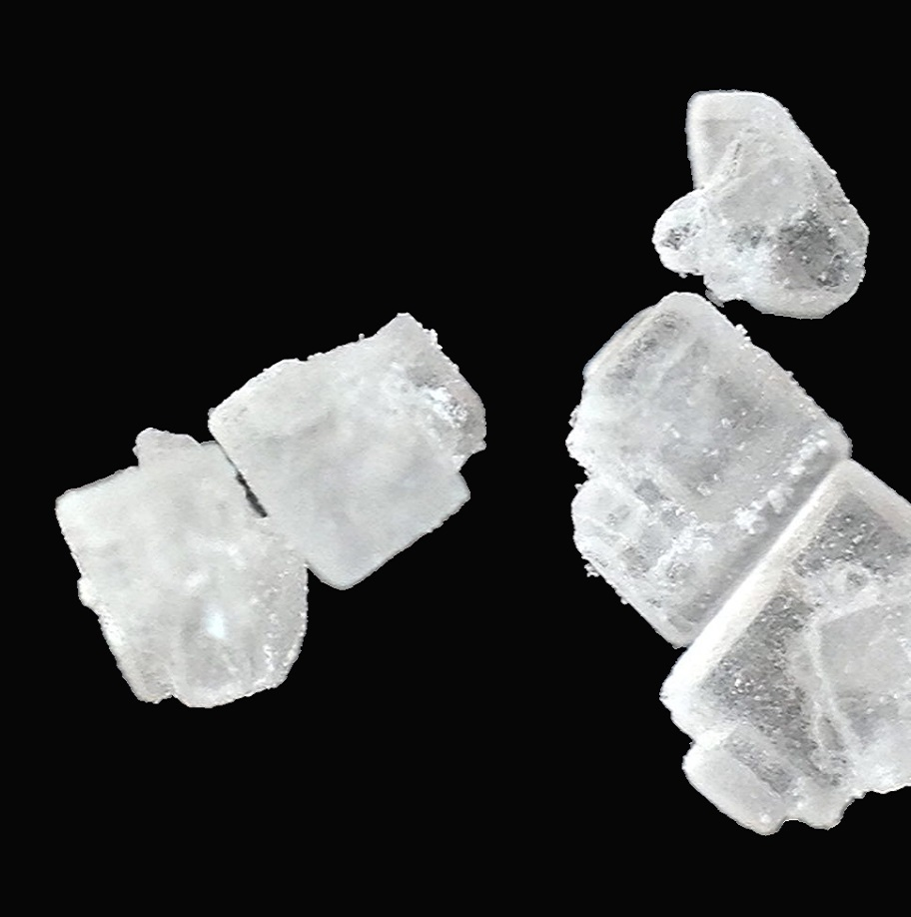
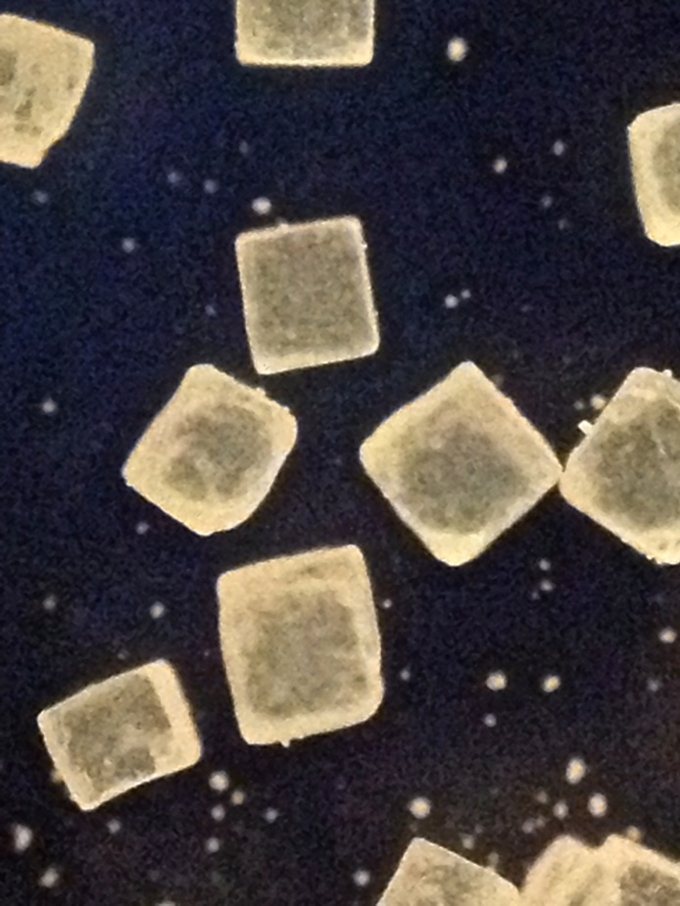

Slide 59
After your team has made all the observations they need of the known salt and sugar samples they should return to the materials table to collect a Test Sample. Observe under the microscope. Then select what is in the Test Sample from the choices below.
The Test Sample is…
A. salt mixed with an unknown substance.
B. salt with sugar and an unknown substance
C. salt only
D. sugar only
E. sugar mixed with an unknown substance
F. salt and sugar only (no unknown substance)
Identify

Slide 60
Identify the SEP and CCC
SEP – Appendix F
CCC – Appendix G

Slide 61
The Core Idea and Standards?
DCI – Appendix E
Is there is specific Performance Expectation aligned to this investigation?

Slide 62
Engineering Design
K-2
3-5
MS
HS
Appendix I

Slide 63


Please be back by 1:00

Slide 64

Microscope II

Slide 65
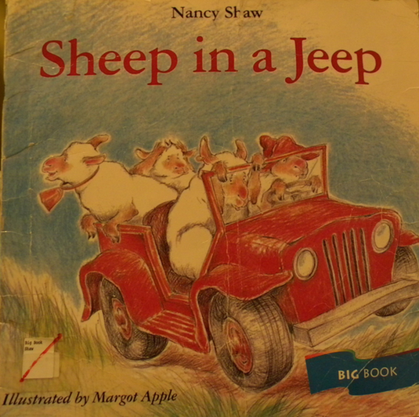
Force and Motion
Give a thumbs-up when you think you hear a force or a motion
Today we are going to read:
Sheep in a Jeep
By Nance Shaw

Slide 66

Sheep In A Jeep
https://www.youtube.com/watch?v=5qp0SkfcmZI

Slide 67
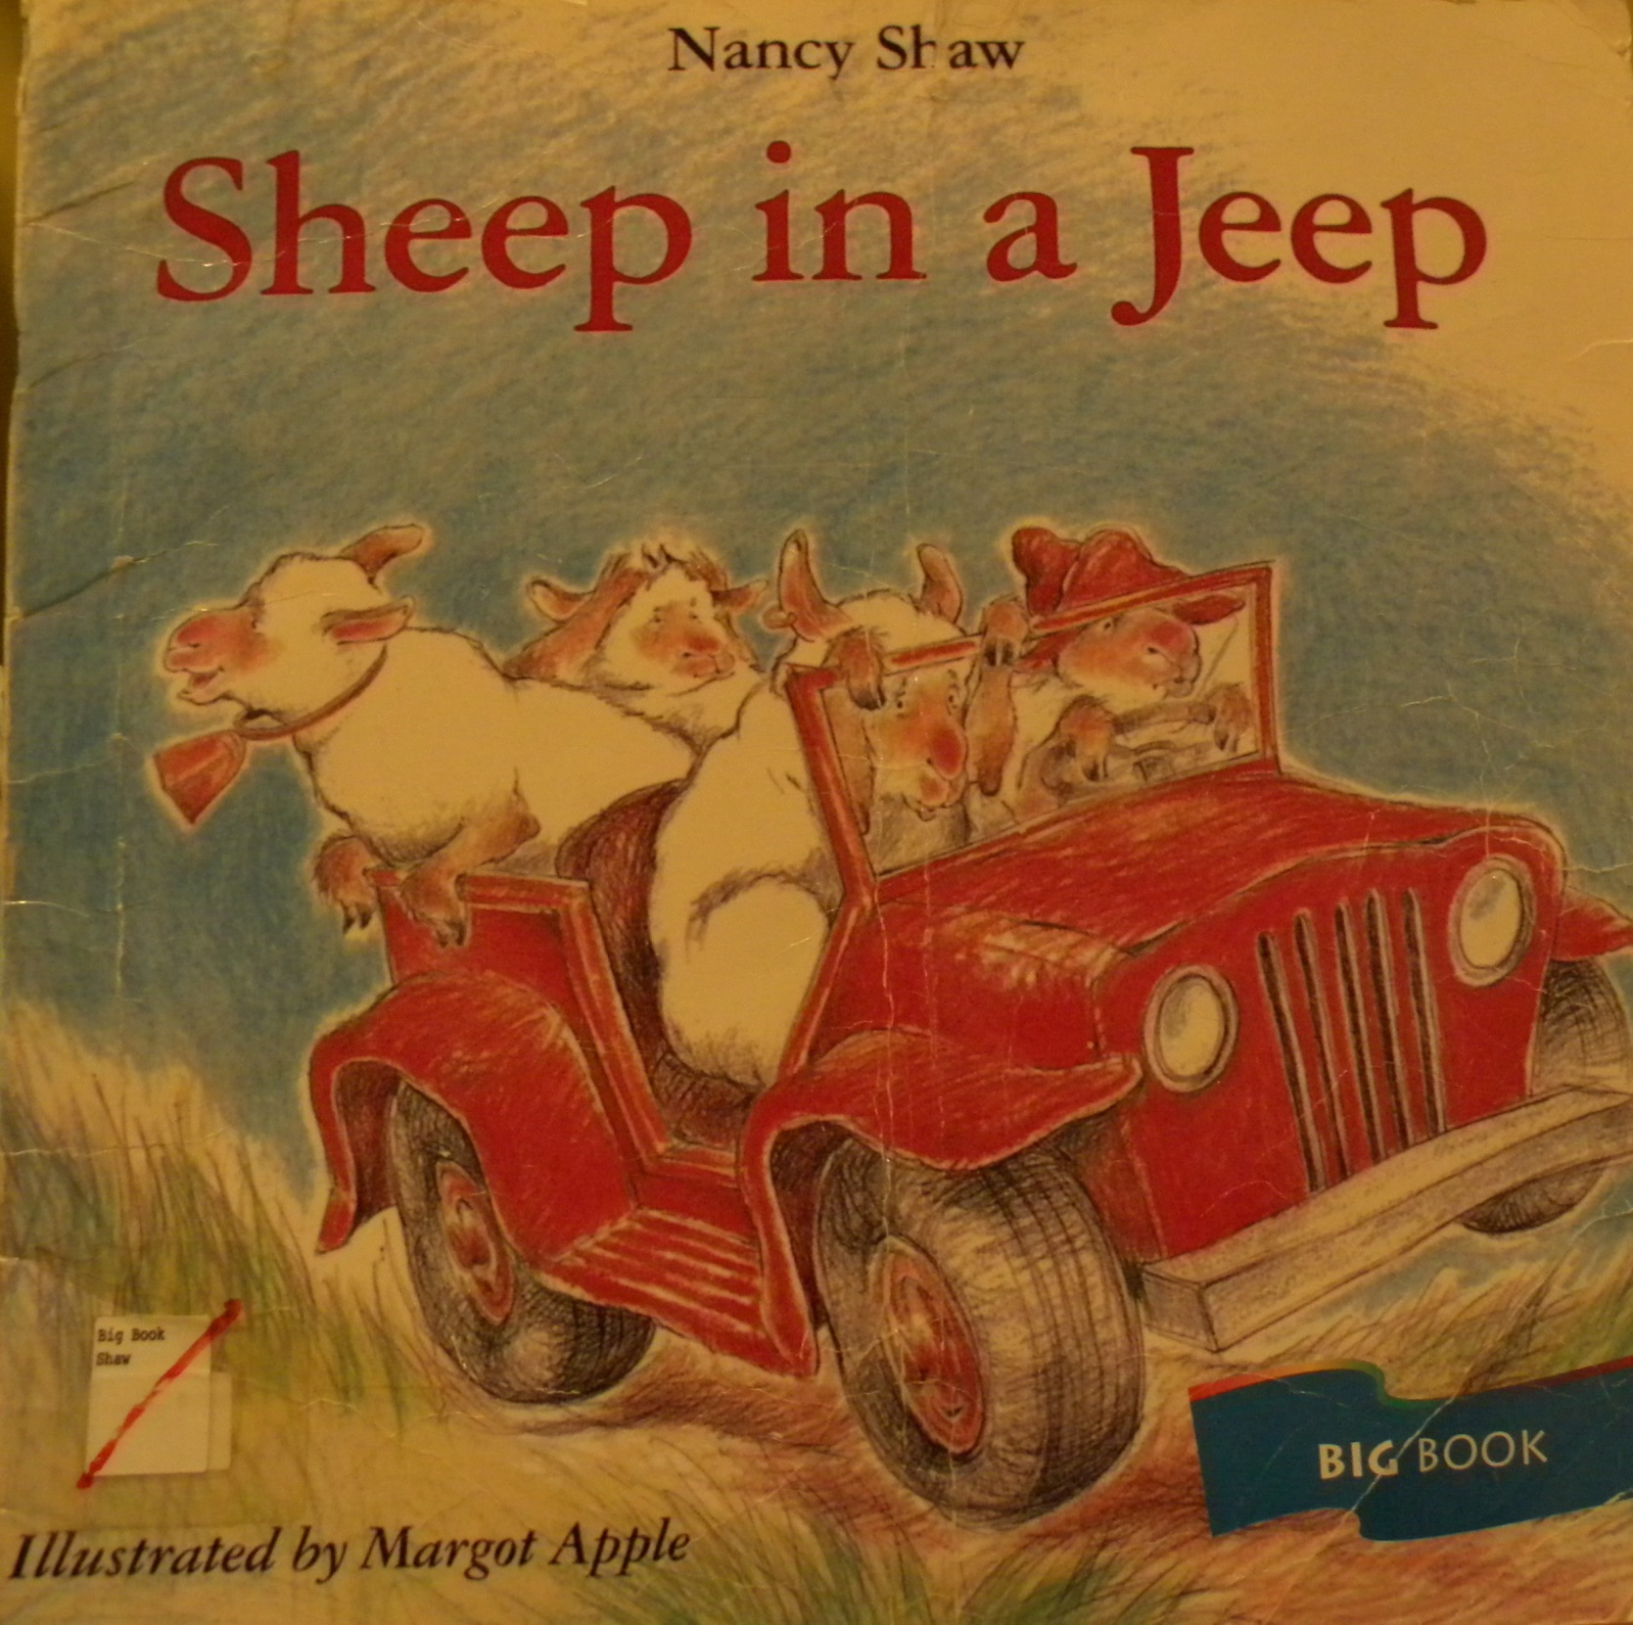

Slide 68
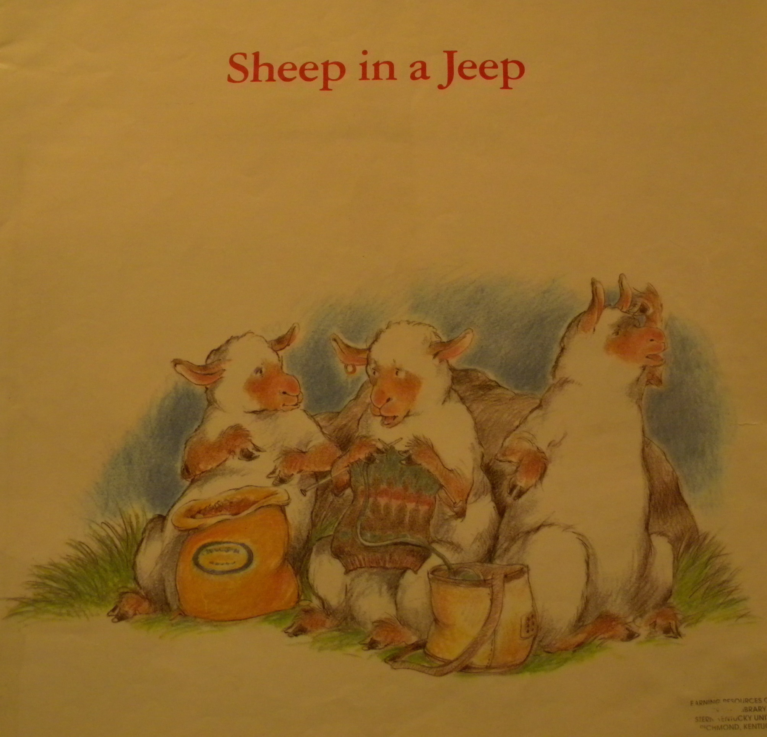

Slide 69
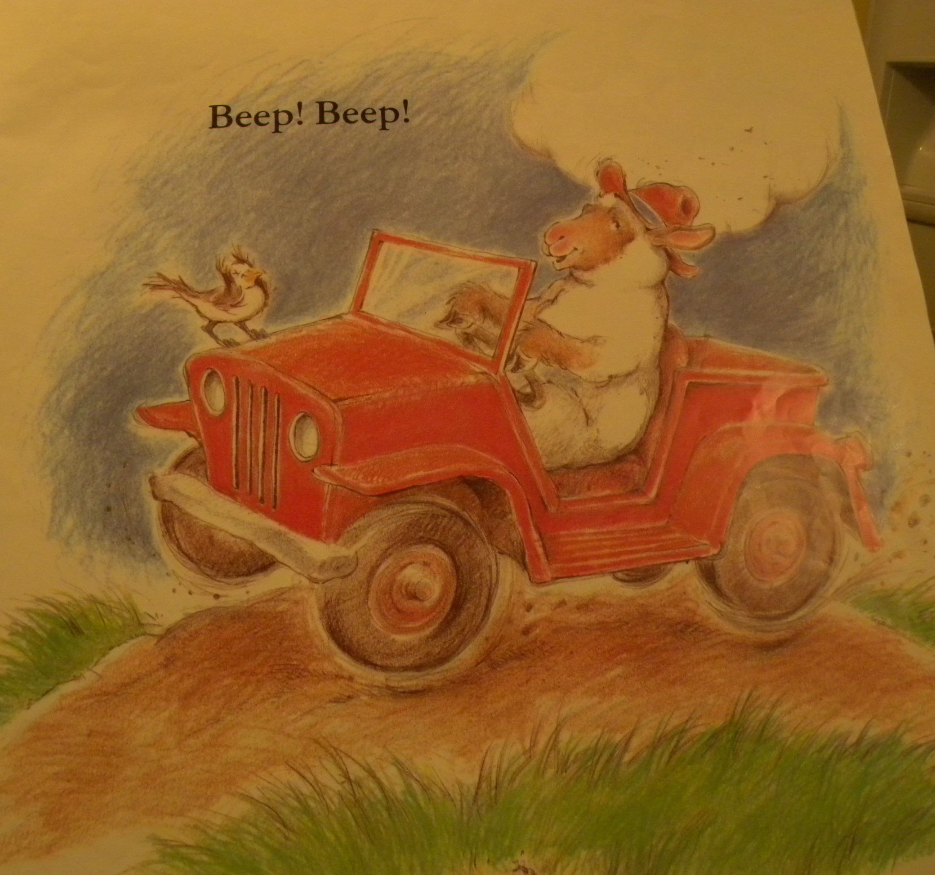

Slide 70
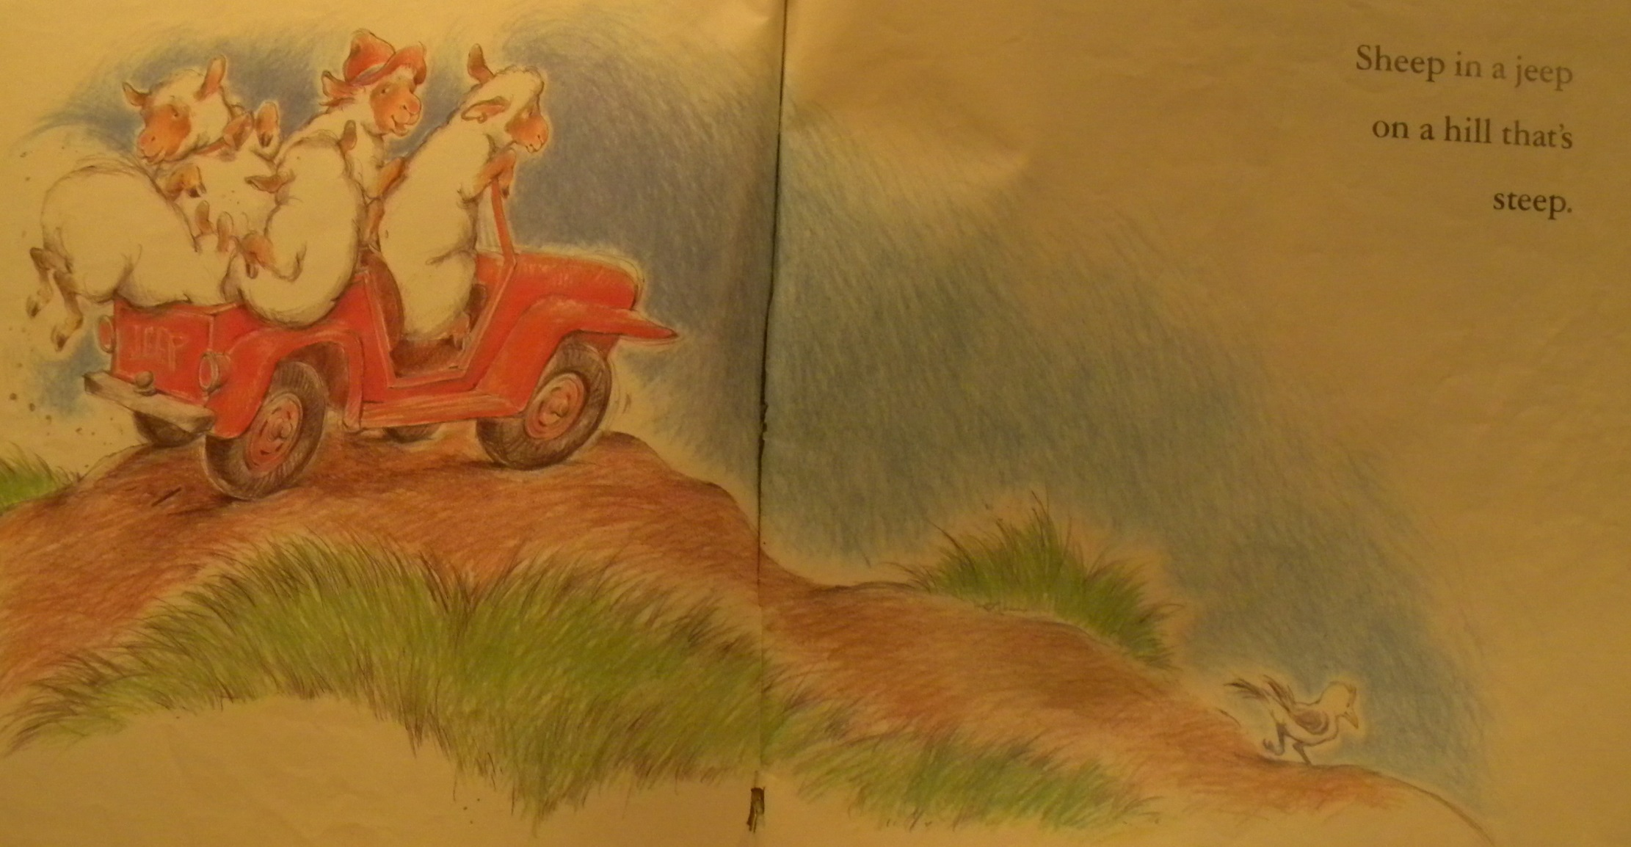

Slide 71
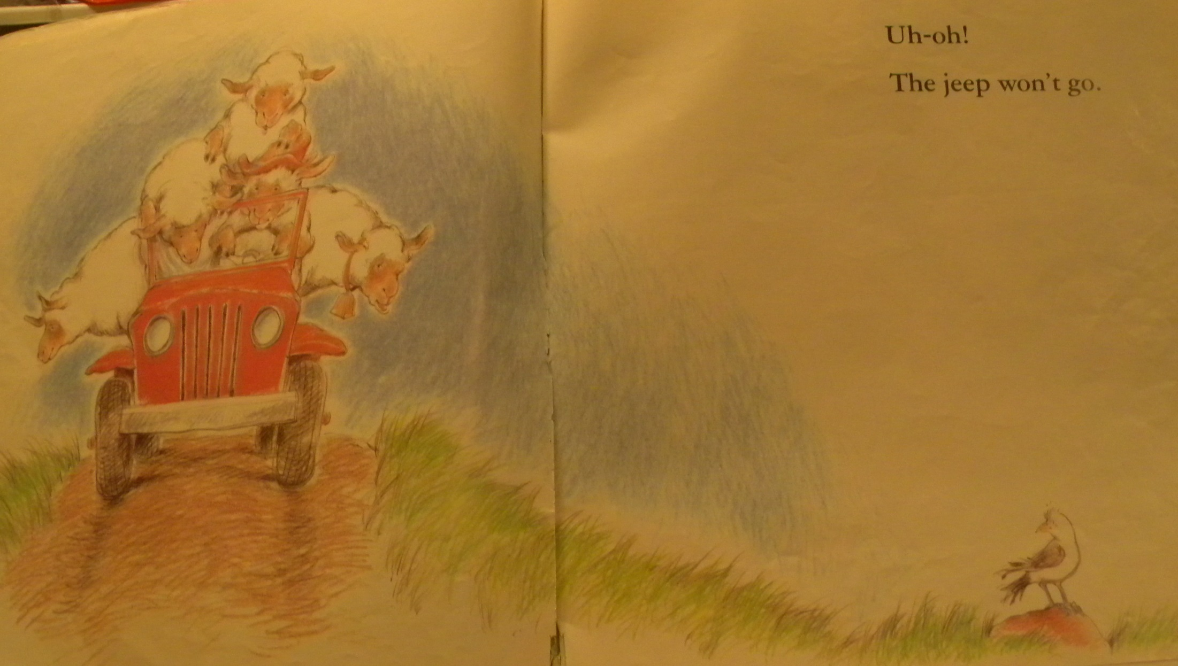

Slide 72
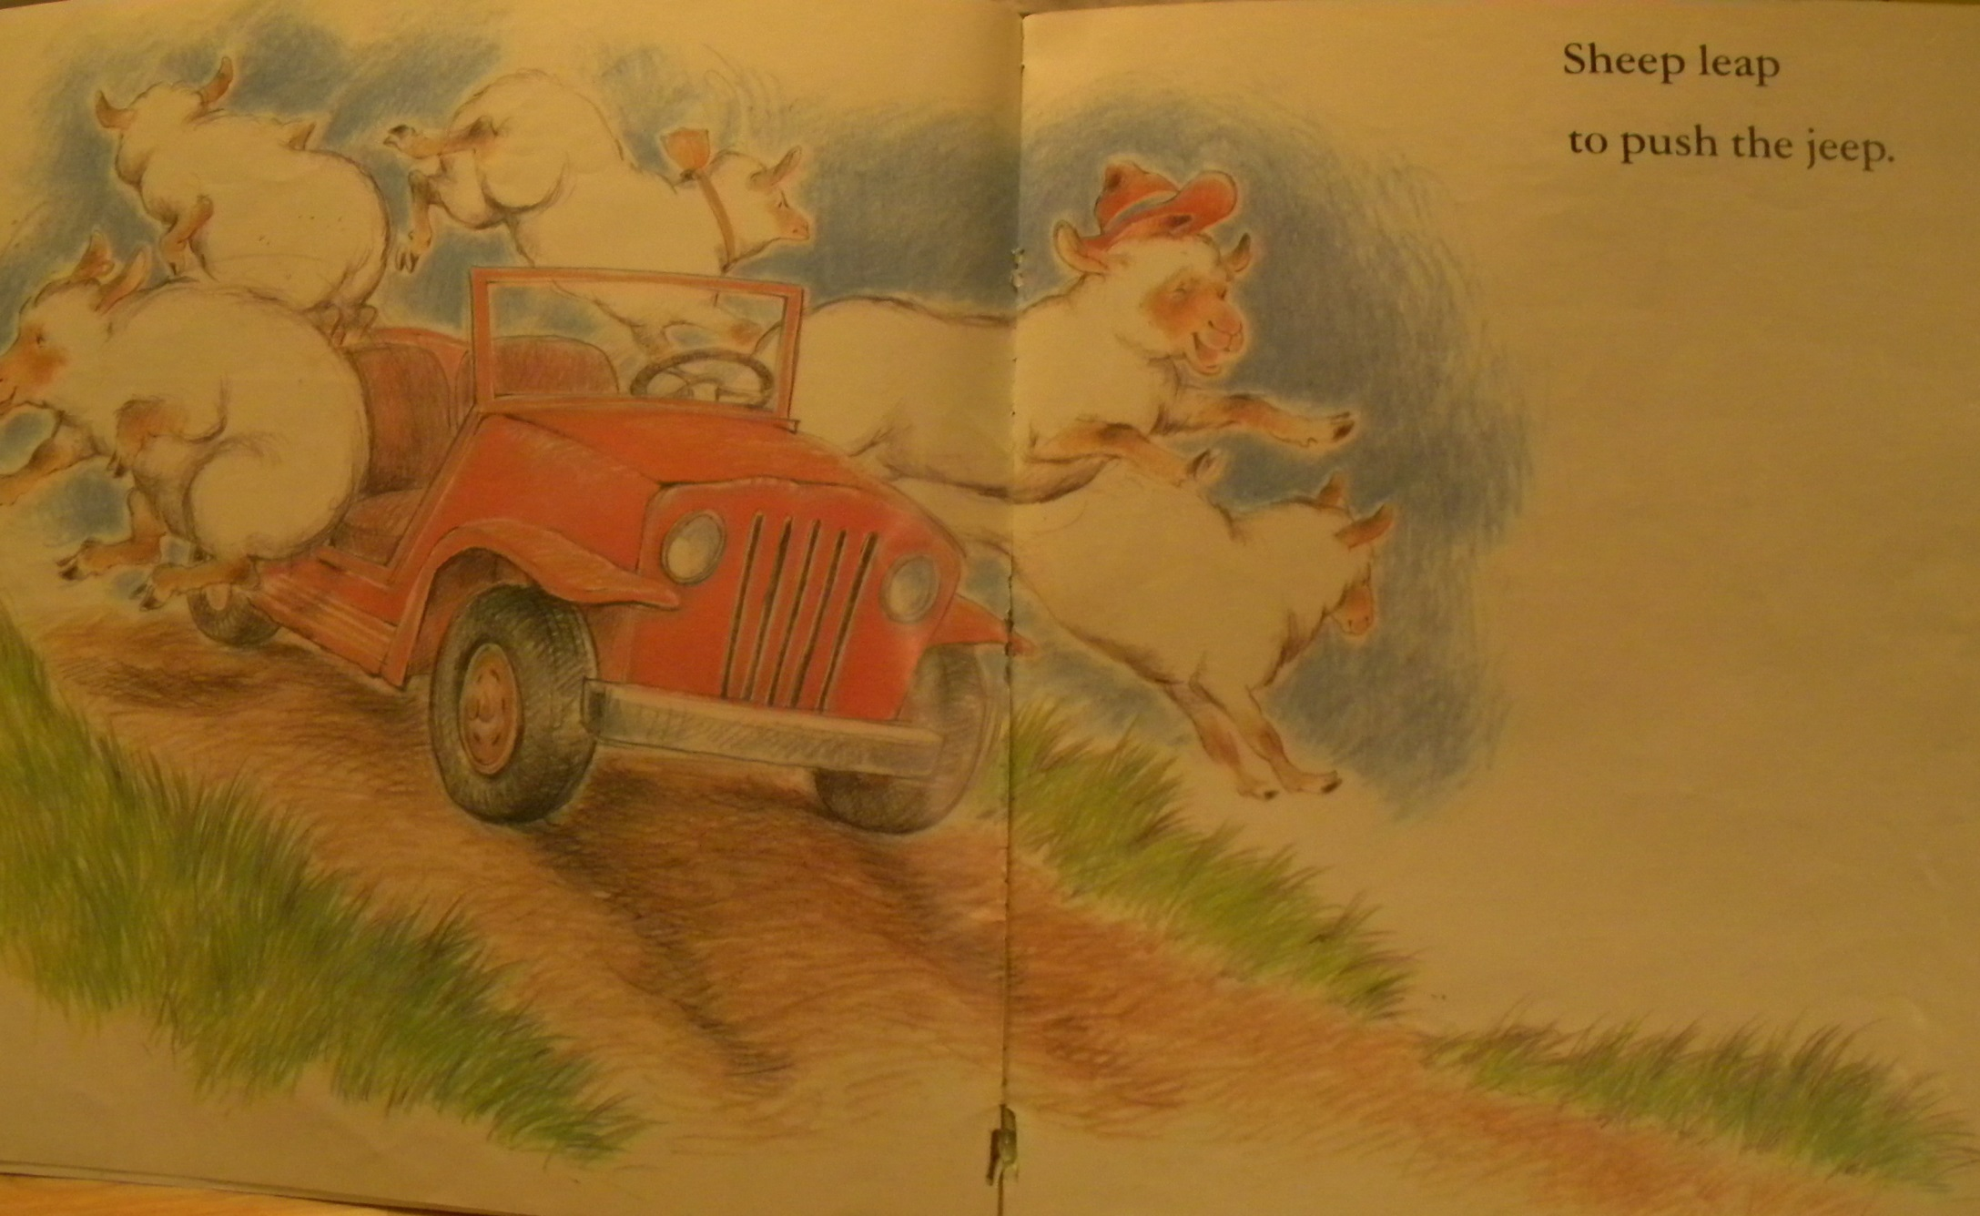

Slide 73
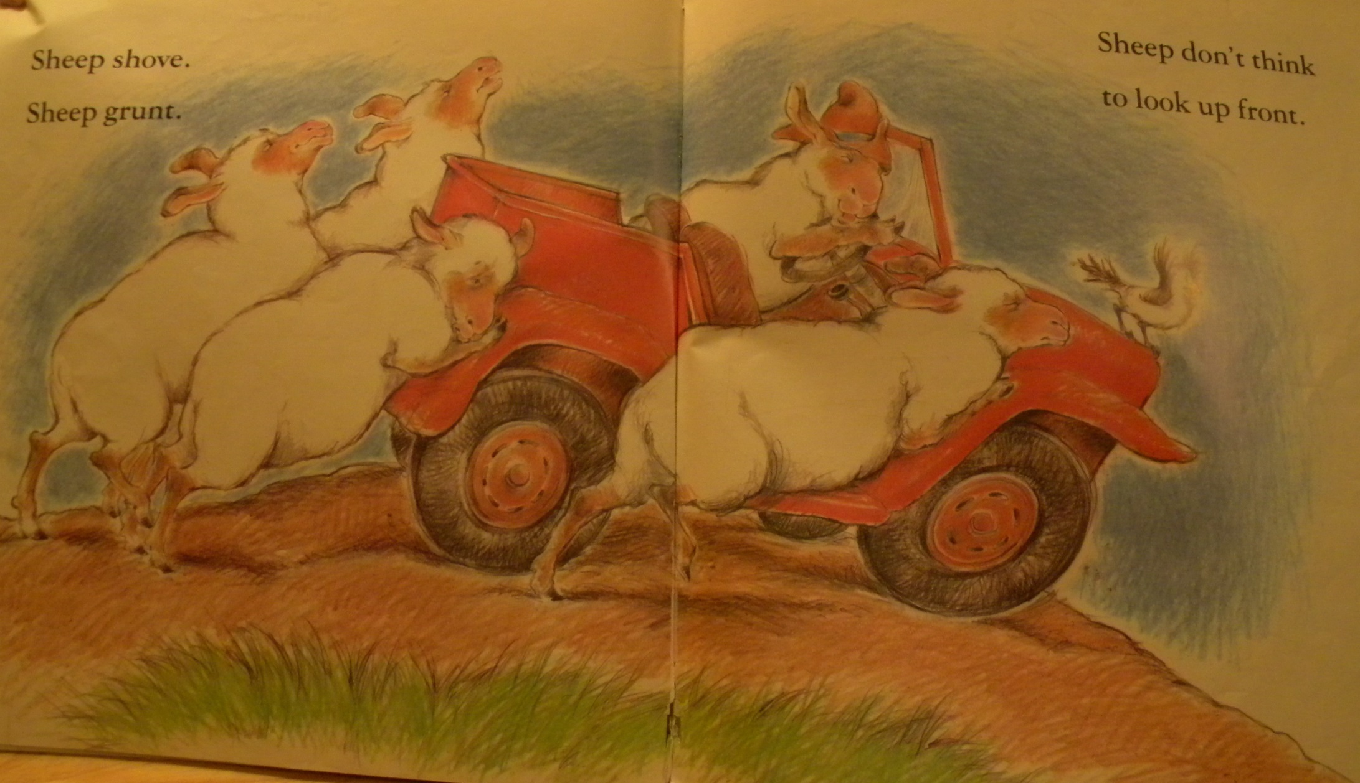

Slide 74
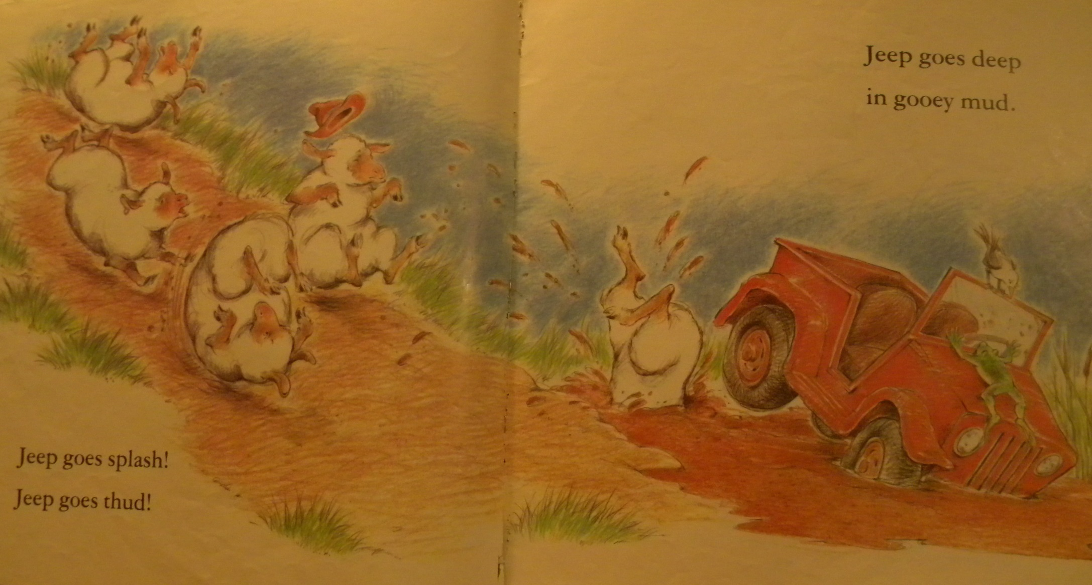

Slide 75
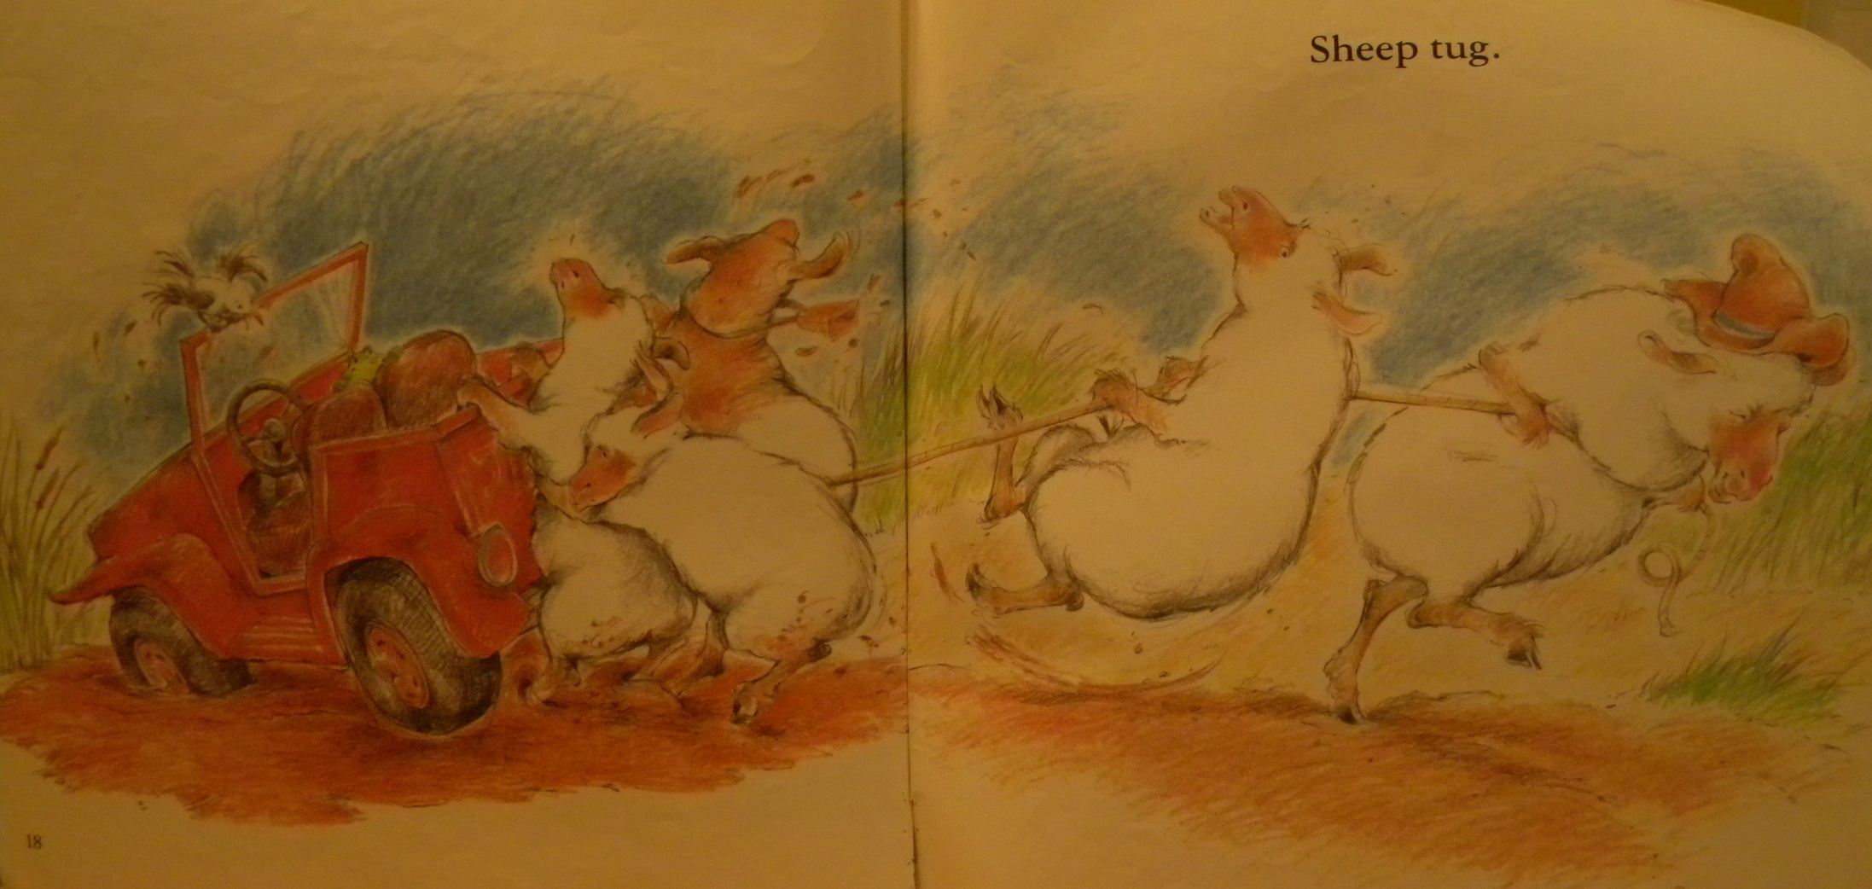

Slide 76
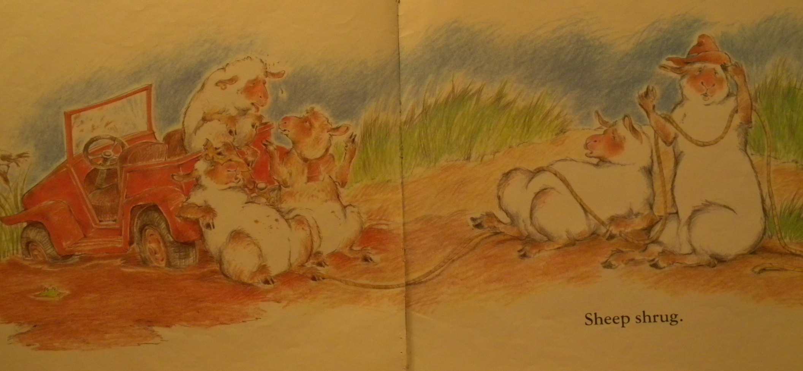

Slide 77
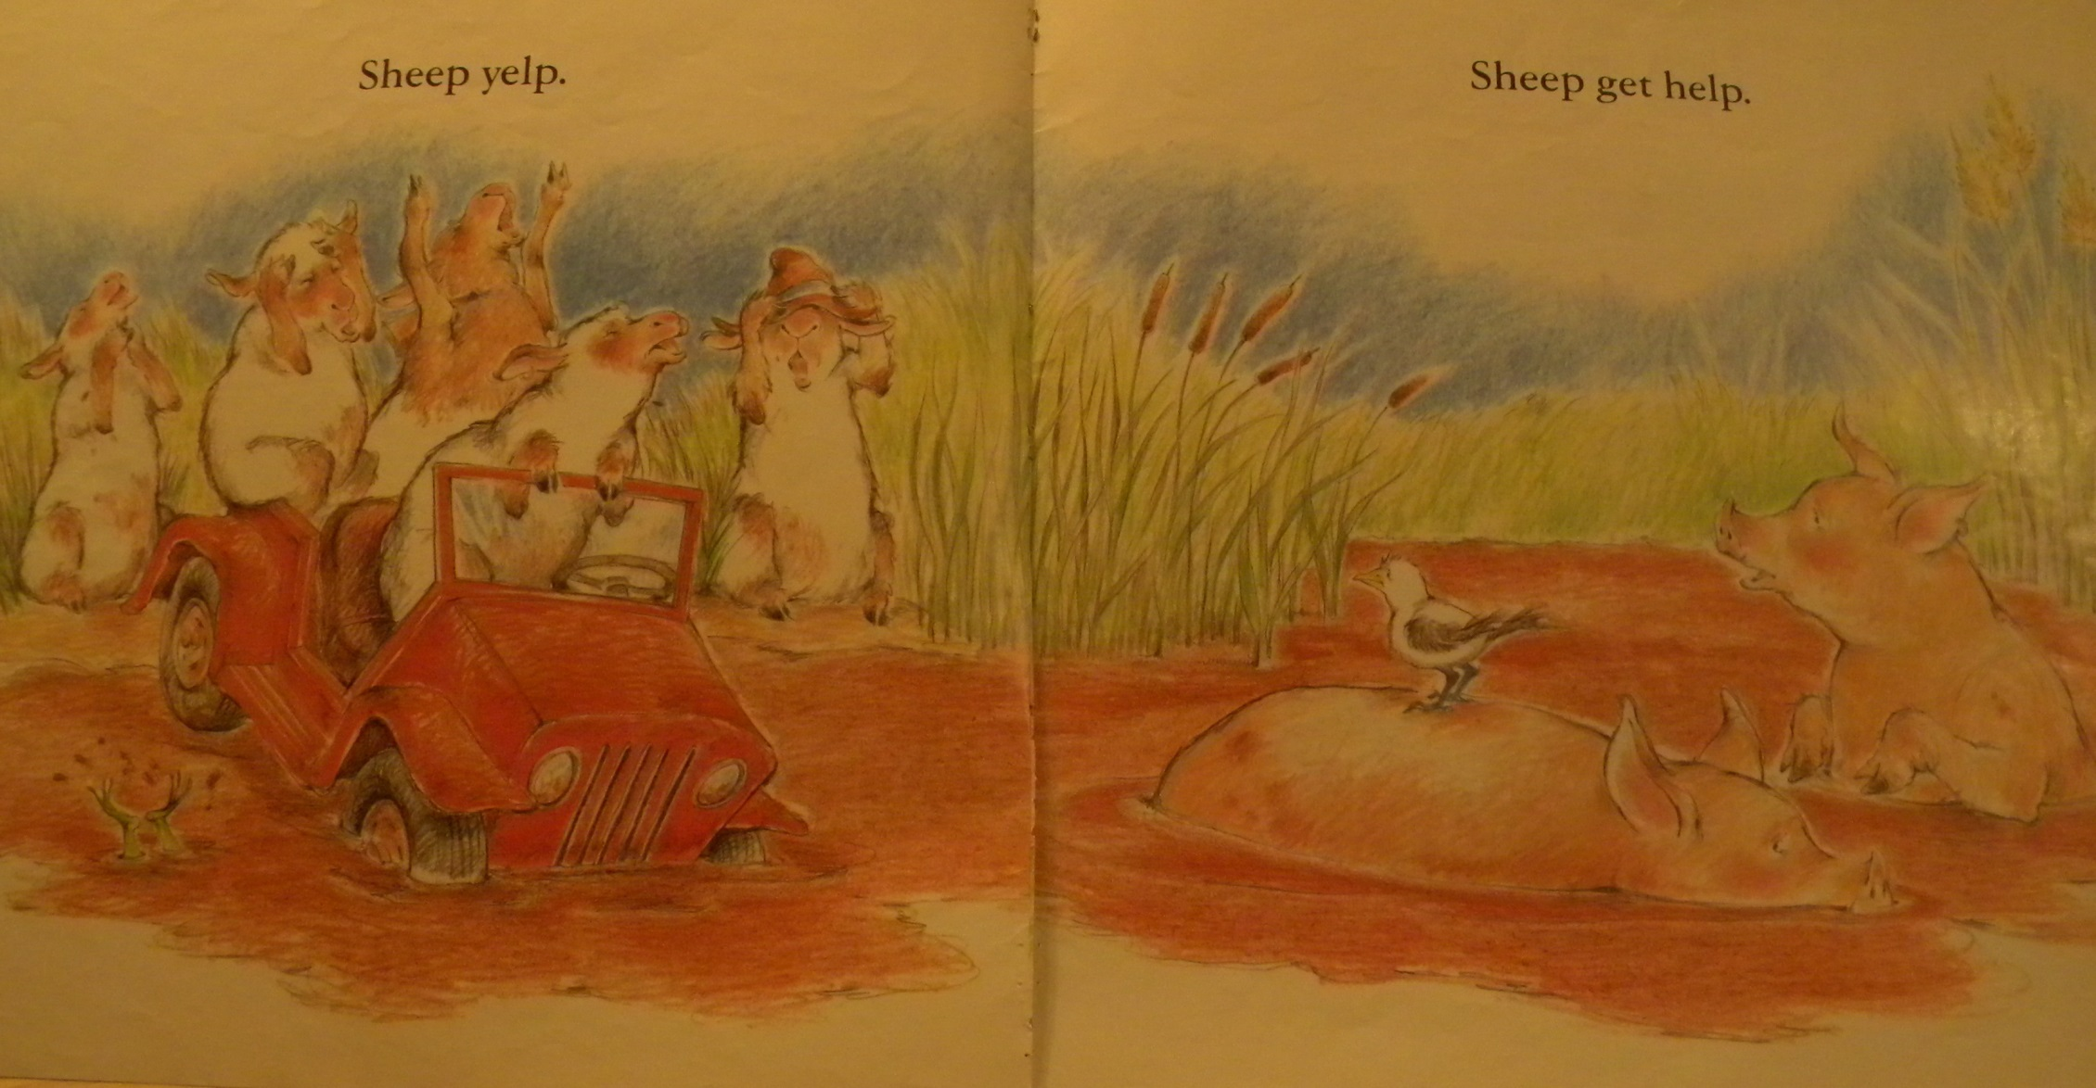

Slide 78
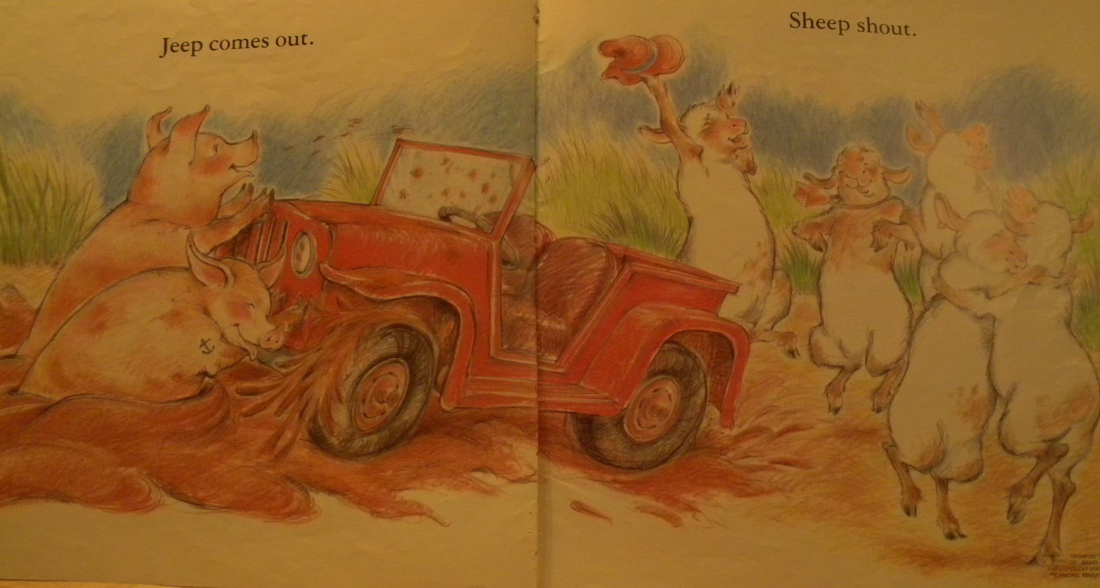

Slide 79
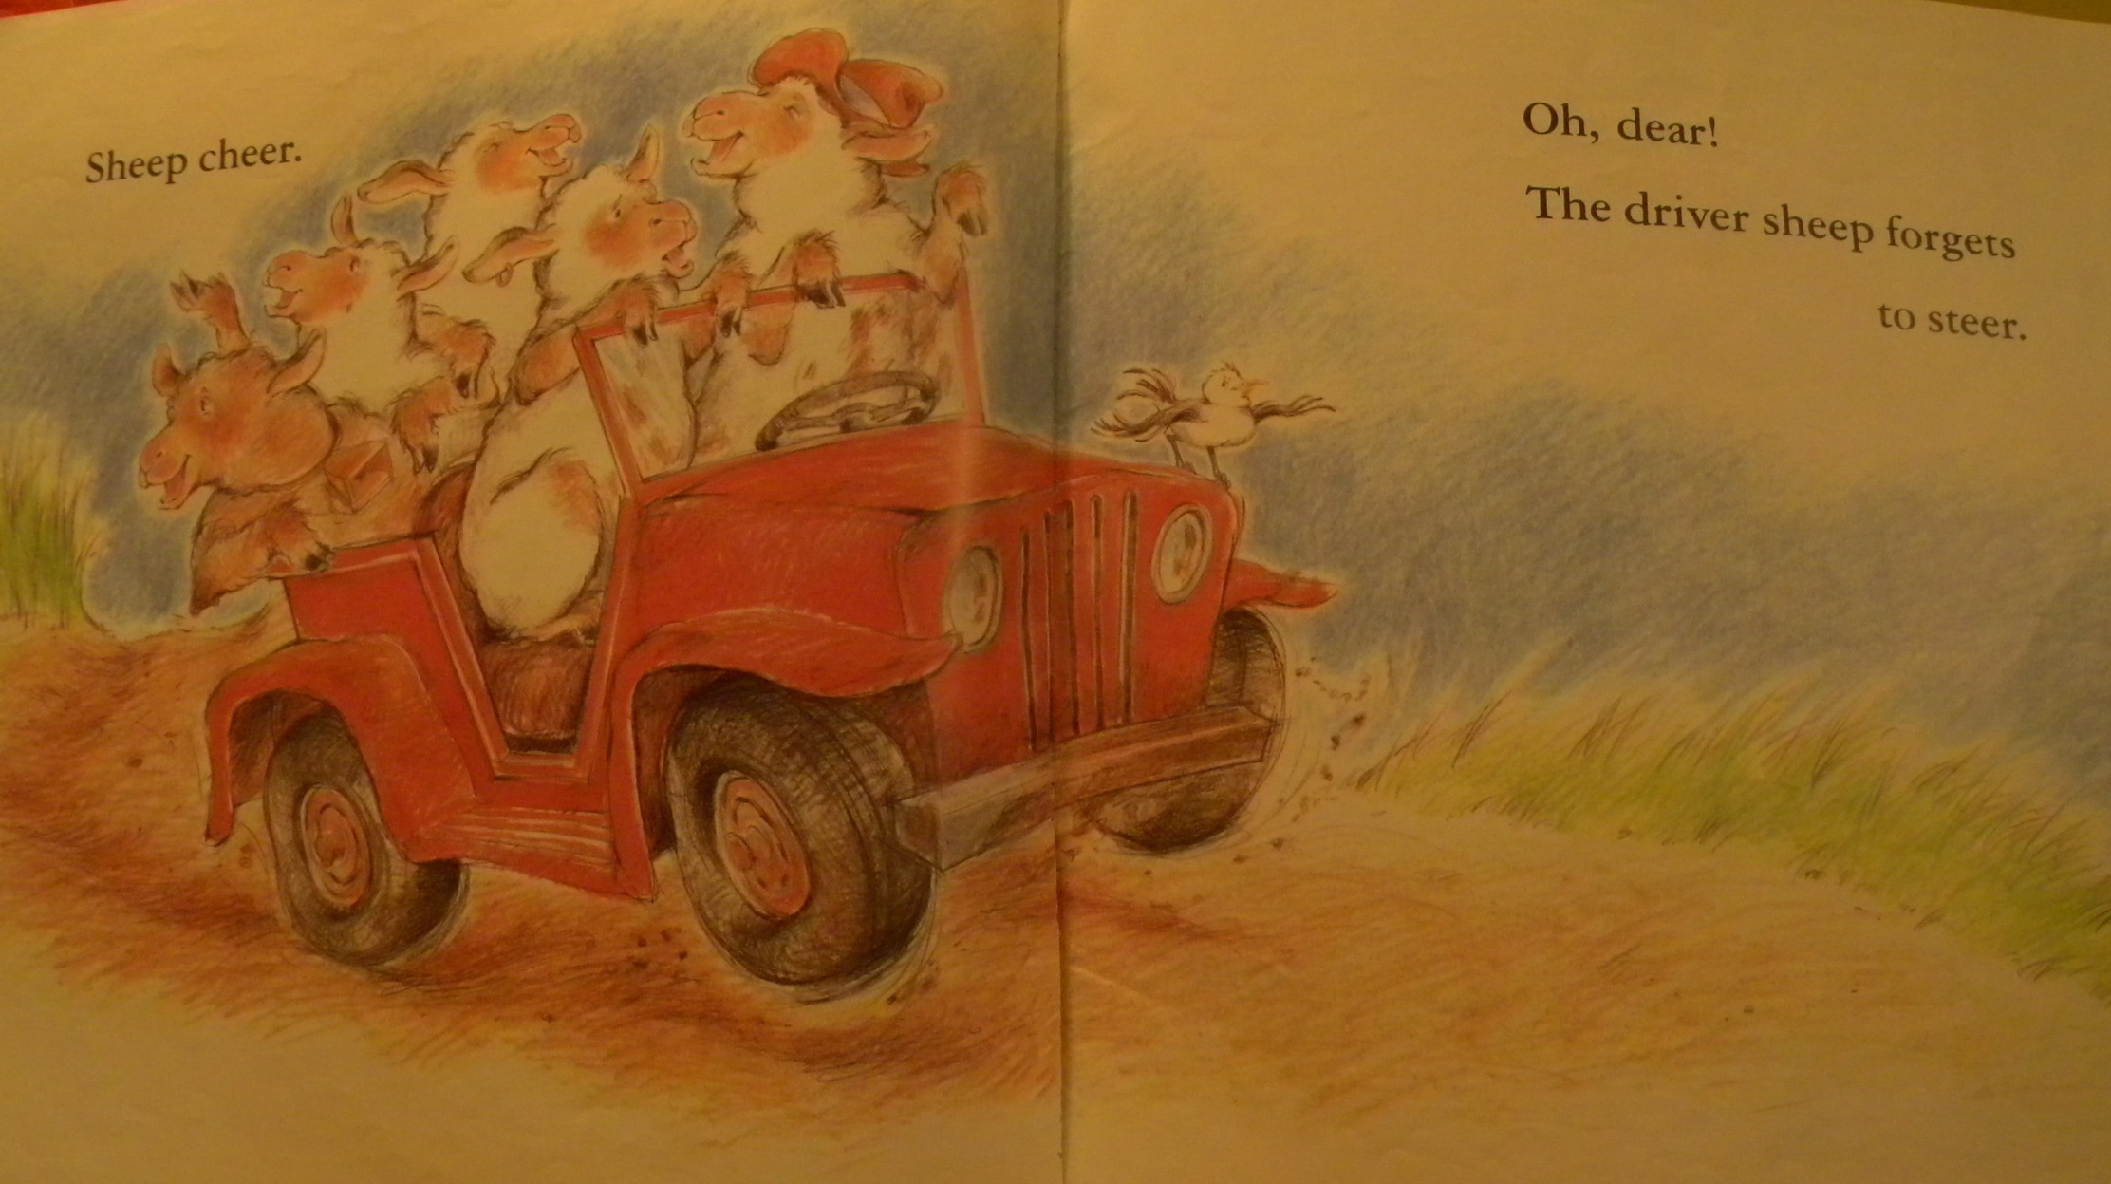

Slide 80
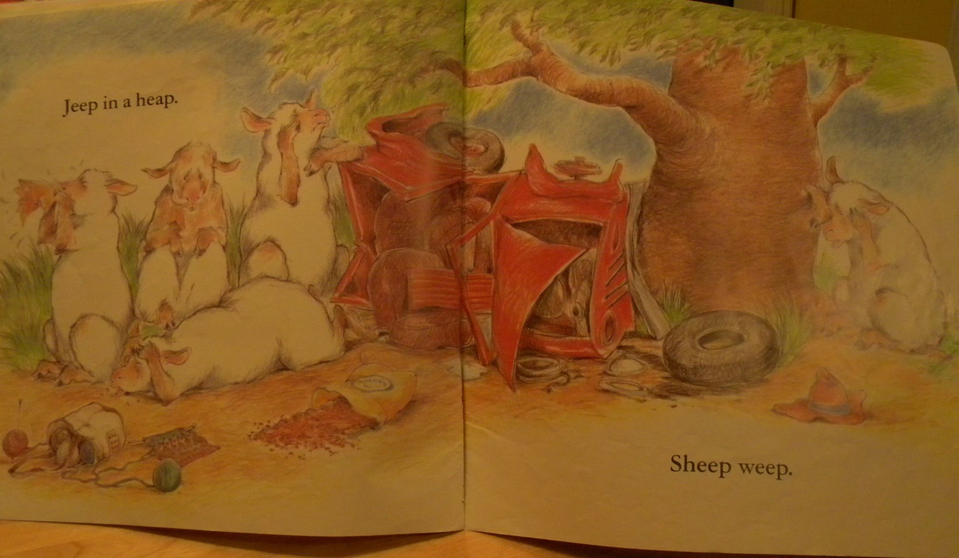

Slide 81
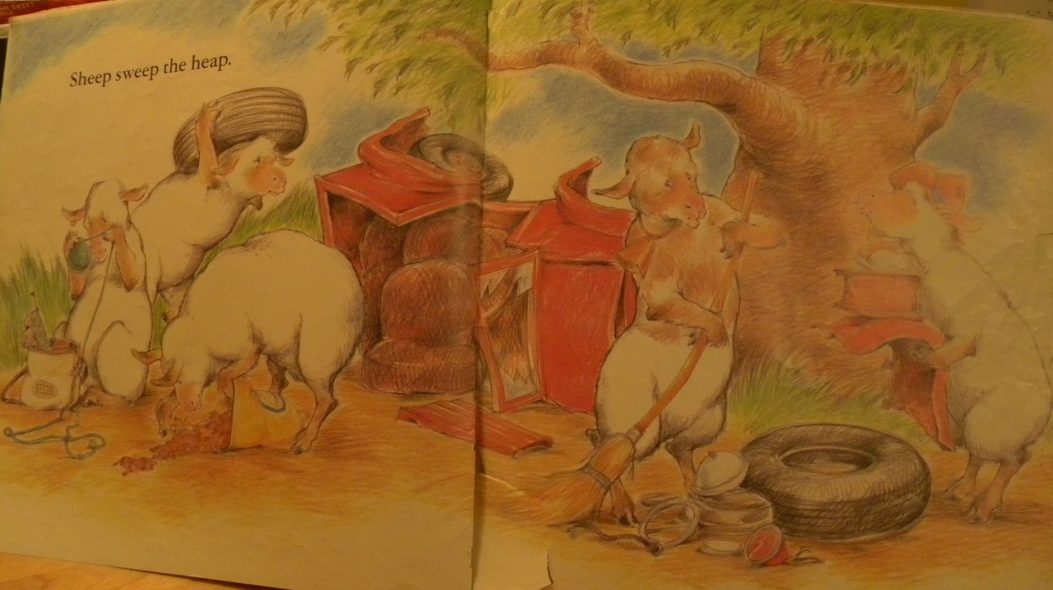

Slide 82
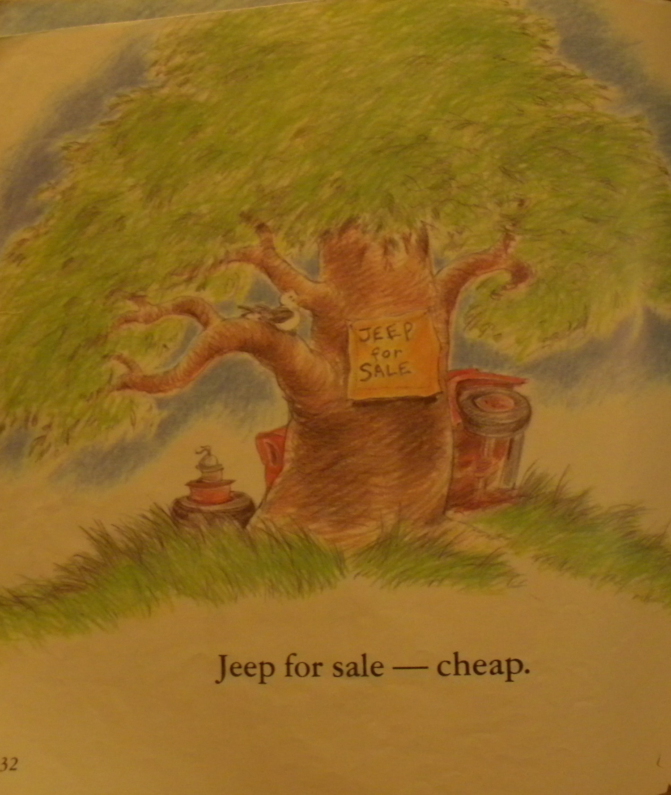

Slide 83
What is a force?
What can forces do?
Is gravity a force?
How do you know?
What is motion?

Slide 84
What is a force?
A force is a push or a pull

Slide 85
What can forces do?
Forces can make things move.
Forces can make things speed up and slow down.
Forces can make things change directions.
Forces can make things go back and forth and around and around.

Slide 86
Is gravity a force?
Yes

Slide 87
How do you know?
Gravity pulls all objects toward the Earth.

Slide 88
What is motion?
Motion is a change in the position of an object.
When you say something has moved, you are describing its motion.

Slide 89
Force and Motion T-Chart
Name examples of Motions and Forces from the book

Slide 90
Force and Motion T Chart
:
:

Slide 91
Force and Motion T Chart
:
:

Slide 92
Sentence Cards
Cut out cards
Read Forces and Motion Sheet (page 5)
Create different sentences from the cards

Slide 93
Sheep push jeep
Force causes motion
Gravity pulls sheep
Gravity pulls jeep
Friction slows jeep

Slide 94
NGSS/KCAS for Science
Code | DCI
PS2.A | Forces and Motion
PS2.B | Types of Interactions
PS3.C | Relationship between energy and forces

Slide 95
`

Slide 96
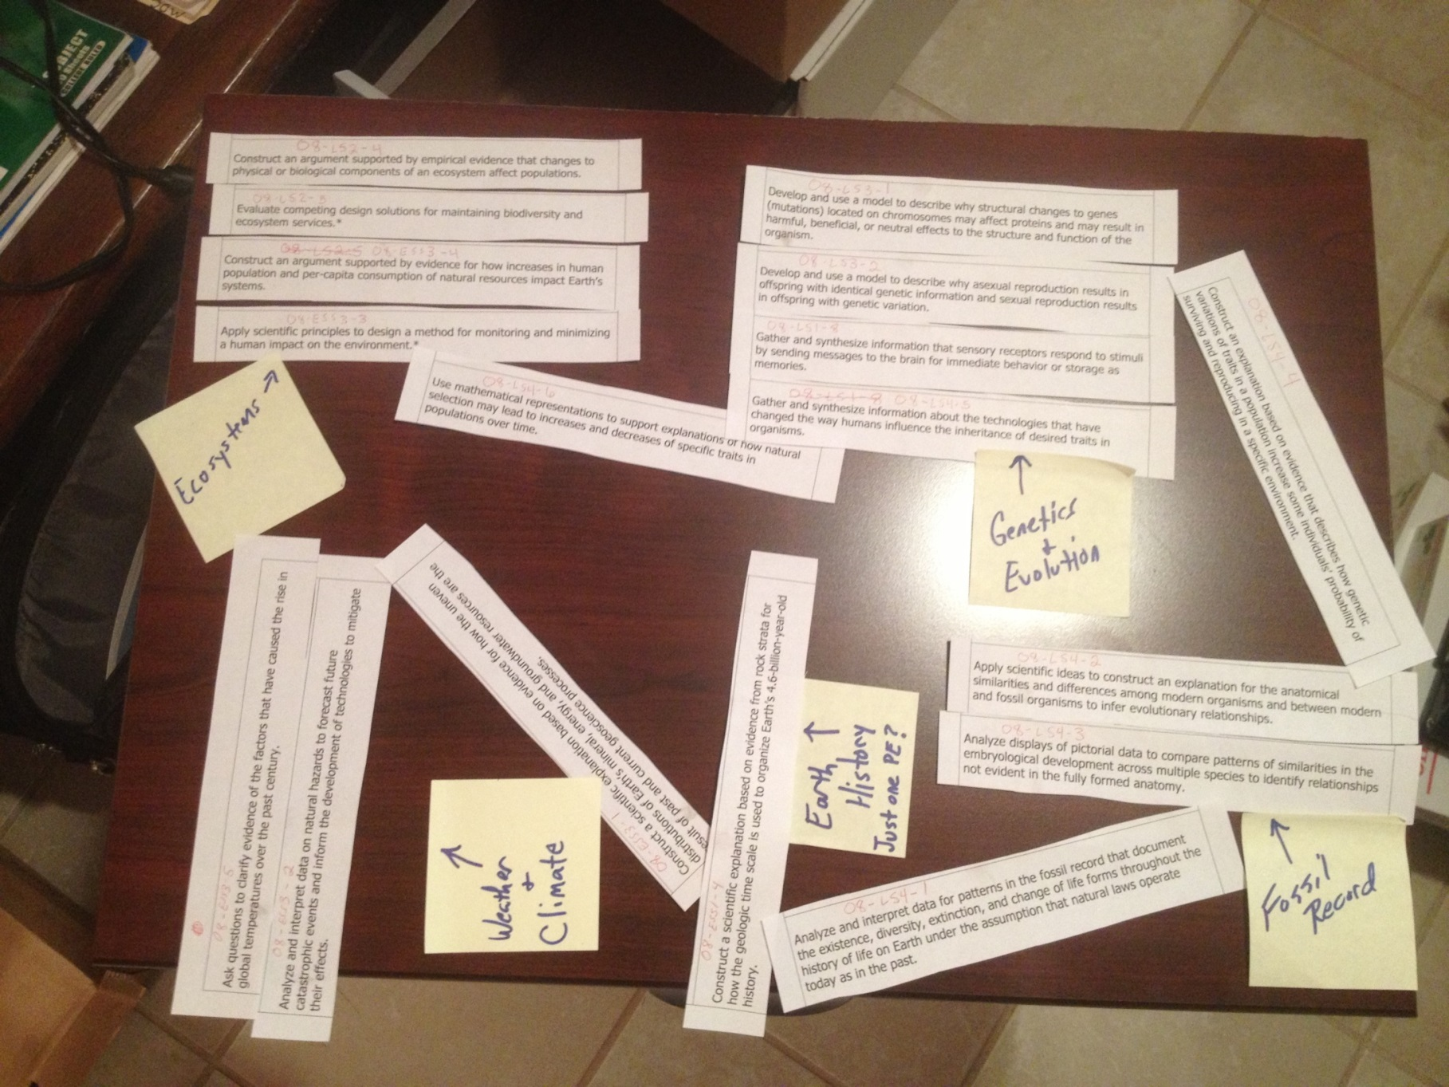
Bundling Performance Expectations

Slide 97

Your Grade?
Your School?
Your District?
Please get into groups with your grade level

Slide 98
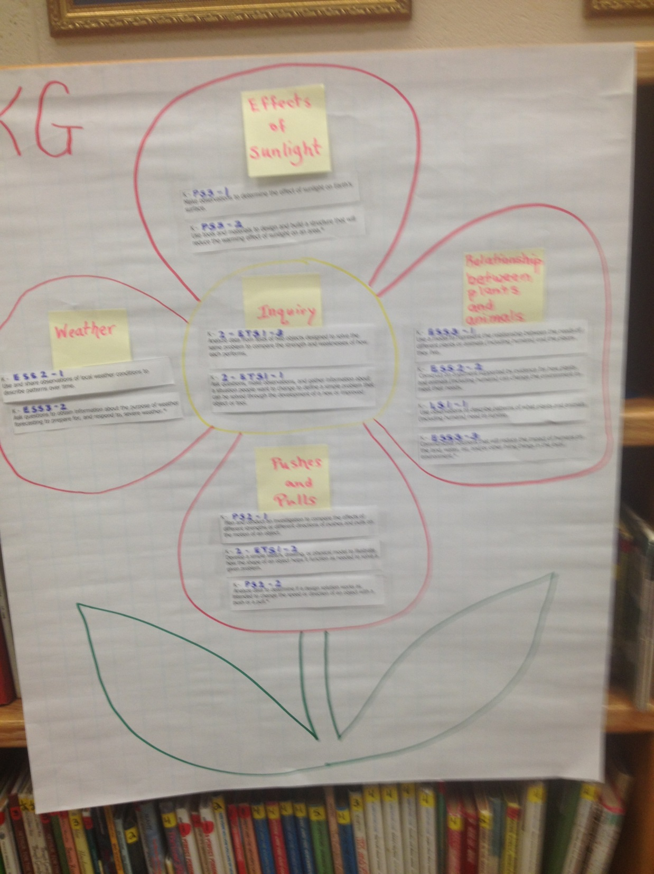

Slide 99
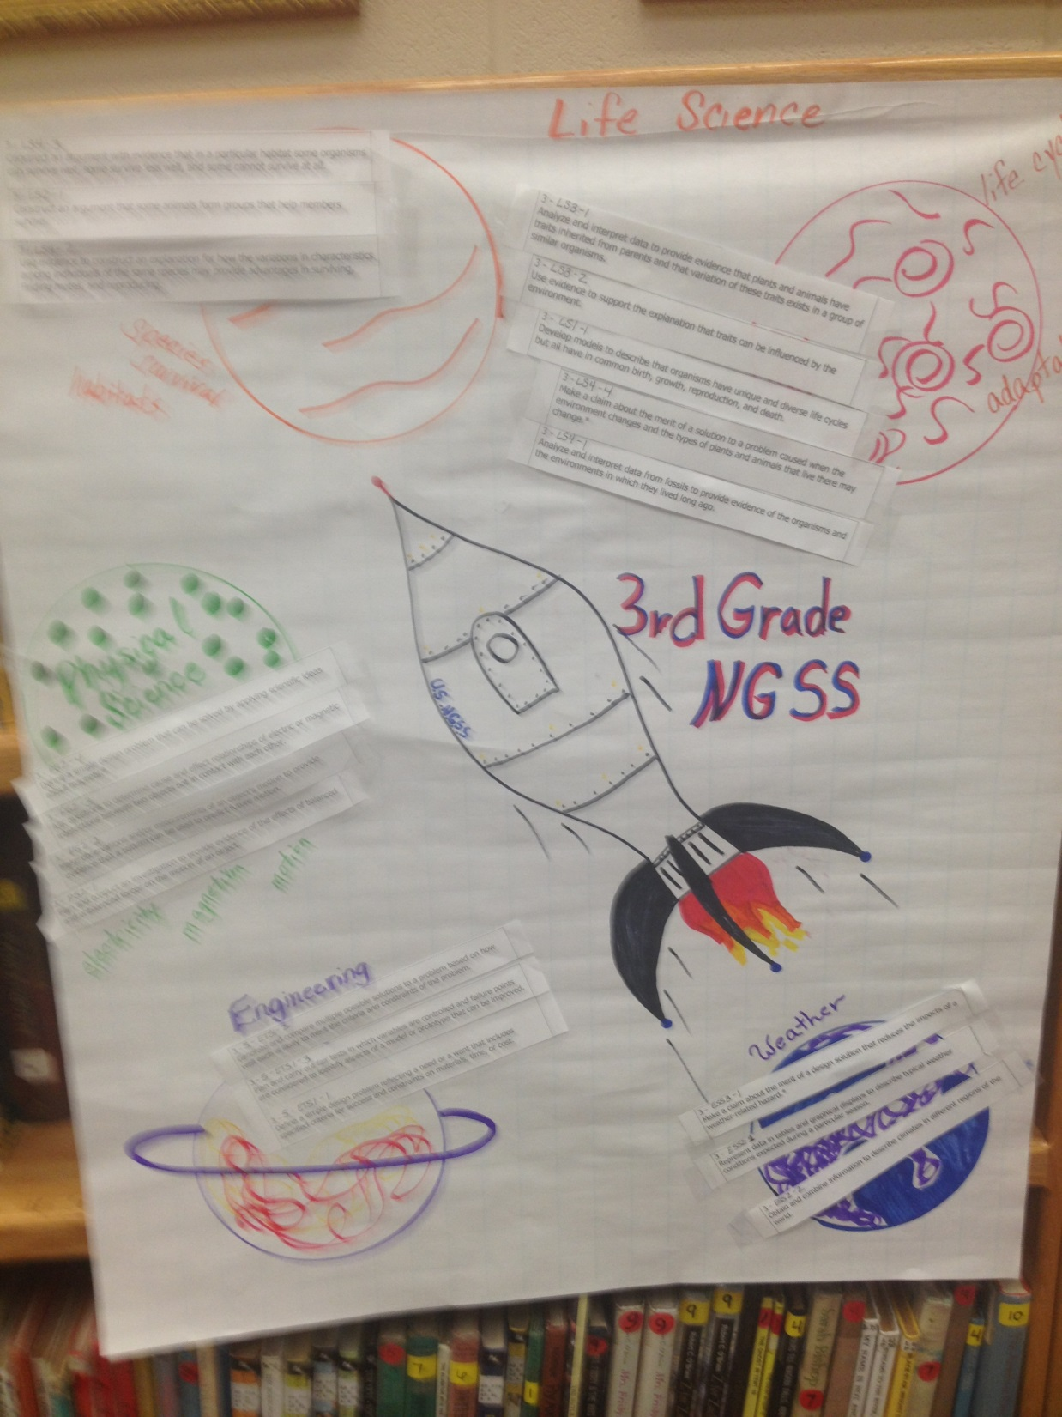

Slide 100
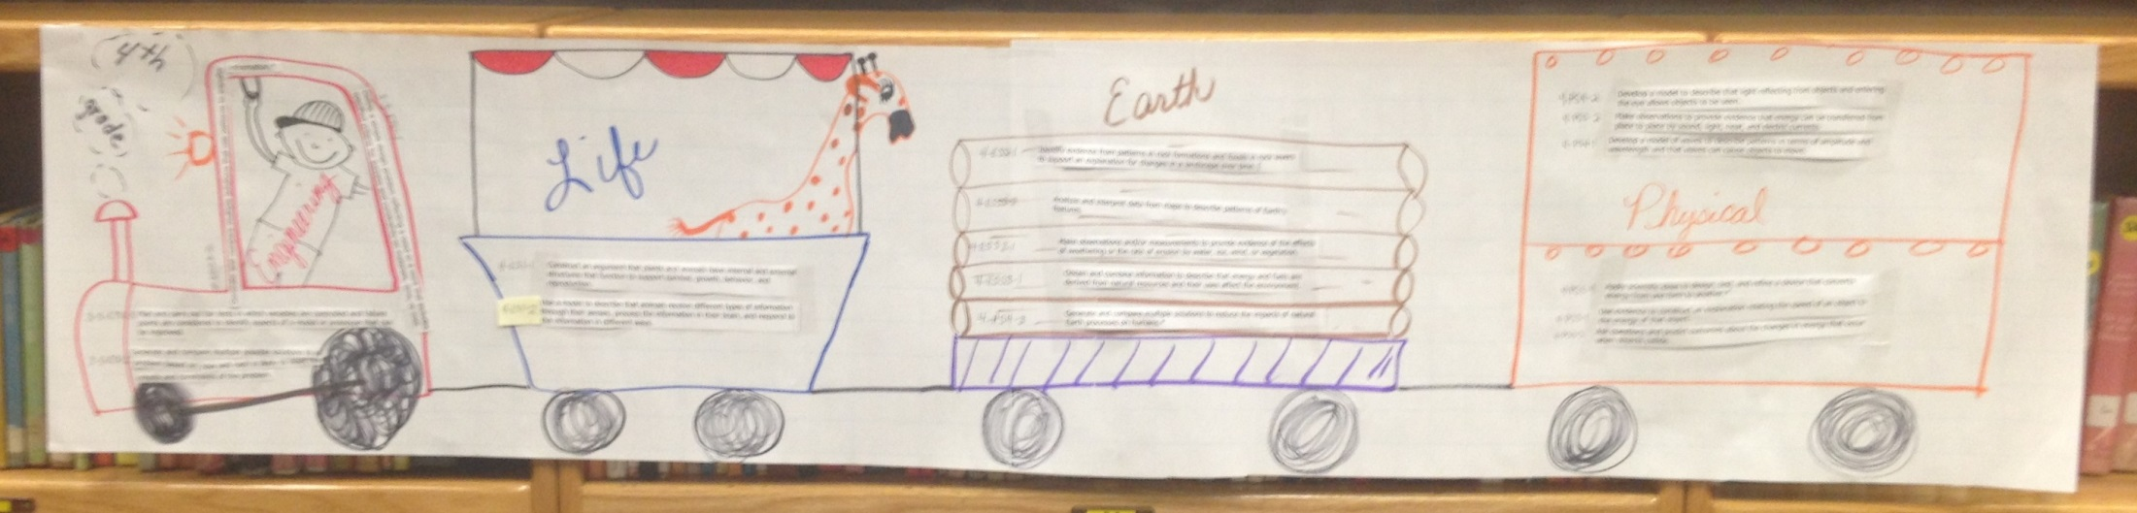

Slide 101
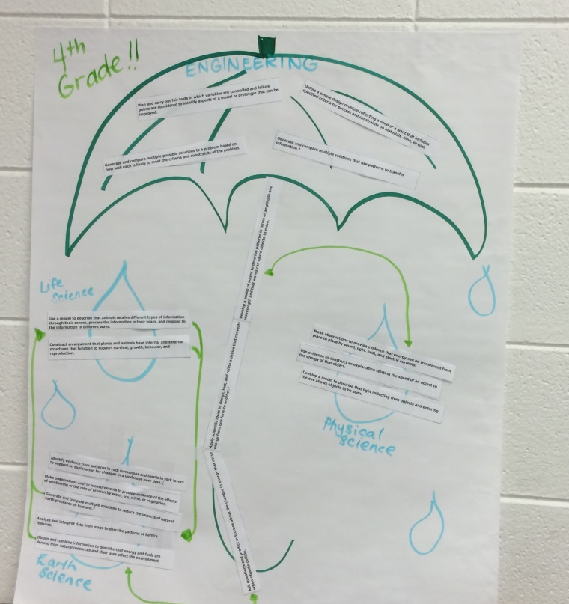

Slide 102
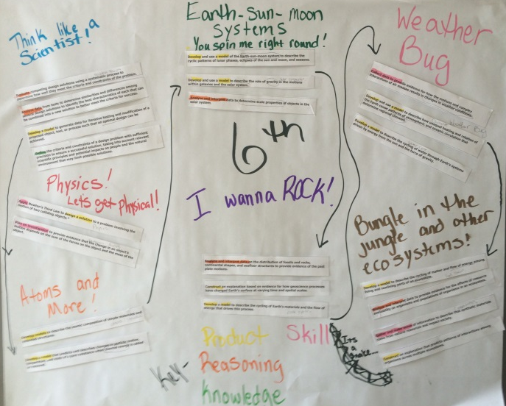

Slide 103
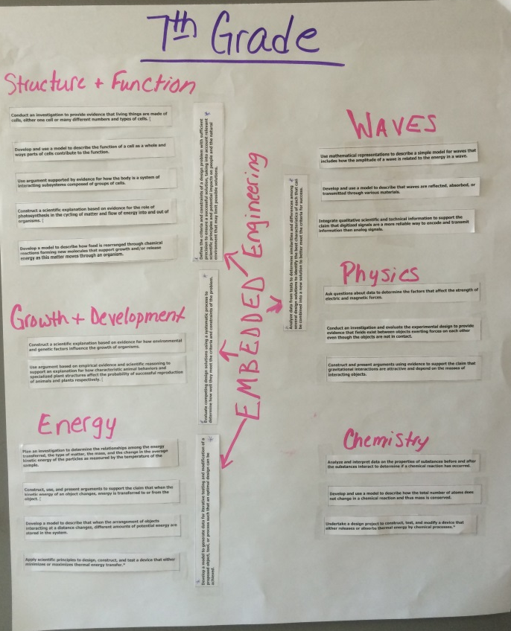

Slide 104
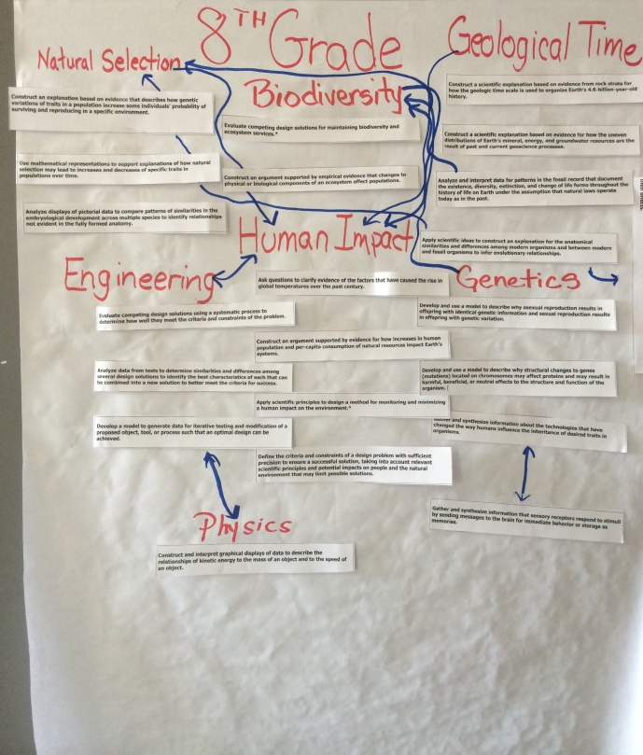

Slide 105
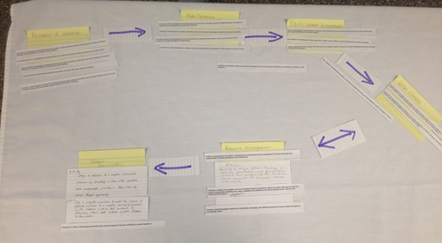

Slide 106
How Do They Go Together?
Thinking About Bundling
Close ipads, laptops, phones and Standards books! NO CHEATING!
Cut each into individual strips
Lay out the strips and begin reading the Performance Expectations
Start thinking about how they fit together; where do they overlap? What PE’s will be bridges to other concepts?
Spread Out – you will need some elbow room

Slide 107
Once partners have come to consensus, tape the strips to chart paper and use markers to write in additional information such as unit names or cross-discipline ideas

Slide 108
Gallery Walk
Look for the flow
Find the connections
What’s Your Story??

Slide 109
Complete your story by adding the PE codes to each strip
Take out your KCAS for Science Book
Write the correct Performance Expectation code on each strip
Take a picture of your finished product

Slide 110
Online Resources

