Slide 1
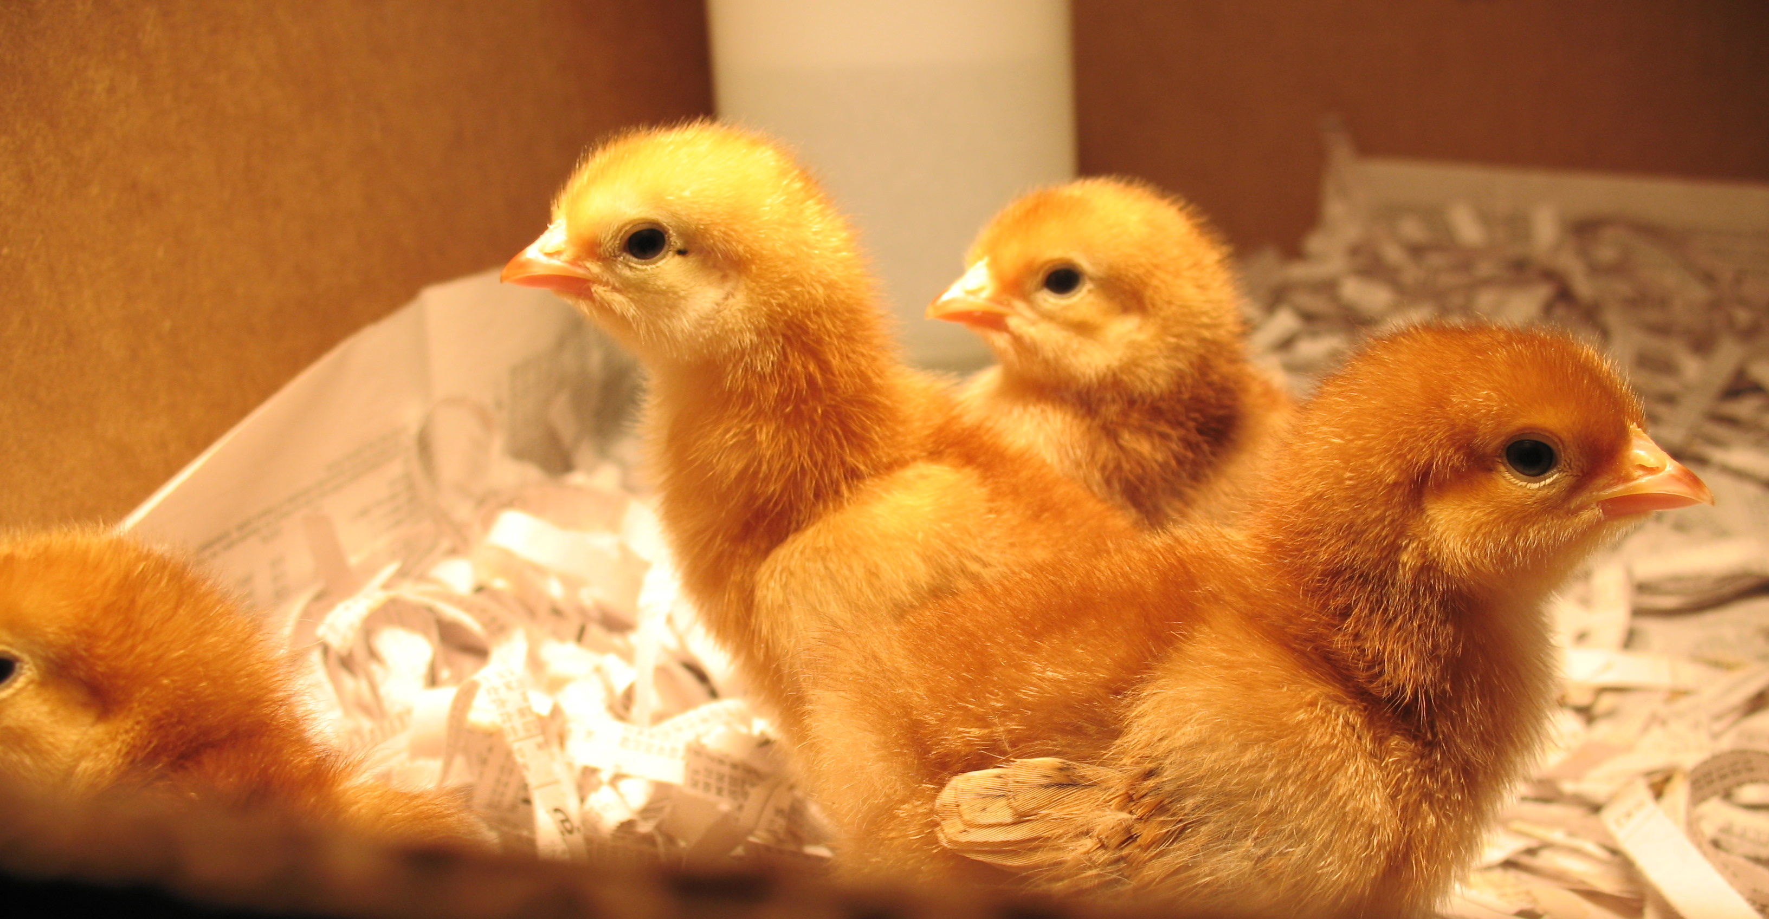

Slide 2
Define the problem

Slide 3
What considerations do you have to factor into a design for a shipping container?

Slide 4
Using the available materials, available draw your design for a shipping container
Share designs with your colleagues
Refine your drawings

Slide 5
Build your prototype
Share your prototype with the group
Ecopacking Inc. has seen your prototype and like your design. They agree to buy your design for an appropriate price. They also indicate that if you can replicate the design with environmentally products there will double your commission. Build your redesign.

Slide 6
Evaluate your design
Availability of water
Freshness of flower
Dryness of container interior
One partner will take the container home. After 24 hours, open the container. Take a picture of the flower and the container itself and send it to your partner.

Slide 7
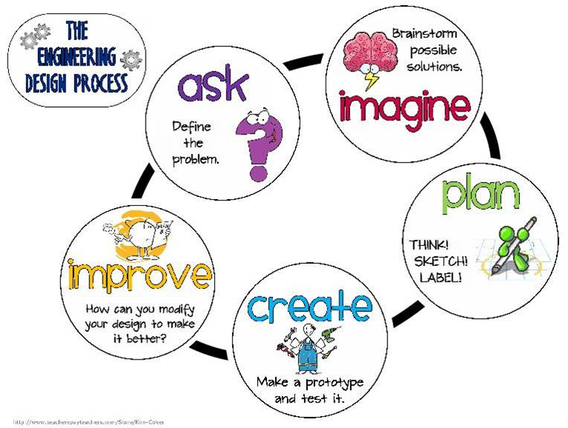

Slide 8
Kentucky Academic Standards
How would this activity look in a middle/high school classroom?
Taken from Try Engineering, http://tryengineering.org/lesson-plans
Notes:
Difference between engineering and science

Slide 9
Evaluate this experience using the rubric for Constructing Explanations and Designing Solutions

