Slide 1
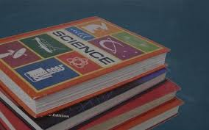
Book Study Update

Slide 2
SUMMER Regional Meetings ???

Slide 3
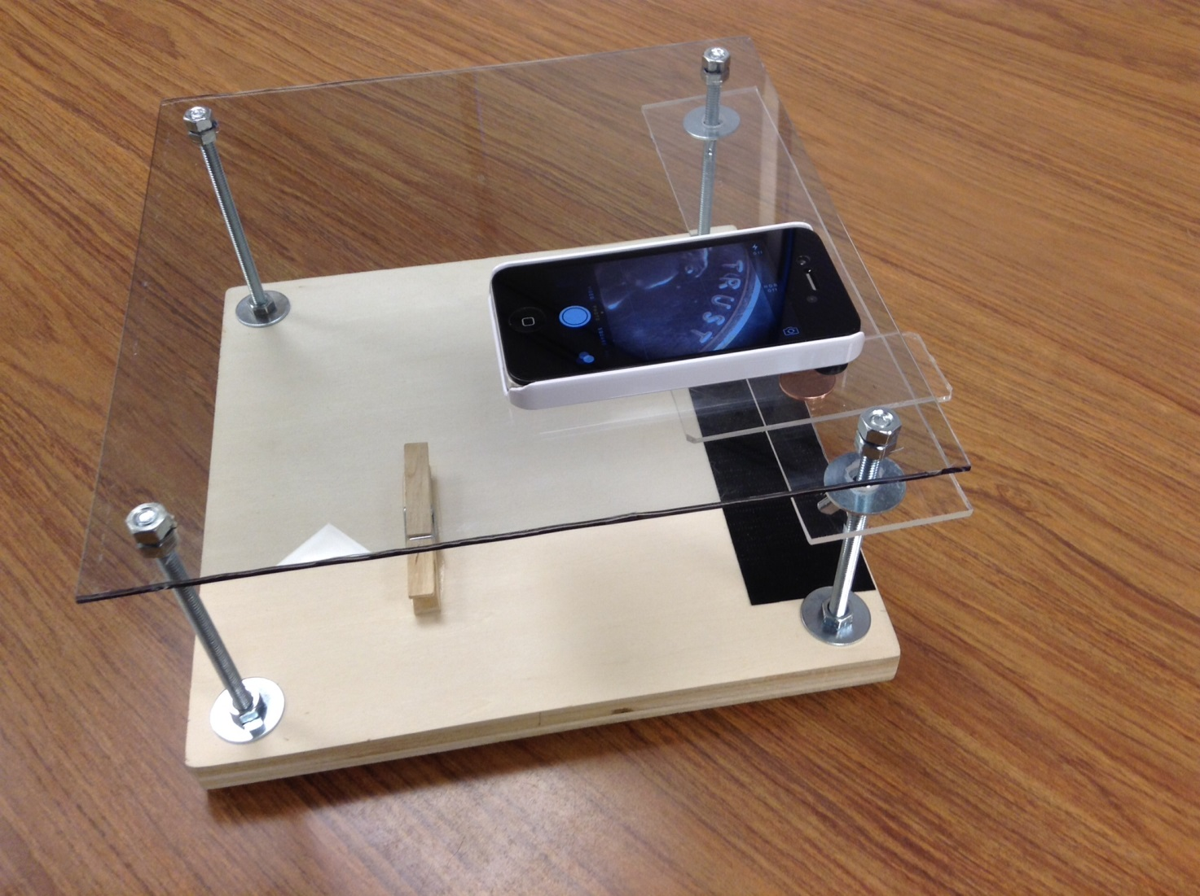
Each table group has an “iPad/iPhone microscope

Slide 4
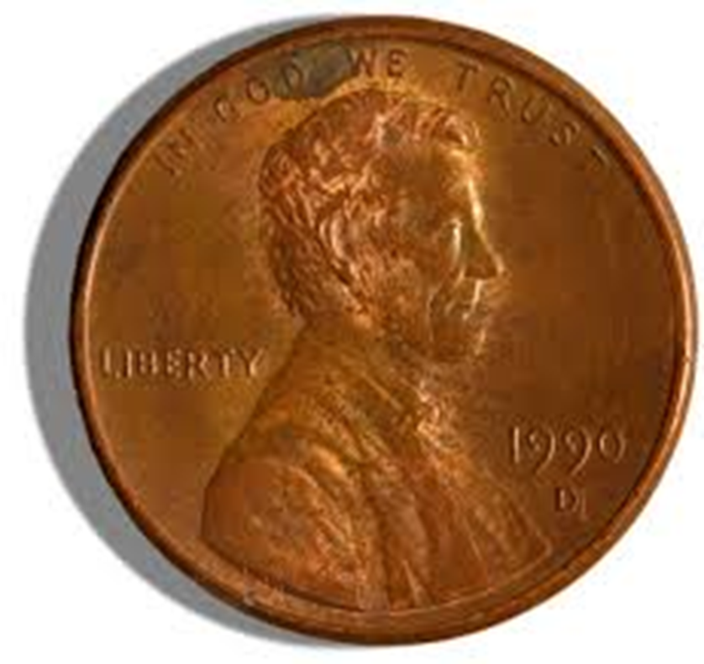
Each group should have a penny

Slide 5
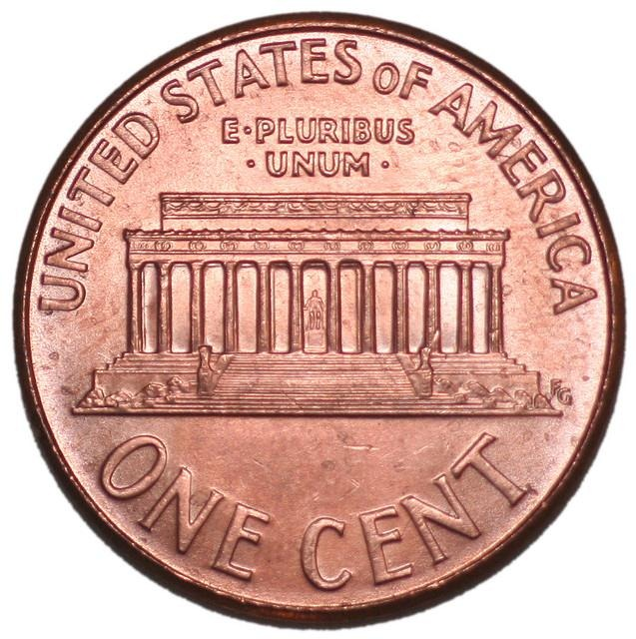
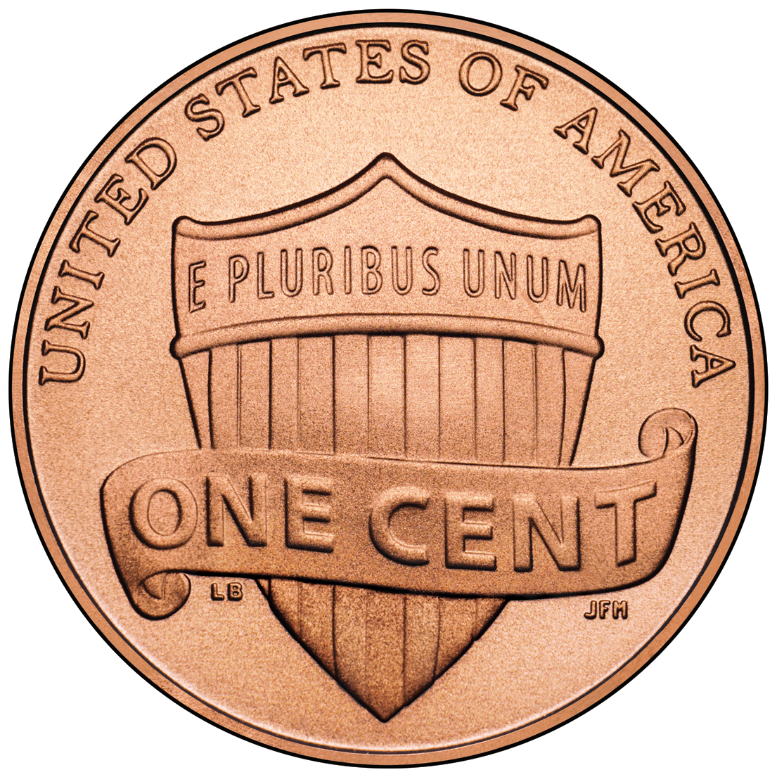
Not just any penny

Slide 6
FINDING ABE LINCOLN

Slide 7
iPad/iPhone Microscope
What are the following pictures?

Slide 8
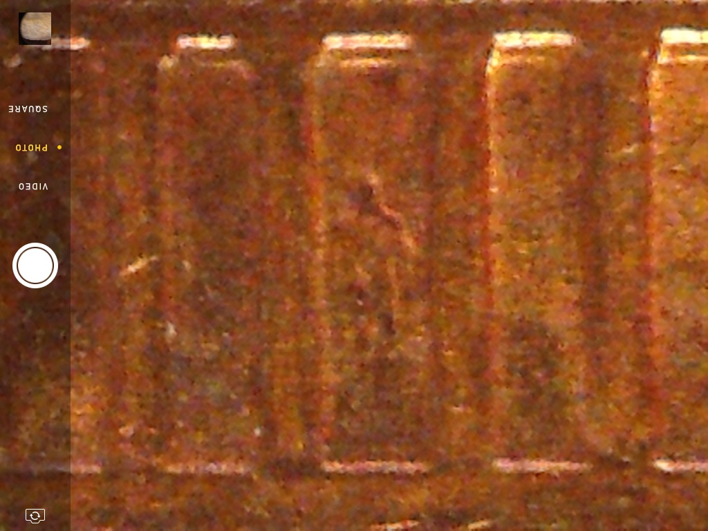

Slide 9
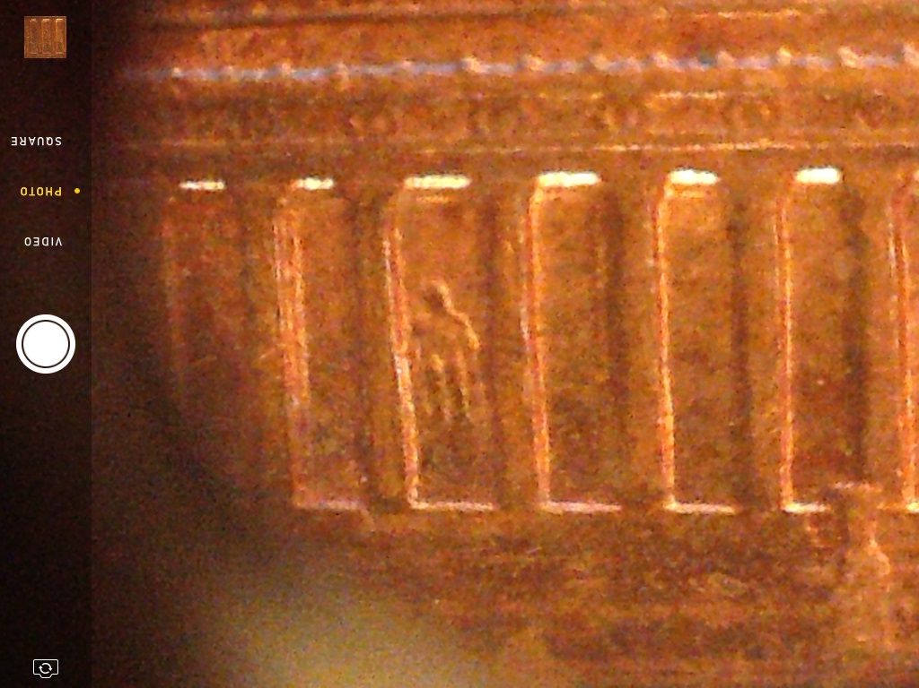

Slide 10
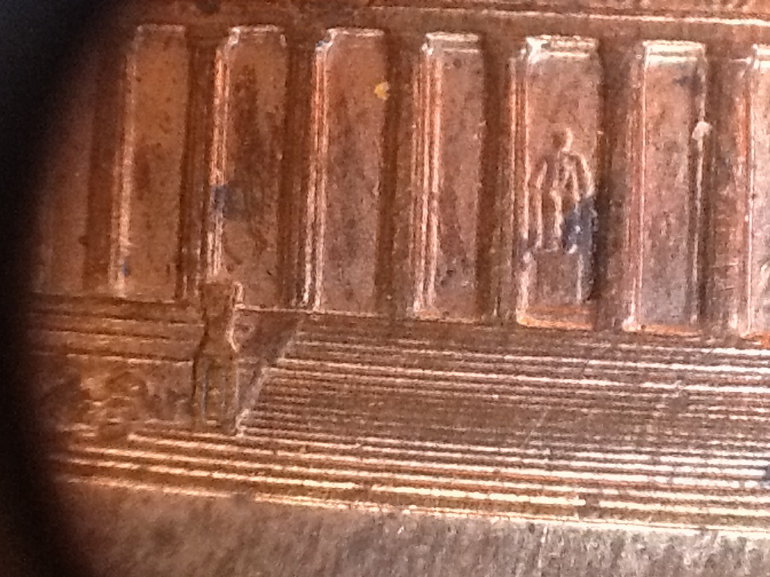

Slide 11
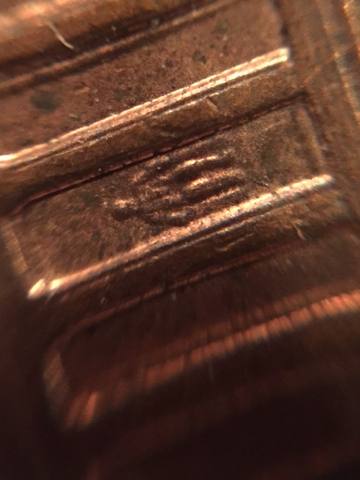
New lens

Slide 12
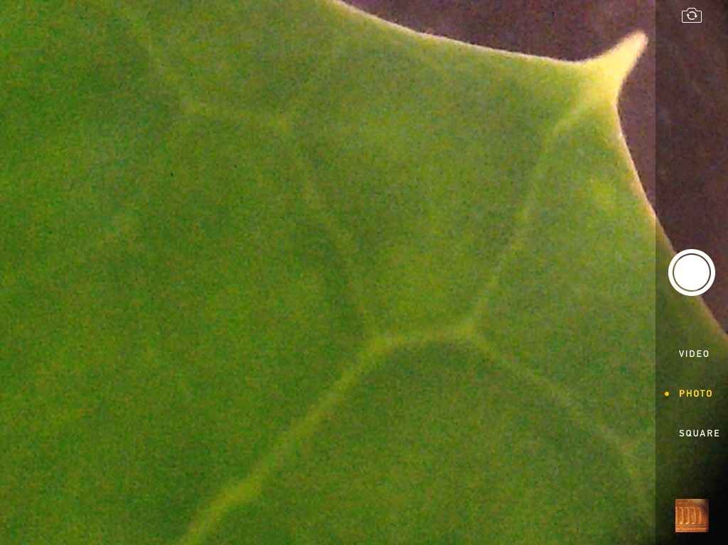

Slide 13
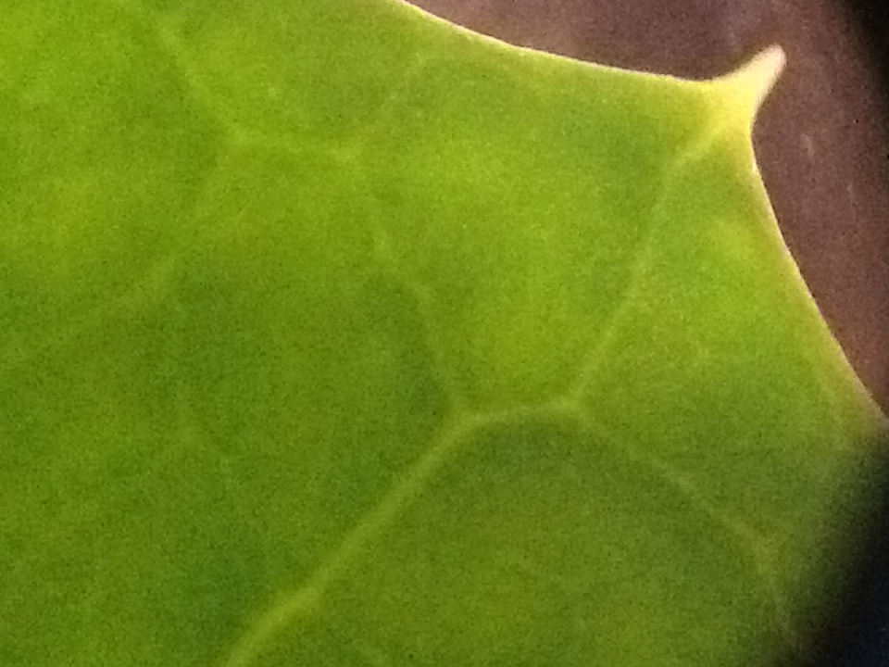

Slide 14
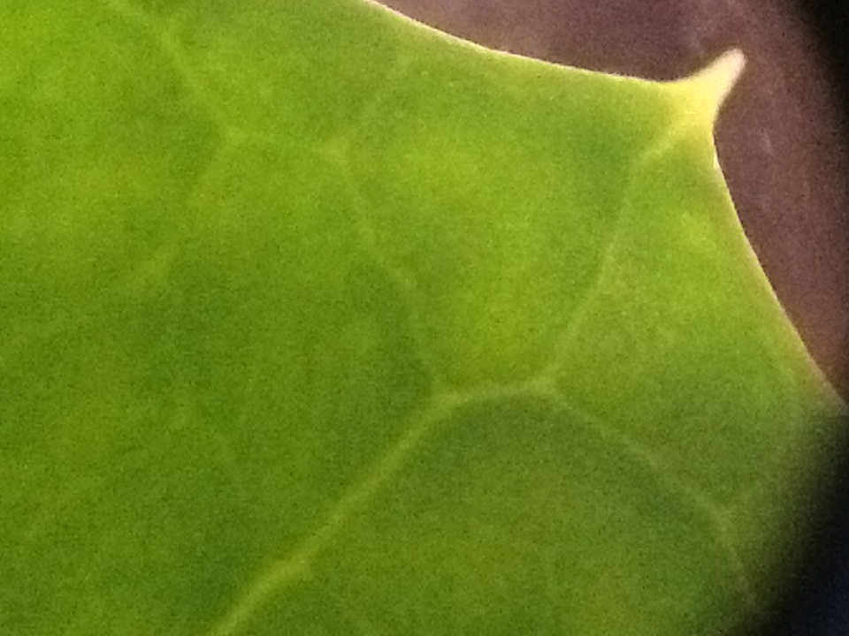

Slide 15
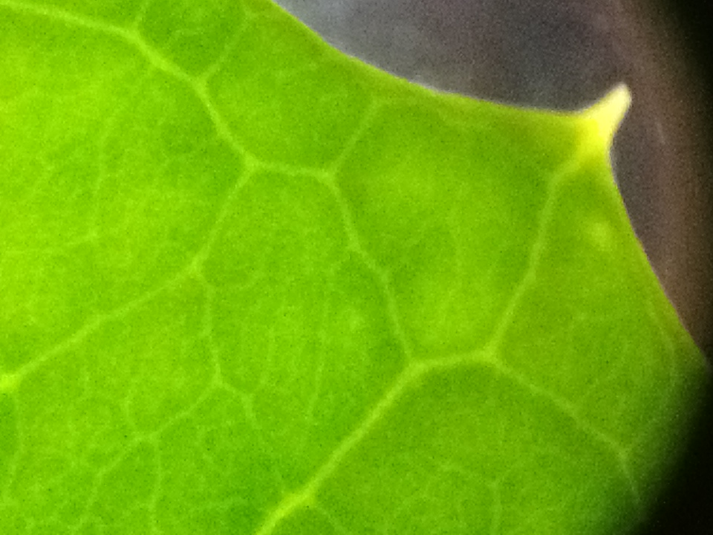

Slide 16
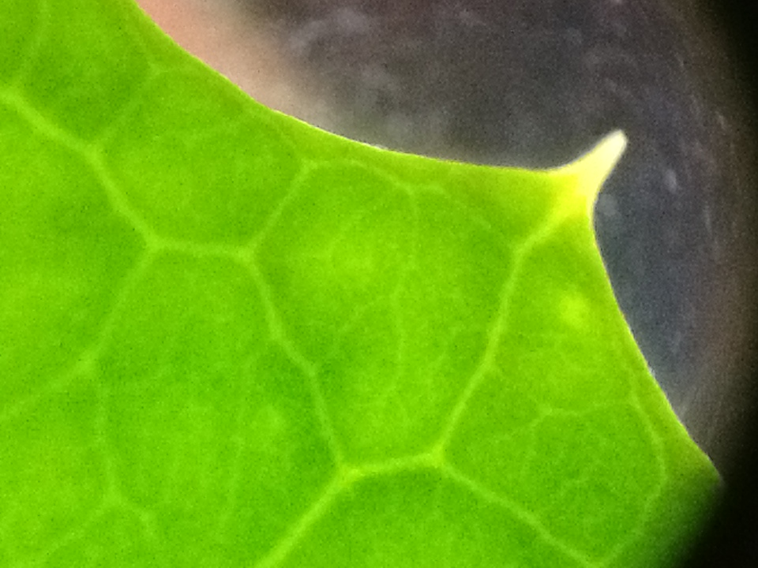

Slide 17
Time to look at some Salt and Sugar Crystals

Slide 18
Once your group understands how to use the microscope get a small sample of both salt and sugar crystals from the materials table.
Observe each sample under the microscope at low and high power. Record any observations about crystal shape, size, color, transparency and any other properties your team believes might help them identify the substance if you were given an unknown sample.
You can also take pictures to use later.

Slide 19
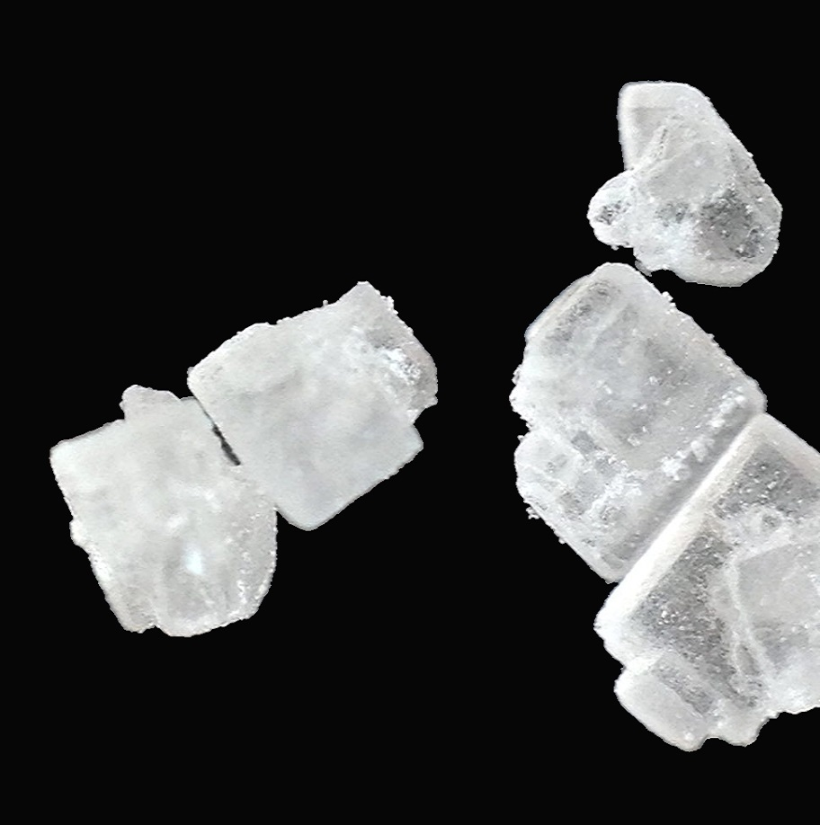
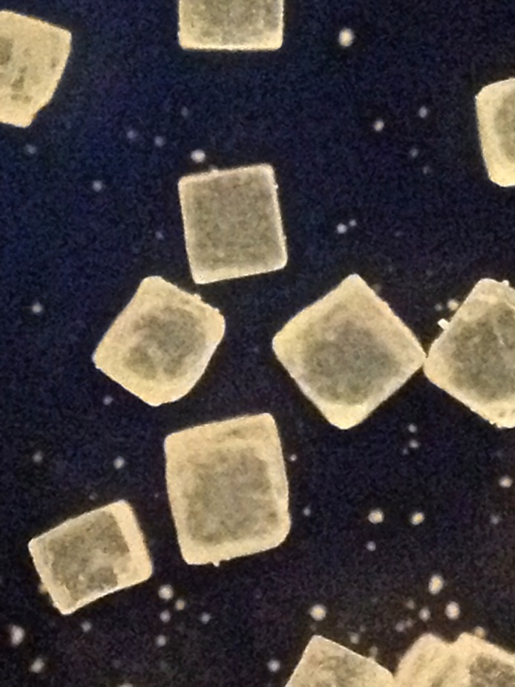

Slide 20
After your team has made all the observations they need of the known salt and sugar samples they should return to the materials table to collect a Test Sample. Observe under the microscope. Then select what is in the Test Sample from the choices below.
The Test Sample is…
A. Salt only
B. Sugar only
C. Salt and sugar only (no unknown substance)
D. Salt mixed with an unknown substance
E. sugar mixed with an unknown substance
F. salt and sugar and an unknown substance
Identify

Slide 21
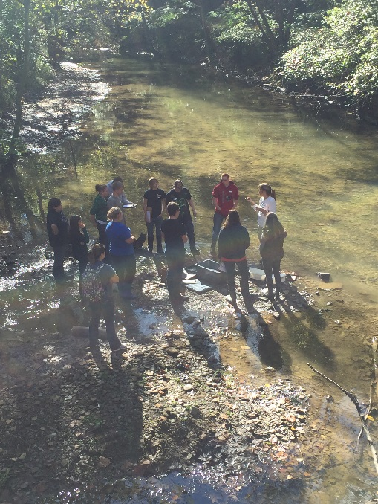
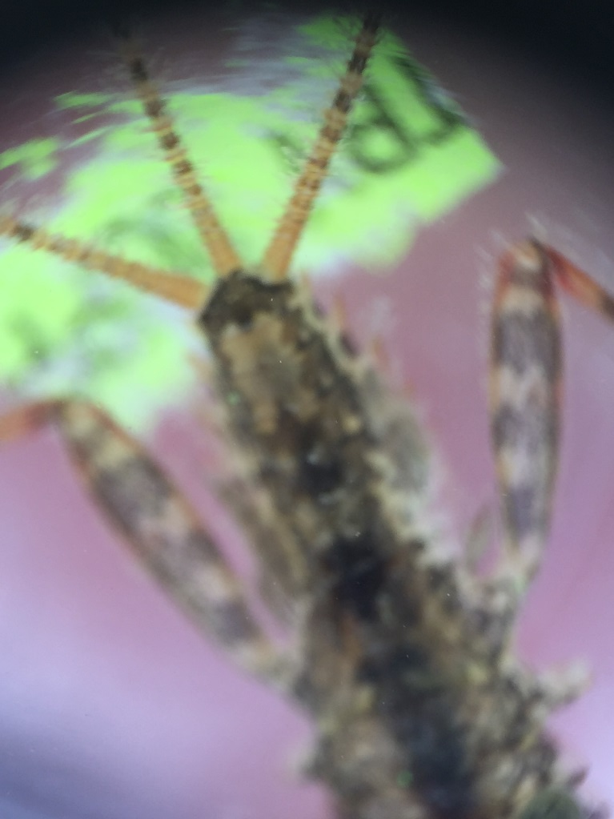
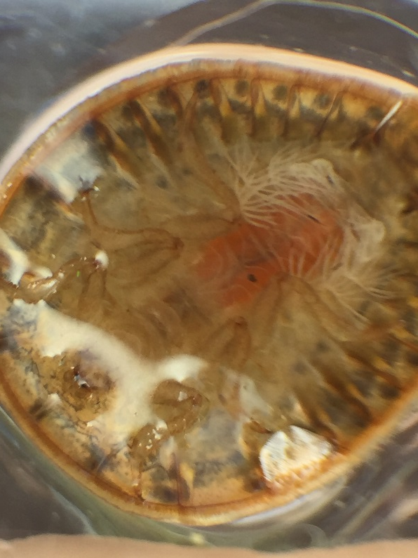
What else can be used with these microscopes?

Slide 22
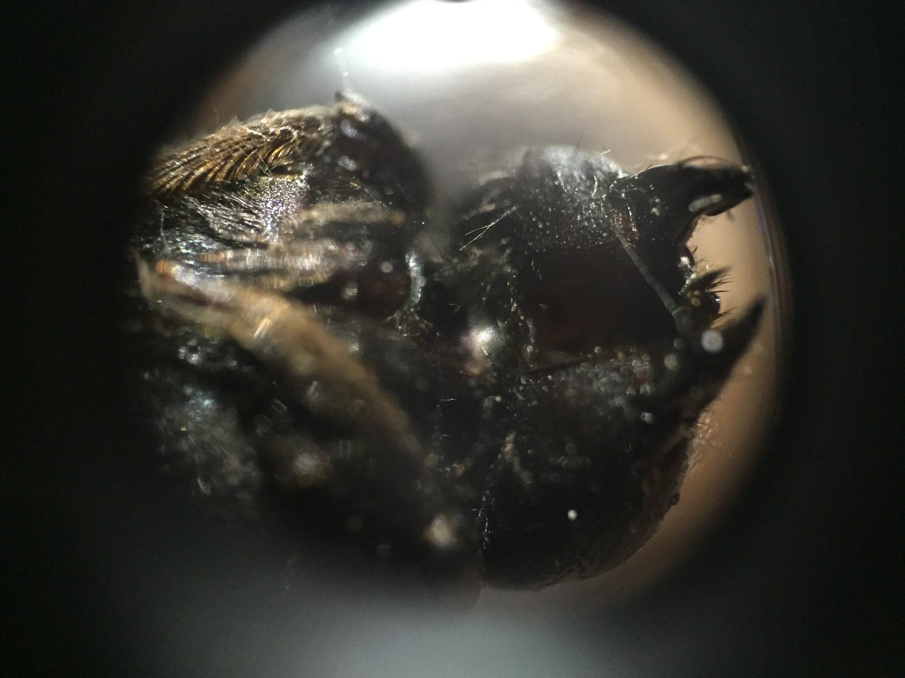

Slide 23
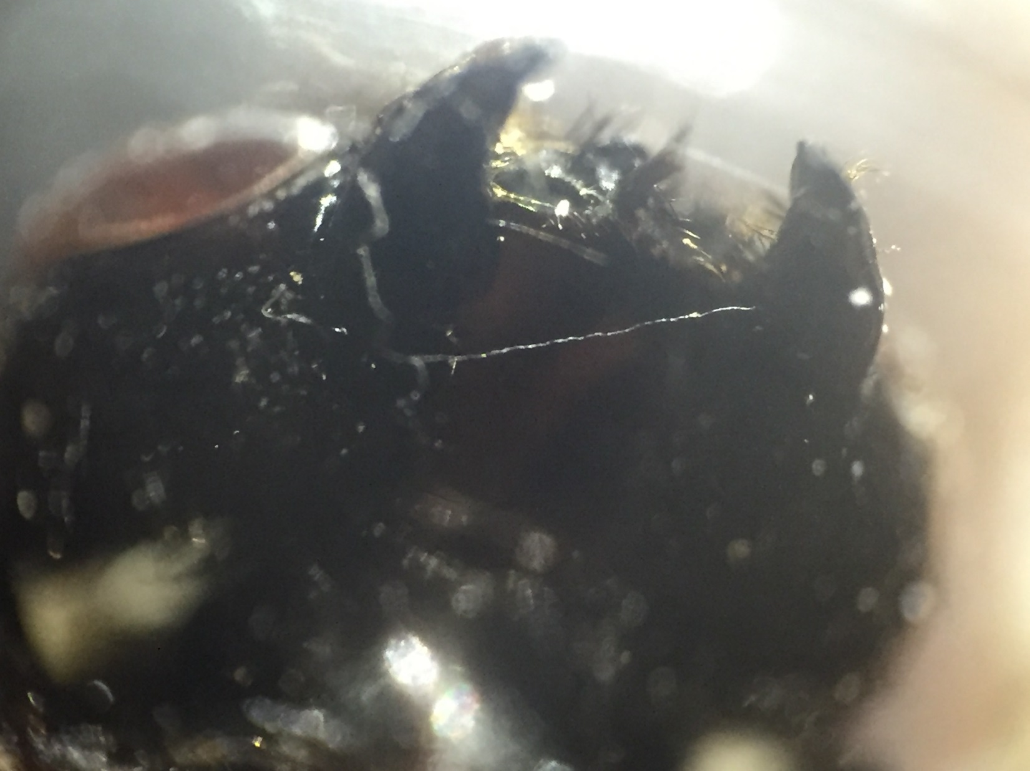

Slide 24
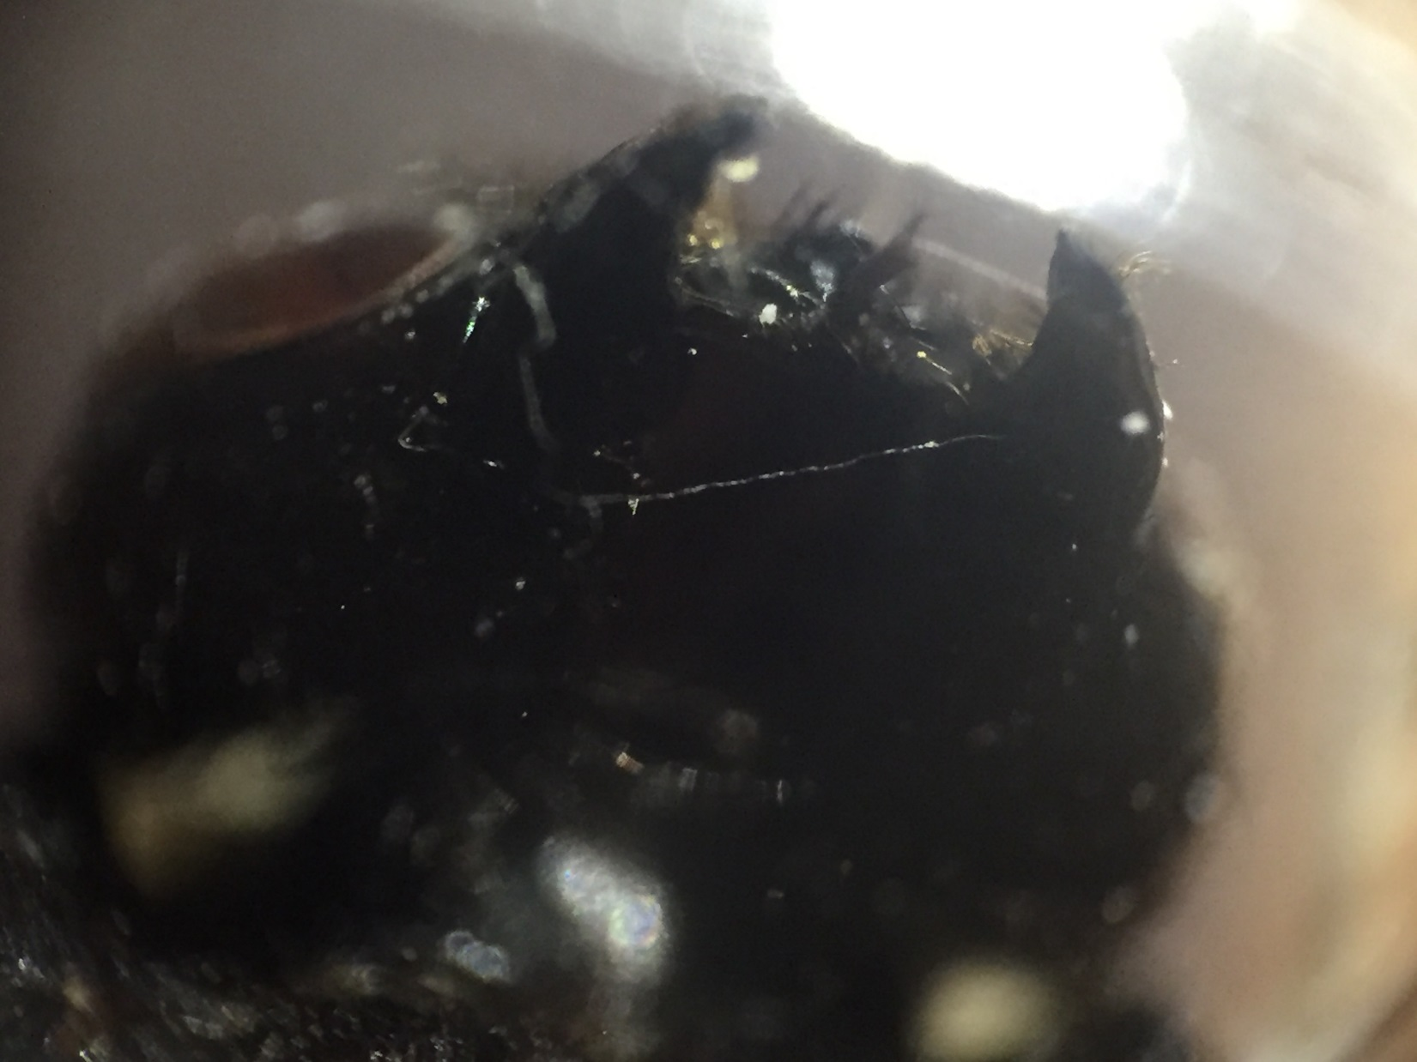

Slide 25
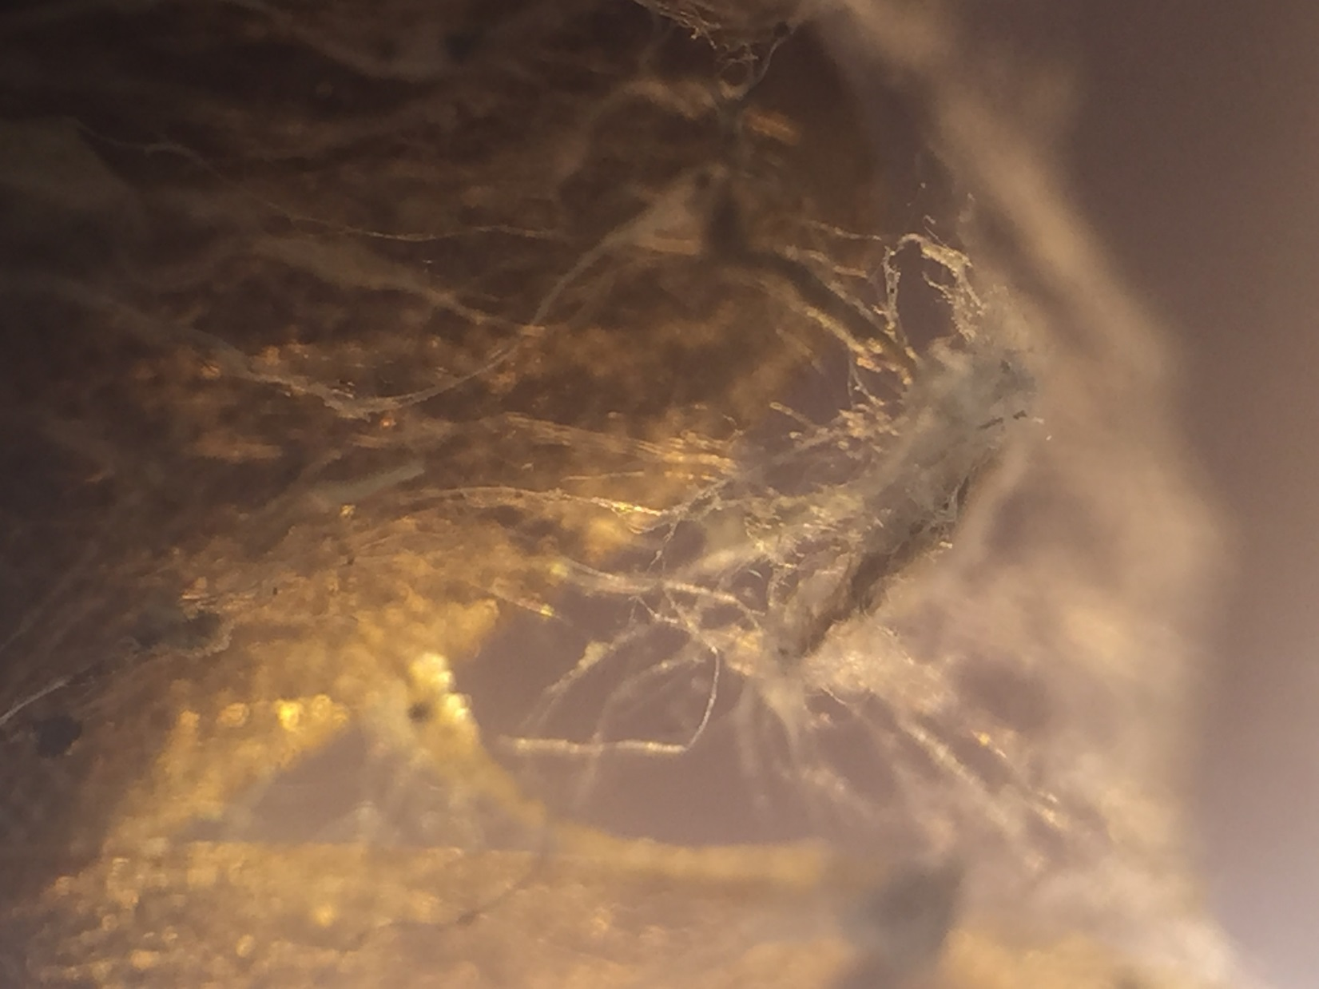

Slide 26
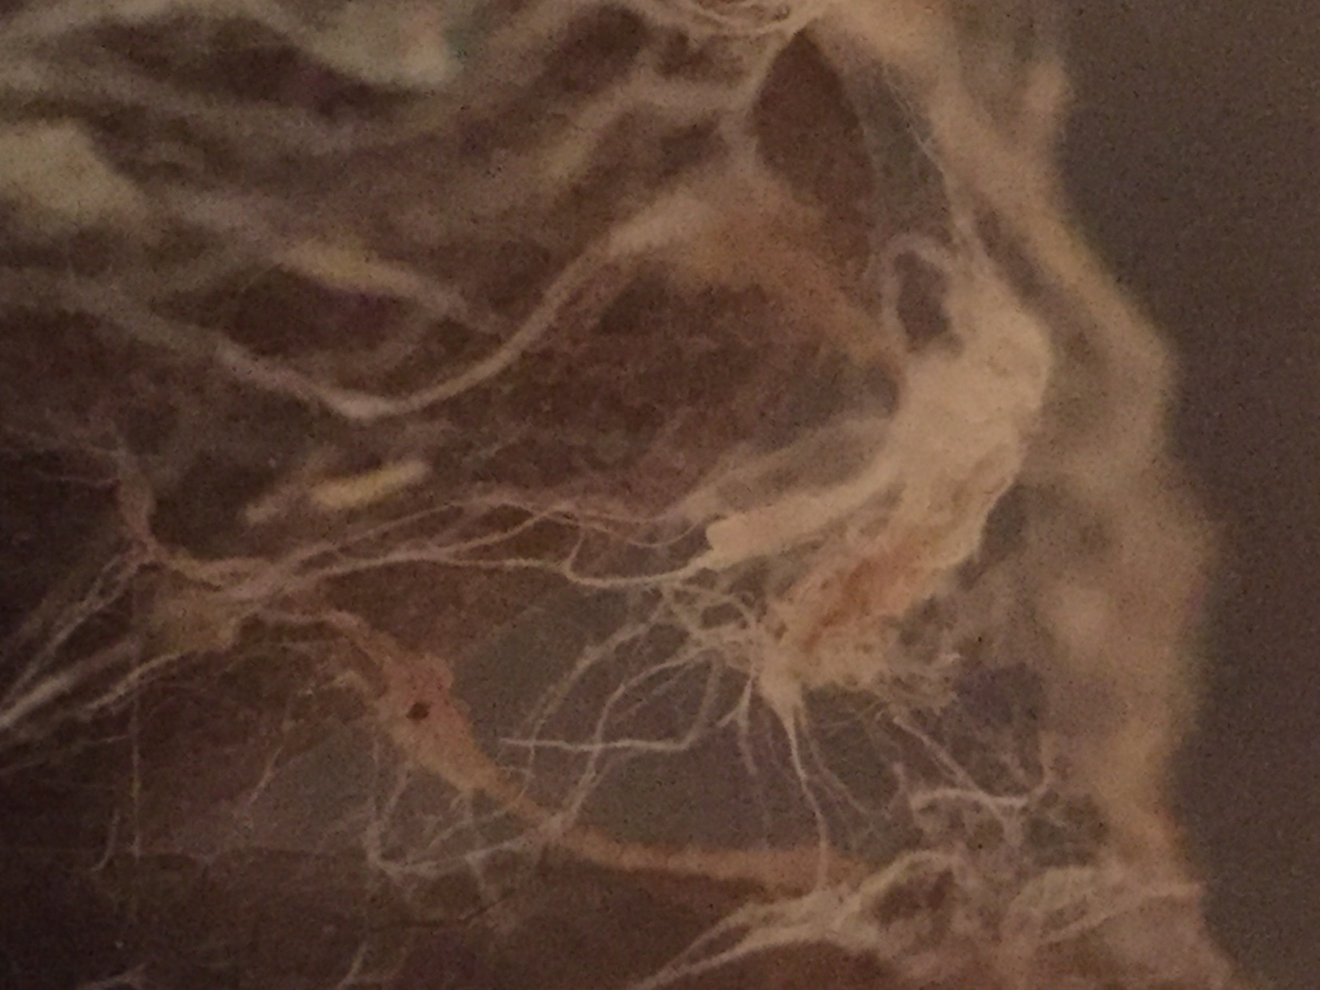

Slide 27
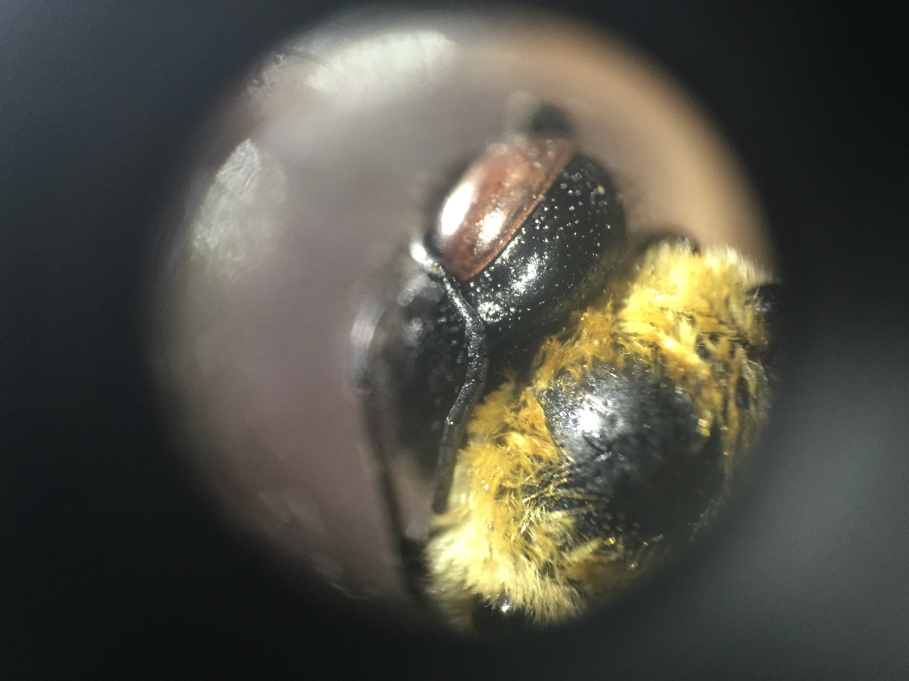

Slide 28
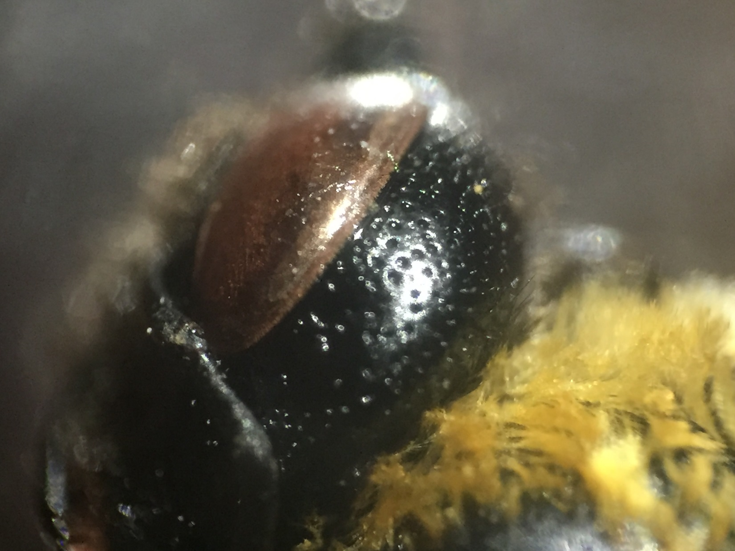

Slide 29
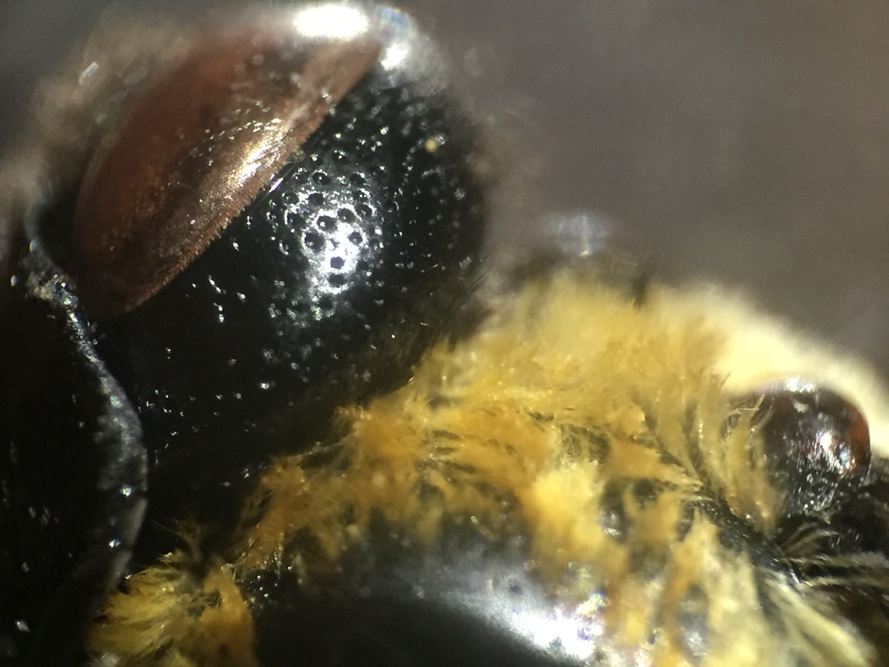

Slide 30
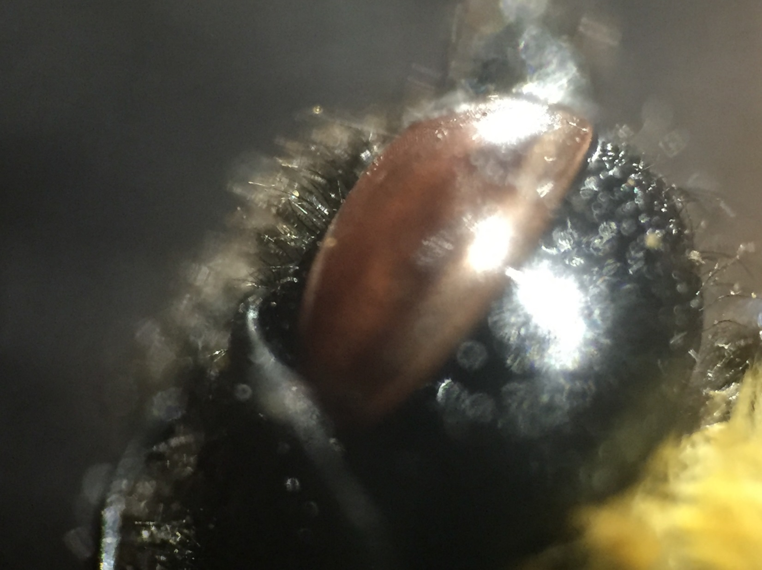

Slide 31
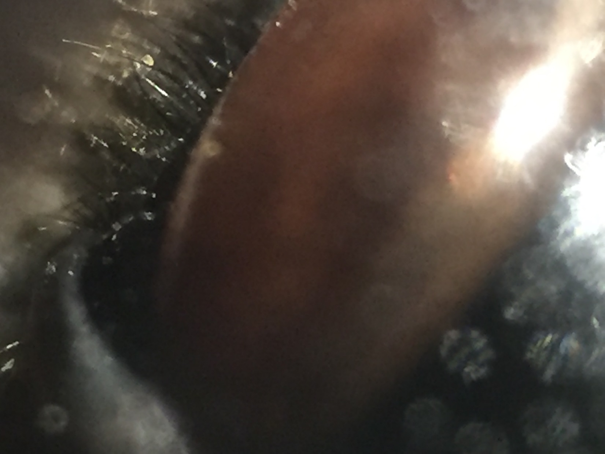

Slide 32
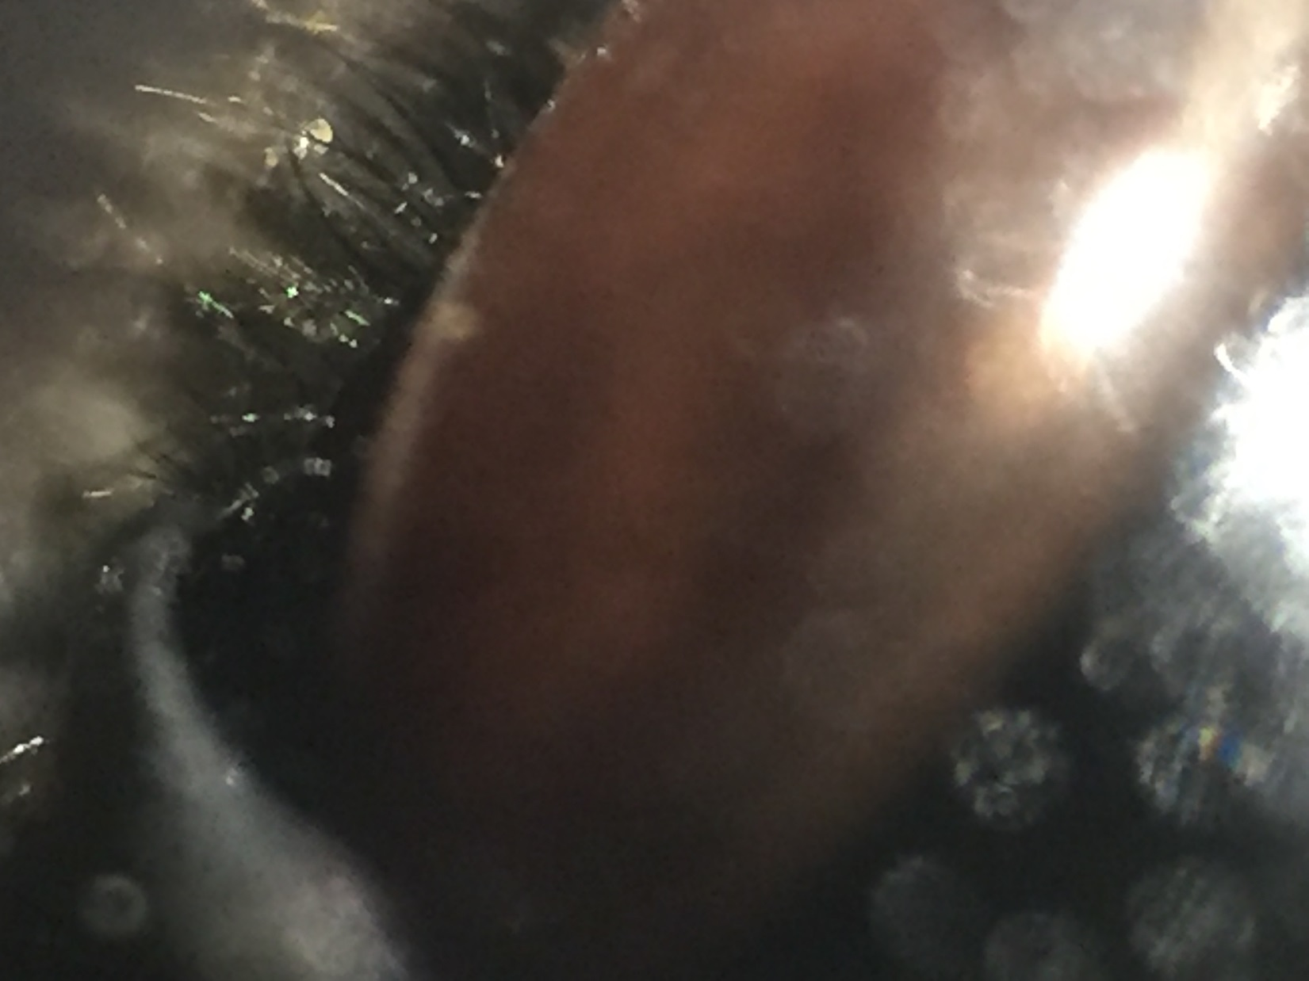

Slide 33
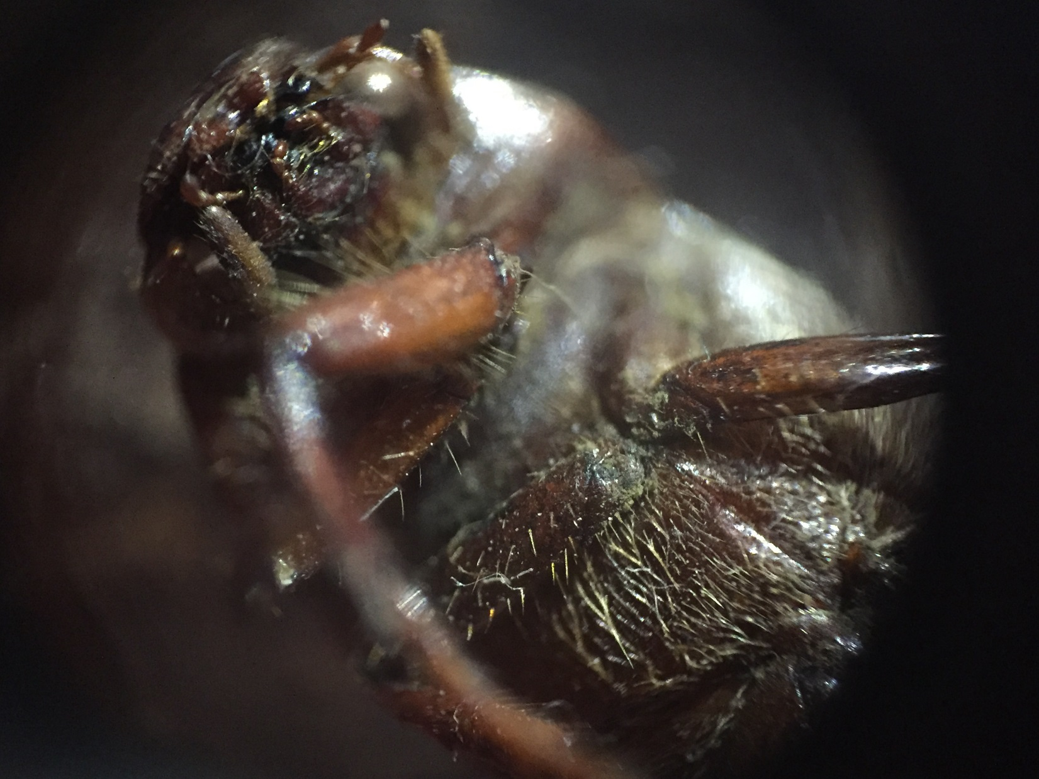

Slide 34
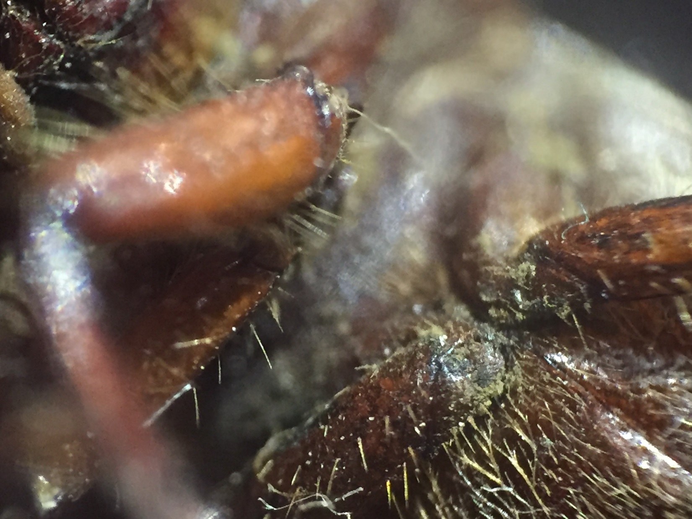

Slide 35
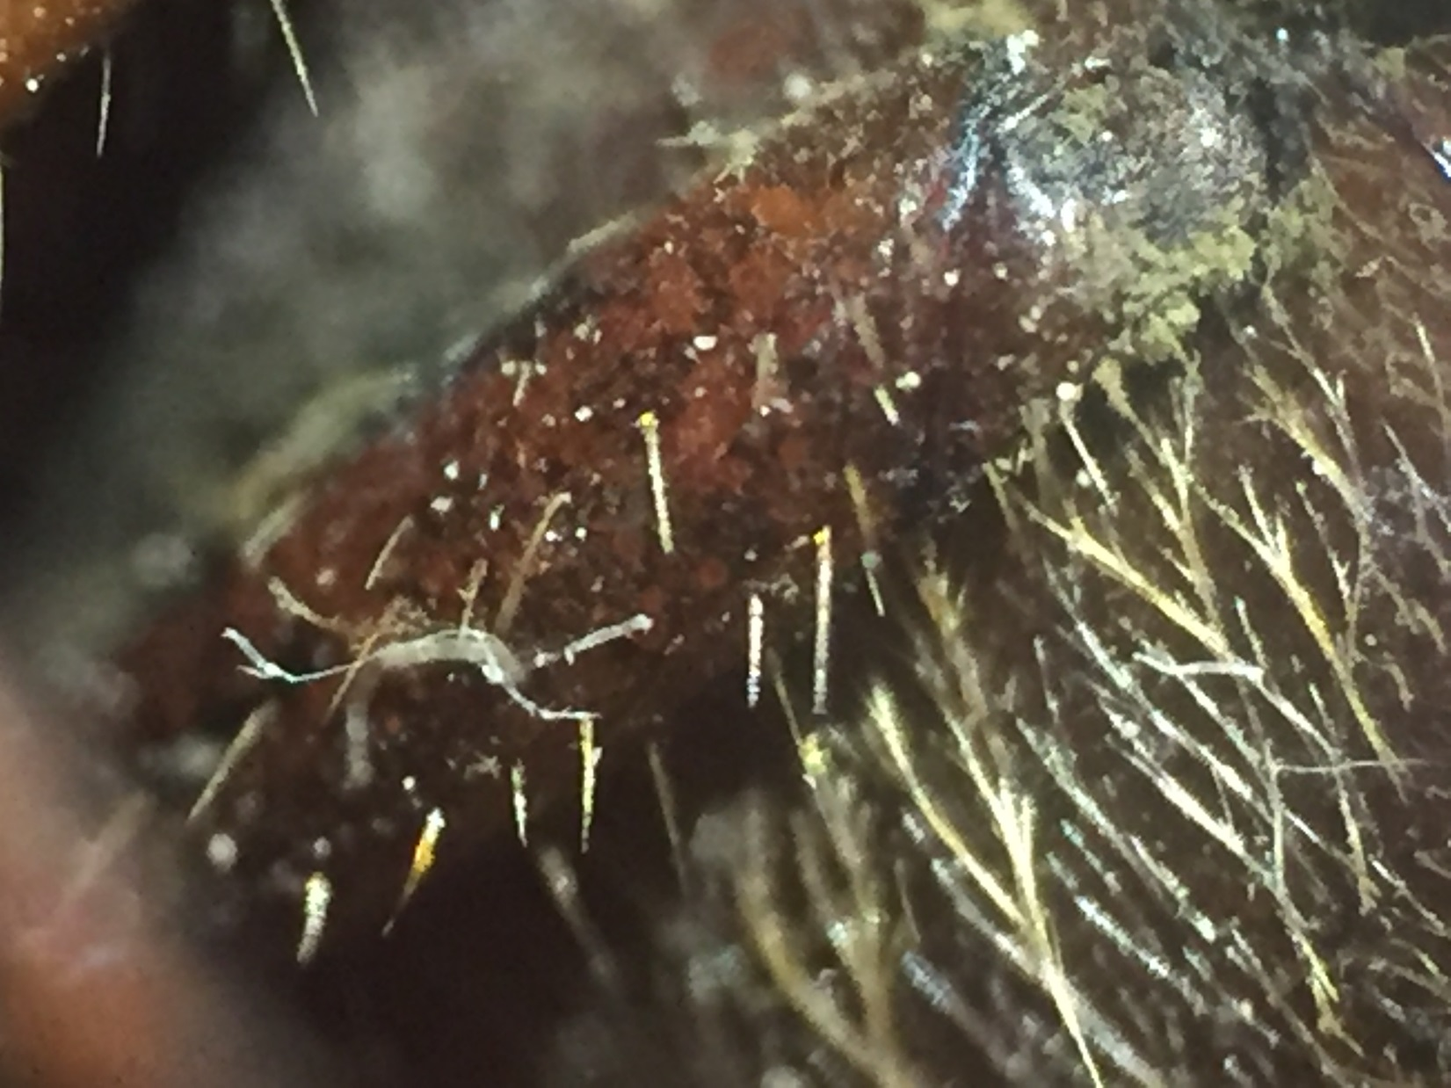

Slide 36
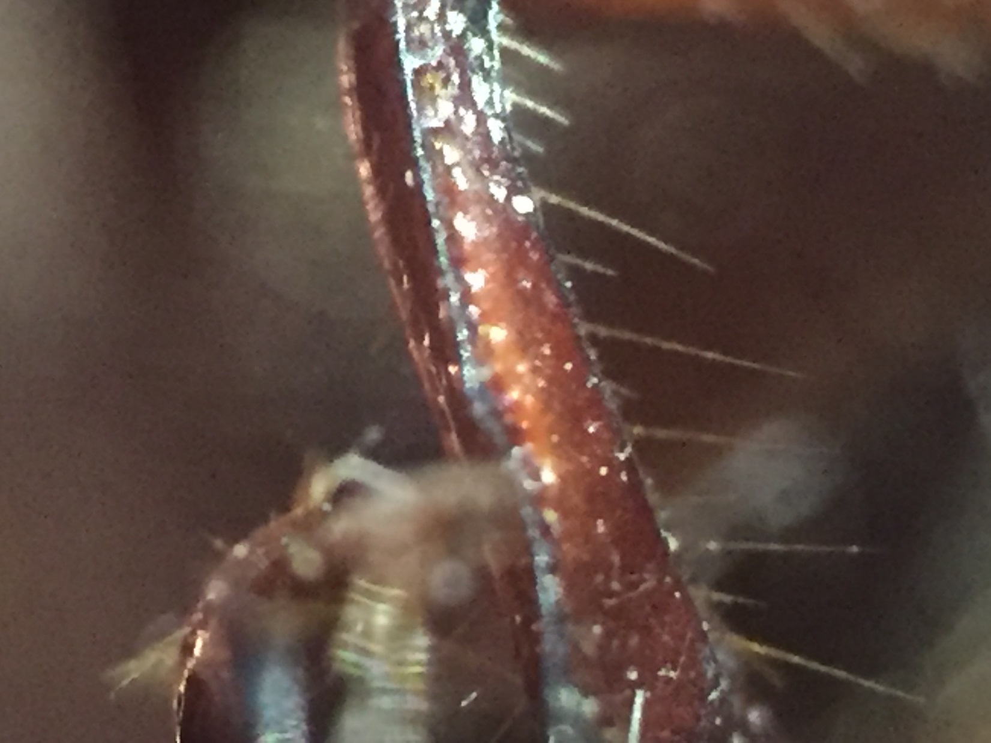

Slide 37
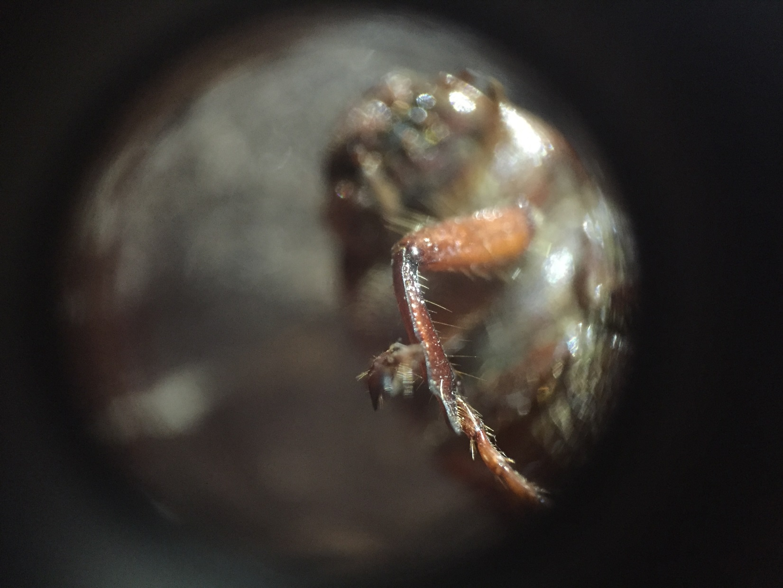

Slide 38
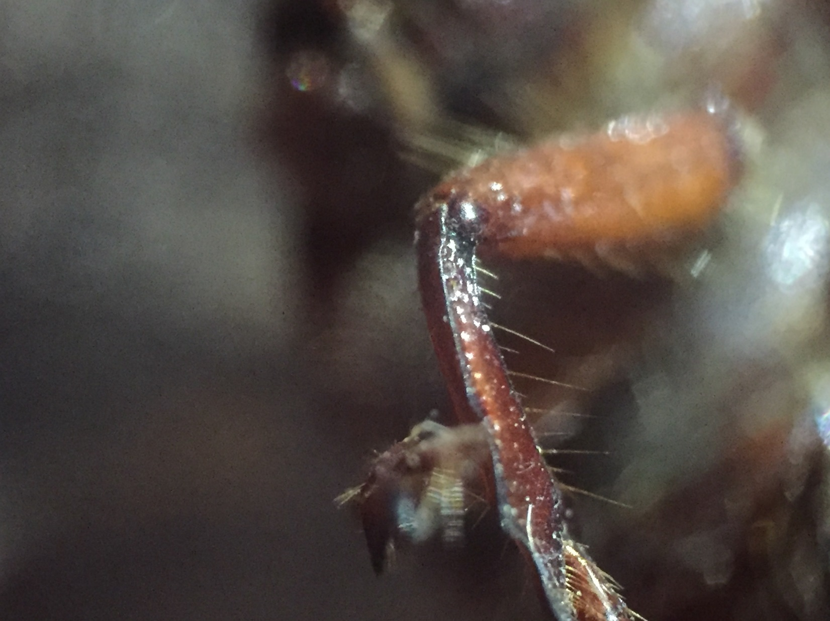

Slide 39
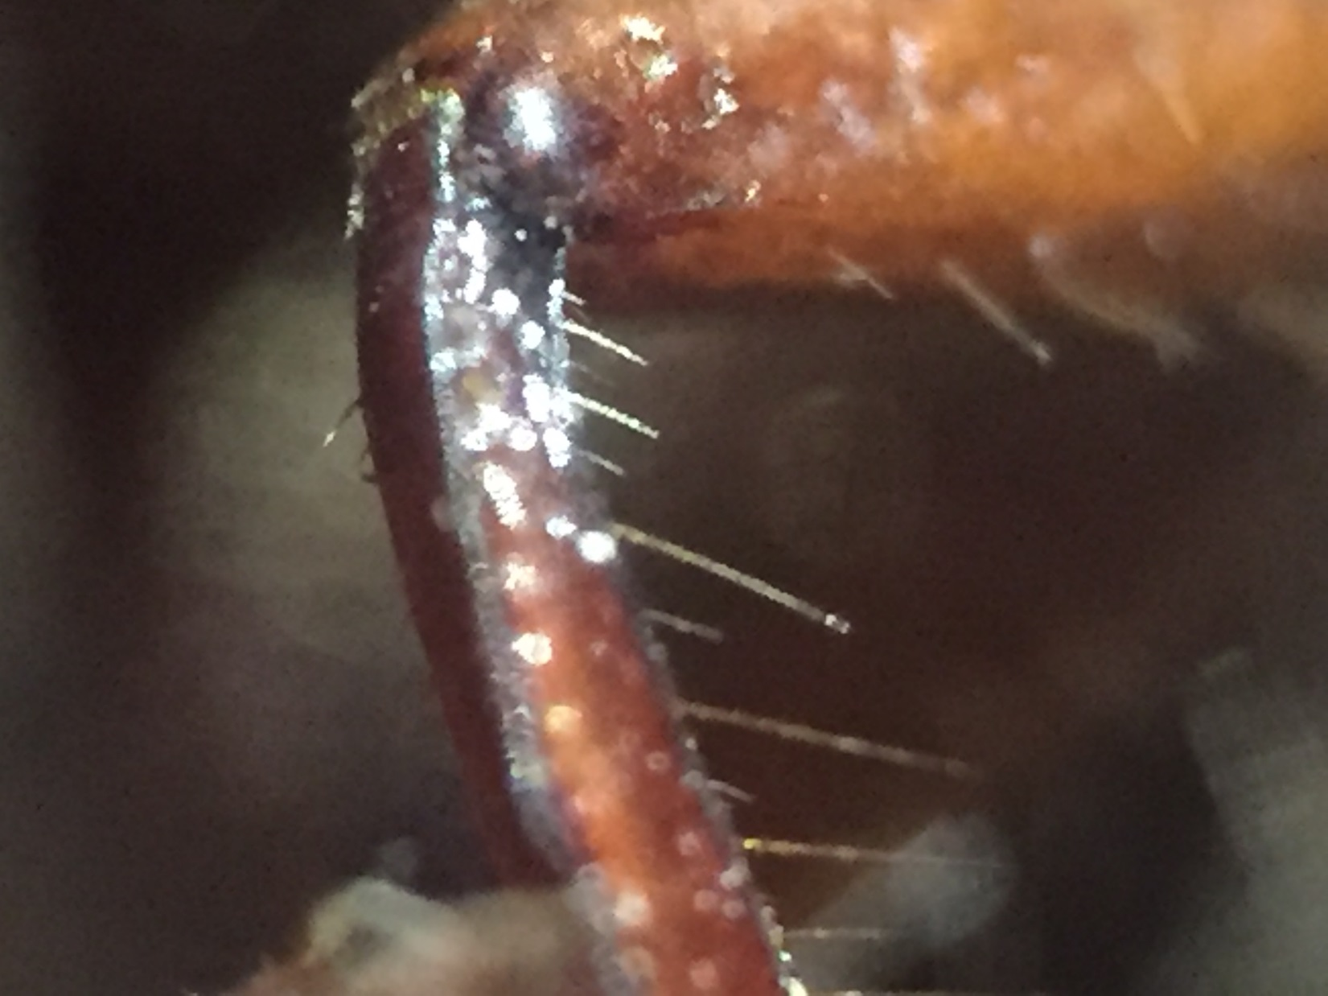

Slide 40
Do you want to look at some leaves?

Slide 41
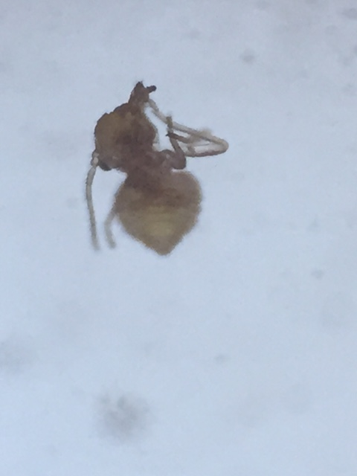

Slide 43
Any Questions

Slide 44
What’s Next?
Regional Meeting
Participant list
My Website
Book?
iPad/iPhone Microscope

Slide 45
THANKS for a Great Three Years
PLEASE KEEP IN TOUCH

