Slide 1
Rough River Day 2
Alignment with SEP and CCC
Microscope Lab
New PLT Carbon and Climate Unit and Activity
Alignment with DCI and PE
What next?

Slide 2
Rough River Day 2
Please get into groups of three or four
Take out your KCAS for Science Books
If you have a PC or iPad please got to the NGSS website or NGSS App

Slide 3
Aligning Activities to the Three Dimensions of NGSS
Each group select one activity
Read through the activity if needed
Locate Appendix F – Science and Engineering Practices
Assign 2 or 3 SEPs to each group member
Determine if the your assigned SEPs are embedded within this activity.
Record your evidence (use the back of sheet if needed)
Determine the “Strength Scale” - write it on data sheet
Share your information with your group

Slide 4
Aligning Activities to the Three Dimensions of NGSS
Staying with the same activity…
Locate Appendix G – Crosscutting Concepts
Assign 2 or 3 CCCs to each group member
Determine if the your assigned CCCs are embedded within this activity.
Record your evidence (use the back of sheet if needed)
Determine the “Strength Scale” - write it on data sheet
Share your information with your group

Slide 5
DCI
Look at the NGSS Three dimensions Cheat Sheet
As a group discuss any DCI that are included with this activity. Select one DCI to analyze first.
1. Record the DCI Code and Title
Find Appendix E and look up the DCI you identified
2. Where is it within the progression?
Read through the Orange Boxes from the NGSS pages

Slide 6
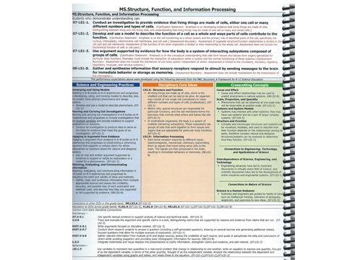

Slide 7
DCI
Look at the NGSS Three dimensions Cheat Sheet
As a group discuss any DCI that are included with this activity. Select one DCI to analyze first.
1. Record the DCI Code and Title
Find Appendix E and look up the DCI you identified
2. Where is it within the progression?
Read through the Orange Boxes from the NGSS pages
3. Determine the best match for the activity within the orange box and record the information
4. List specific evidence from the activity that aligns with this DCI

Slide 8
Aligning Activities to the Three Dimensions of NGSS
Determine the “Strength Scale” - write it on data sheet
Look at the end of the DCI statement in Orange box
Record the PE that this DCI is embedded
Do this for all the DCIs that are included within the activity

Slide 9
Your Score?
The lab, investigation or activity you examined can have a maximum score of 15.
Discuss with your group your overall score
In the last section determine what is missing that kept your lab, investigation or activity from scoring a perfect 15?

Slide 10
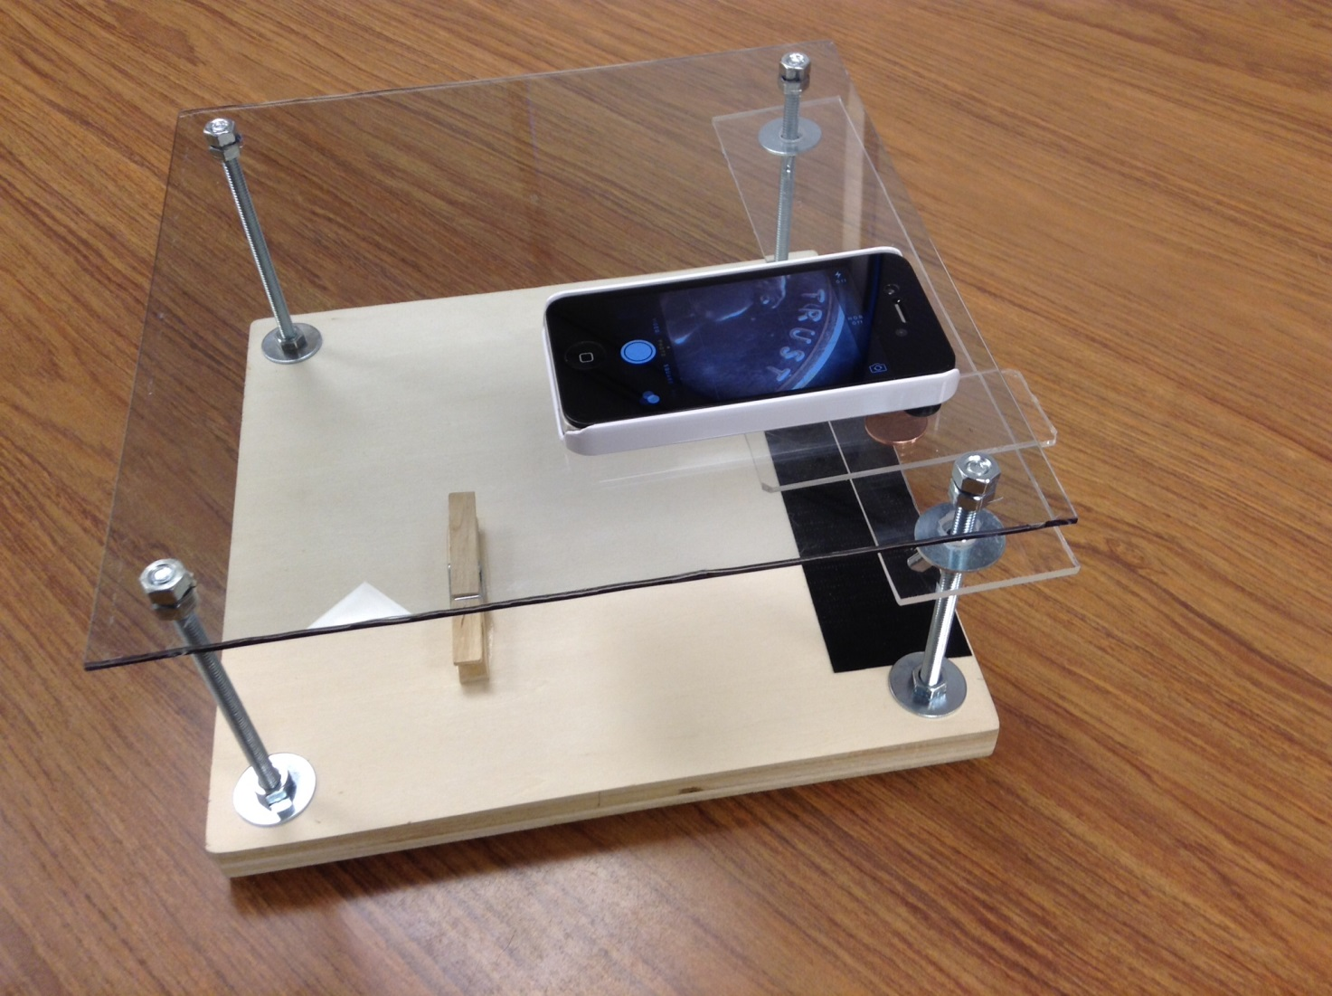
Each table group has an “iPad/iPhone microscope

Slide 11
iPad/iPhone Microscope
What are the following pictures?

Slide 12
Each table group has an “iPad/iPhone microscope.
Find objects to practice and learn to focus and zoom in and out using your iPad or iPhone.

Slide 13
Once your group understands how to use the microscope get a small sample of both salt and sugar crystals from the materials table.
Observe each sample under the microscope at low and high power. Record any observations about crystal shape, size, color, transparency and any other properties your team believes might help them identify the substance if you were given an unknown sample.
You can also take pictures to use later.

Slide 14
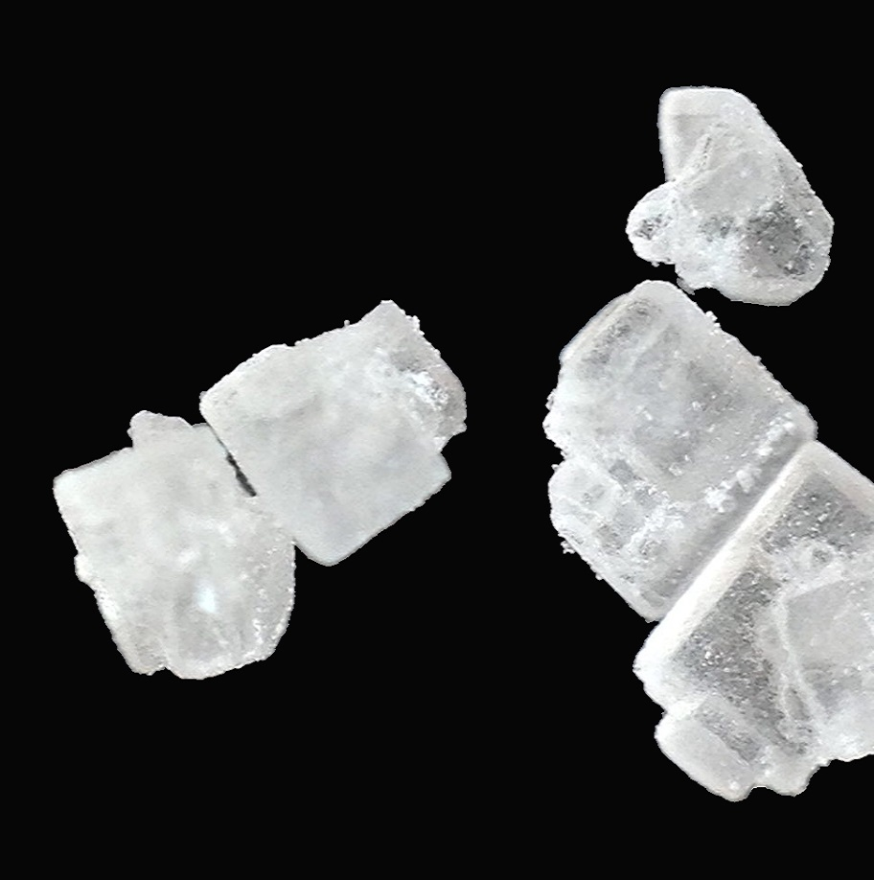
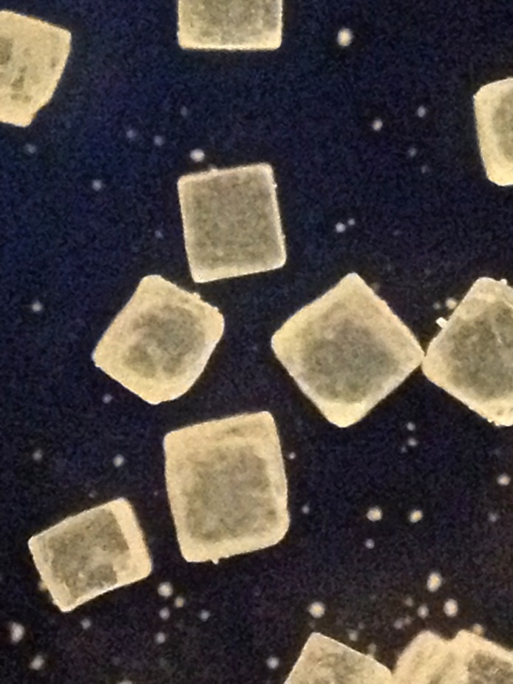

Slide 15
After your team has made all the observations they need of the known salt and sugar samples they should return to the materials table to collect a Test Sample. Observe under the microscope. Then select what is in the Test Sample from the choices below.
The Test Sample is…
A. salt mixed with an unknown substance.
B. salt with sugar and an unknown substance
C. salt only
D. sugar only
E. sugar mixed with an unknown substance
F. salt and sugar only (no unknown substance)
Identify

Slide 16
PS1.A Structure and Properties of Matter
5-PS1-3
Make Observations and measurements to identify materials based on their properties

